Slide 1
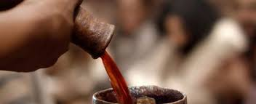
Looking Forward
~ New Year, Good News ~
Monday 17th January 2022
Brentwood Diocese Education Service

Slide 2
We are Looking Forward
~ In the Year of the Family ~
At the wedding in Cana, Jesus responded to the request for help
from his mother in changing the water into wine.
It was the first time that Jesus revealed himself to be divine.
We look forward to meeting Jesus in the Eucharist
where bread and wine are turned into His Body and Blood.
How do you respond to requests?
How do you prepare yourself to meet Jesus?
BDES

Slide 3
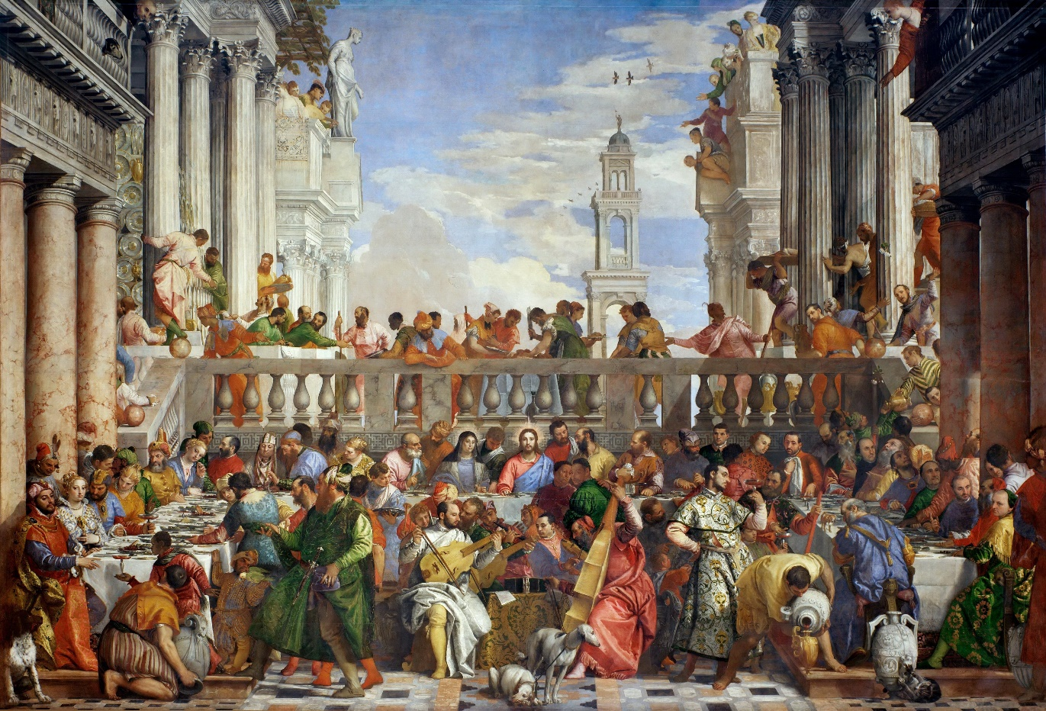
The Synoptic Problem
In Sunday’s Gospel Reading …
16th January 2022 :
In the Gospel of John, Mary says:
“Do whatever he tells you.”
BDES

Slide 4
Reflection
“O divine Master, grant that I may never seek so much to be loved as to love.” x – Prayer of St Francis
BDES

Slide 5
Preparing as communities for World Youth Day 2023
“Jesus reassures us :
I am always with you”
- Pope Francis, Youth Sunday Mass 2021
BDES

Slide 6
Week of prayer for Christian Unity:
18th to 25th January 2022
Creator of light, illumine our path by the light
of Christ who moves before us and leads us.
May he be a beacon for our pilgrimage.
Enlighten us and dwell within us.
Guide us to discover a manger in our hearts
where a great light still shines.
We thank you for the gift of that unfading Star,
Jesus Christ, our Lord and Saviour.
Heal our divisions and draw us closer to the Light
that we may find our unity in him.
Amen.
BDES

Slide 7
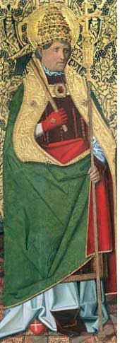
St Fabian: 20th January
St Fabian was a Pope and martyr who lived in the 3rd Century.
He was killed by the Roman Emperor Decius in an attempt to destroy the Church. His body was taken in procession to be buried in the catacombs below Rome in 250 AD. It was then moved to the church of St Sebastian by Pope Clement XI in the 18th Century.
Fabian had not sought to become Pope; he had not wanted high office but was elected Pope because of a miraculous sign. A dove descended on him showing that he was the choice of the Holy Spirit.
Becoming Pope meant that he was likely to be threatened and ultimately he died for his beliefs. He would not give up or renounce his faith and had lived a pure and holy life. He died on 20th January 250 AD.
BDES

Slide 8
Saints and Schools # 10 : St Antony of Padua
St Antony of Padua was a priest and a friar of the Franciscan order. He was born and brought up in Portugal and died in Italy.
He was well known for his preaching and knowledge of scripture as well as his love of the poor and the sick.
There are 2 primary schools in the diocese named after St Antony, one at Woodford Green and the other in Forest Gate. The school at Forest Gate was founded by the Ursulines in 1862, as a school originally for the poor, so not only has a very long tradition but reflects the work of St Antony, one of the patrons of the poor..
The schools place God at their heart and celebrate and respect difference.
BDES

Slide 9
Looking Forward
~ New Year, Good News ~
Monday 17th January 2022
Brentwood Diocese Education Service

