Slide 1
Looking Forward
~ New Year, Good News ~
Monday 24th January 2022
Brentwood Diocese Education Service

Slide 2
We are Looking Forward
~ In the Year of the Family ~
This week began with the Third Sunday of Ordinary Time, known since 2019 as
Sunday of the Word of God.
In the reading from St Luke’s Gospel,
Jesus Himself reads from the scroll of Isaiah
in the synagogue of his home town of Nazareth.
He reads the section which proclaims :
“He sent me to give the Good News to the poor …”
Let us be Christ-like.
Let us be messengers of the Word of God.
Let us give the Good News to those who need it most.
BDES

Slide 3
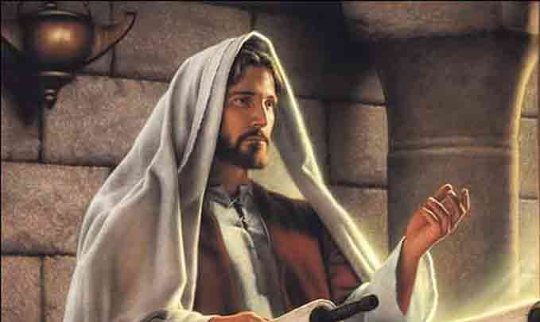
The Synoptic Problem
In Sunday’s Gospel Reading …
23rd January 2022 :
In the Gospel of Luke, Jesus says :
“The Spirit of the Lord is upon me.”
BDES

Slide 4
Reflection
“It is in giving
that
we receive.”
x
– Prayer of St Francis
BDES

Slide 5
Preparing for World Youth Day 2023
“Jesus reassures us :
‘I am always with you’.”
- Pope Francis, Youth Sunday Mass 2021
BDES

Slide 6
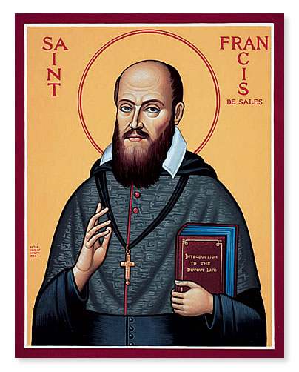
St. Francis de Sales
Feast day :
24th January
Francis de Sales (1567–1622) was a Bishop of Geneva noted for his deep faith and his gentle approach to the religious divisions in his land resulting from the Protestant Reformation. As a missioner in the Chamblais area, he was a target for persecution and attempted assassination, but on account of his patience and gentleness he is known as The Gentleman Saint. He is also famous for his writings on spiritual direction and formation, particularly in his Introduction to the Devout Life and the Treatise on the Love of God; he is therefore the patron saint of writers and journalists.
BDES

Slide 7
Prayer of St Francis de Sales
If 2022, the third year of the challenges of the pandemic and disruption to our lives, has begun as a time of concern for the future, consider this calming prayer of St Francis De Sales.
Do not look forward in fear to the changes and chances of this life;
rather, look to them with full confidence that, as they arise,
God, to whom you belong will in His love enable you to profit by them.
He has guided you thus far in life, and He will lead you safely through all trials;
and when you cannot stand it, God will bury you in His arms.
Do not fear what may happen tomorrow;
the same everlasting Father who cares for you today
will take care of you then and every day.
He will either shield you from suffering,
or will give you unfailing strength to bear it.
Be at peace, then, and put aside all anxious thoughts and imaginations.
Amen.
BDES

Slide 8
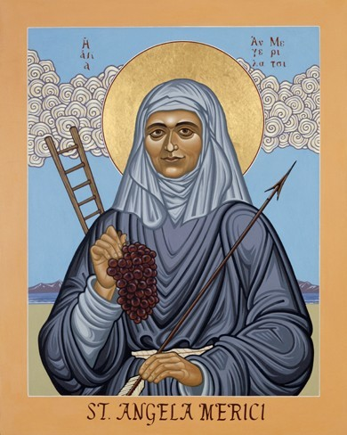
Schools and founders # 11 : St Angela Merici
This week sees the feast day of the amazing St Angela Merici, founder of the Company of St Ursula, dedicated to the education of poor girls. She named her company after the martyr St Ursula of Cologne and her Companions. St Angela is a patron saint of the sick, those with disabilities, and those who have lost parents.
In the Diocese of Brentwood we are blessed to have St Angela’s Ursuline School in Forest Gate, the Brentwood Ursuline Convent High School, the Ursuline Academy and the Ursuline Preparatory School in Ilford, and the Ursuline Preparatory School in Warley. All of them take their inspiration from St Angela and are proud of their Ursuline traditions.
BDES

Slide 9
Looking Forward
~ New Year, Good News ~
Monday 24th January 2022
Brentwood Diocese Education Service

