Slide 1
Looking Forward
~ New Year, Good News ~
Monday 31st January 2022
Brentwood Diocese Education Service

Slide 2
We are Looking Forward
~ In the Year of the Family ~
In his homily on Youth Sunday 2021, Pope Francis says that
Jesus will bring back the bright sky.
It is sometimes difficult in winter,
when the days are dark in the morning and dark again early in the evening, to imagine a time when there will be light.
However Spring will be with us shortly and with it the hope of Easter.
We have to keep in our thoughts that
Jesus is the light of the world who brings relief from the dark.
BDES

Slide 3
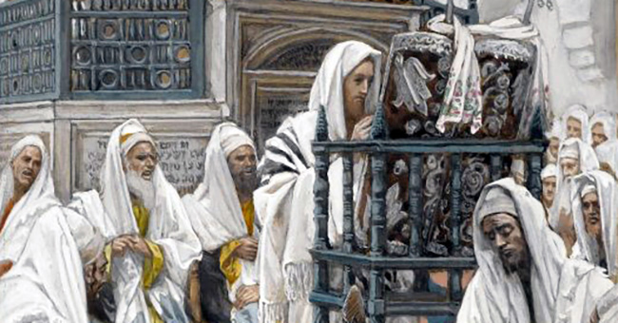
The Synoptic Problem
In Sunday’s Gospel Reading …
30th January 2022 :
The Gospel of Luke:
“All spoke highly of him and were amazed at the gracious words that came from his mouth.”
BDES

Slide 4
Reflection
“It is in pardoning
that we are pardoned.” x – Prayer of St Francis
BDES

Slide 5
Preparing as communities for World Youth Day 2023
“Jesus reassures us :
I come to bring back the bright sky.”
- Pope Francis, Youth Sunday Mass 2021
BDES

Slide 6
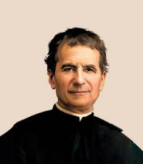
St John Bosco: 31st January
St John Bosco was born just over 200 years ago in 1815.
He dedicated his life to working with young people and in educating them used the principle of love rather than punishment. His work was originally with the poor and disadvantaged in Turin. He was clear in his instruction to different groups of people pointing out that “It is a mistake to skirt difficulties or to skip what you don't understand and go on to something else. Tackle the obstacle until you have overcome it”.
He founded the Salesian Order of Don Bosco in Italy and helped found a congregation of nuns who looked after and educated poor girls.
To carry on his work, he also developed a network of organisations xxx and centres which are still supporting young people today.
BDES

Slide 7
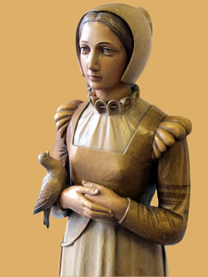
Saints and Schools # 12 : St Anne Line
St Anne Line was one of the 40 Martyrs of England and Wales. She was canonised in 1970.
She was born, grew up and married in Essex. She became a Catholic some time in the 1580s despite it being illegal. She looked after a house of refuge for Catholic priests who had to hide from the authorities at the time. In 1601 she was arrested on 2nd February after allowing a number of Catholics to hear Mass. She was tried and executed in the same month. She refused to repent for hiding a priest and said she wished it had been a thousand more.
There are 2 schools in the diocese named St Anne Line, both in Basildon, one infant and one junior. They celebrate the feast of Anne Line in the first week of February.
BDES

Slide 8
Looking Forward
~ New Year, Good News ~
Monday 31st January 2022
Brentwood Diocese Education Service

