Slide 1
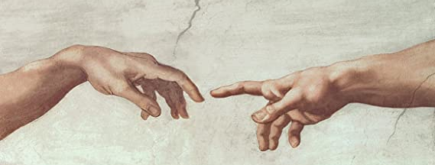
Looking Forward
~ New Year, Good News ~
Monday 7th February 2022
Brentwood Diocese Education Service

Slide 2
We are Looking Forward
~ In the Year of the Family ~
Sometimes life is a challenge.
Sometimes it’s difficult to motivate oneself.
Sometimes it’s difficult to have faith in a positive outcome.
In the Gospel on Sunday, Jesus tells his followers to
“Launch out into the deep.”
Do something. Dare something.
Shake off the doubts and the worry.
Ask for help. Accept help. Help others.
You’re not alone.
As Jesus says :
DO NOT BE AFRAID.
BDES

Slide 3
The Synoptic Problem
In Sunday’s Gospel Reading …
6th February 2022 :
In the Gospel of Luke, Jesus says :
“Do not be afraid.”
BDES

Slide 4
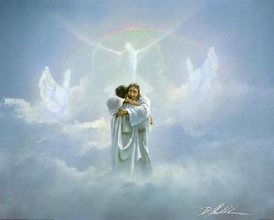
Reflection
“… we are born to eternal life.”
x
– Prayer of St Francis
BDES

Slide 5
Preparing for World Youth Day 2023
“Let your eyes remain bright even amid the darkness.”
- Pope Francis, Youth Sunday Mass 2021
BDES

Slide 6
Children’s Mental Health Week 2022
“The very first truth I would tell each of you is this: “God loves you”. It makes no difference whether you have already heard it or not. I want to remind you of it. God loves you. Never doubt this, whatever may happen to you in life. At every moment, you are infinitely loved..”
- Pope Francis, Christus vivit
BDES

Slide 7
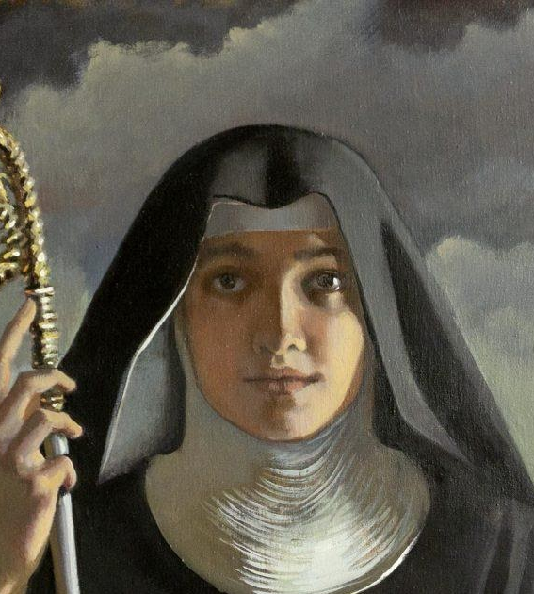
St. Scholastica
Feast day :
10th February
St Scholastica (c. 480–543) was the sister of St Benedict and is regarded as the founder of Benedictine nuns. She established a hermitage near Monte Cassino, where she lived with a small number of companions, effectively the first convent. She is often represented in art in a Benedictine habit and carrying the crozier of an abbess. Sometimes she is shown holding the Rule of St Benedict, sometimes with a dove – upon her death, it is said that St Benedict saw, from his own monastic cell nearby, his sister’s soul ascending to heaven in the form of a shining white dove.
BDES

Slide 8
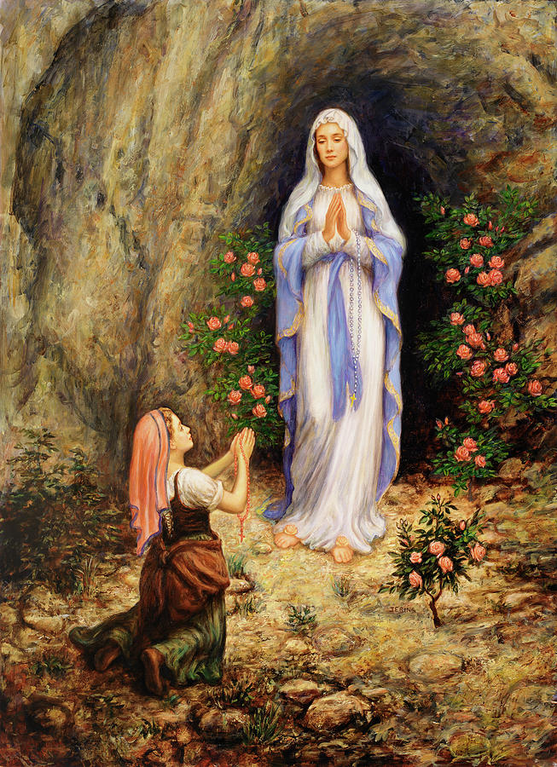
Schools and saints # 13 : Our Lady of Lourdes
In 1858, Our Lady appeared 18 times to Bernadette Soubirous at the grotto of Massabielle in Lourdes in the south of France. Bernadette described her as wearing a white veil and a blue girdle, with a golden rose on each foot and holding a rosary of pearls.
Our Lady of Lourdes is the Principal Patroness of the Diocese of Brentwood. We celebrate the feast day this Friday, 11th February. Two diocesan schools are named in her honour, one in Leigh-on-Sea and one in Wanstead.
Every summer, there is a diocesan pilgrimage to Lourdes, which incorporates the Youth Pilgrimage. Sadly, in 2020 and in 2021 there was no pilgrimage due to Covid 19.
Will 2022 be your year?
BDES

Slide 9
Looking Forward
~ New Year, Good News ~
Monday 7th February 2022
Brentwood Diocese Education Service

