Slide 1
Looking Forward
~ Looking Forward to Easter ~
Monday 21st February 2022
Brentwood Diocese Education Service

Slide 2
We are Looking Forward
~ In the Year of the Family ~
We are looking forward to the hope of Easter and reflecting on the fact that Jesus is the light of the world.
In the Gospel we are reminded to forgive others.
The Lord’s Prayer regularly reminds us of this as we say
“Forgive us our trespasses as we forgive those who trespass against us.”
Can you reflect on forgiveness in your life.
When did you need to forgive and be forgiven?
BDES

Slide 3
The Synoptic Problem
In Sunday’s Gospel Reading …
20th February 2022 :
The Gospel of Luke:
“Forgive and you shall be forgiven.”
BDES

Slide 4
Reflection
“Brother Sun”
- St Francis of Assisi, Canticle of the Creatures
BDES

Slide 5
Reflection
Be praised, my Lord, through all your creatures, especially through my lord Brother Sun, who brings the day; and you give light through him. And he is beautiful and radiant in all his splendour! Of you, Most High, he bears the likeness.
BDES

Slide 6
Preparing as communities for World Youth Day 2023
“Never stop seeking the light amid whatever darkness we may bear in our hearts or see all around us.”
- Pope Francis, Youth Sunday Mass 2021
BDES

Slide 7
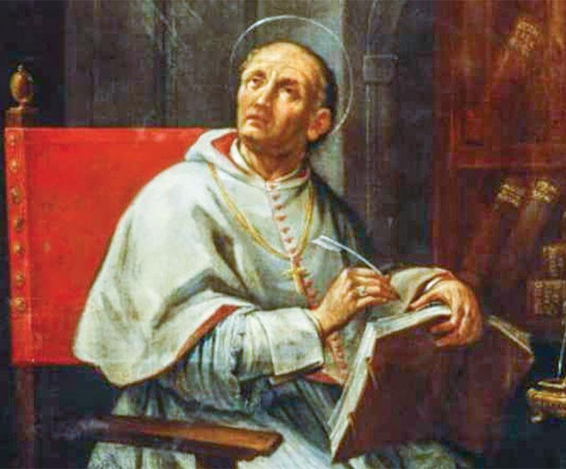
St Peter Damian: 21st February
St Peter Damian lived over 900 years ago.
He was dedicated to the Church, was well known as a teacher, reformer and Papal envoy.
He wanted to ensure that the church was well run and that the monks observed the religious life. His reforms were such that the famous abbey at Monte Cassino took them as an example
He worked as an envoy for the Pope and visited France, various Italian city states and Germany.
When he died his body was buried in the monastery which is now St Maria Vecchia, since then his body xxxx has been moved six times.
BDES

Slide 8
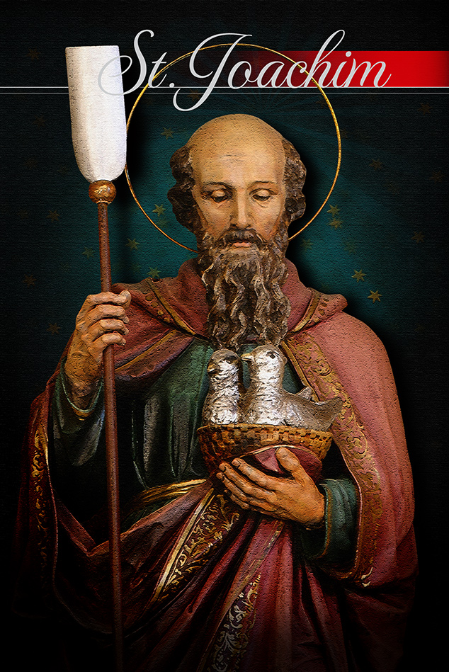
Saints and Schools # 14 : St Joachim
St Joachim was the husband of St Anne and the father of Mary, the mother of Jesus. He was regarded as a rich and pious man, who regularly gave to the poor.
St Joachim and St Anne were blessed with a child late in life, which was viewed at the time as signifying that the child would do great things.
He is the patron saint of fathers and grandfathers.
In the Diocese of Brentwood, St Joachim’s at Custom House is named after him. This is a school where students are seen to achieve through God and their mission statement says that they play and pray, love and learn together.
BDES

Slide 9
Looking Forward
~ Looking Forward to Easter ~
Monday 21st February 2022
Brentwood Diocese Education Service

