Slide 1
Looking Forward
~ Looking Forward to Easter ~
Monday 28th February 2022
Brentwood Diocese Education Service

Slide 2
We are Looking Forward
~ In the Year of the Family ~
The season of Lent begins this Wednesday, 2nd March.
During Lent, we are encouraged to pray, to fast, and to give alms.
In order to prepare, consider who you might like to pray for. Consider what things in our world you might like to pray for.
How would you like to fast? Is there something you would consider giving up?
What would you be prepared to give? Your time, your money, your help?
How will you prepare for Easter with your Lenten journey?
BDES

Slide 3
The Synoptic Problem
In Sunday’s Gospel Reading …
27th February 2022 :
In the Gospel of Luke, Jesus reminds us :
“A good person out of the store of goodness in his heart produces good.”
BDES

Slide 4
Reflection
“Sister Moon”
- St Francis of Assisi, Canticle of the Creatures
BDES

Slide 5
Reflection
Praised be You, my Lord, through Sister Moon
and the stars, in heaven you formed them clear and precious and beautiful.
BDES

Slide 6
Preparing for World Youth Day 2023
“You have been entrusted with an exciting but also a challenging task : … to be sentinels prepared to see the light in night visions.”
- Pope Francis, Youth Sunday Mass 2021
BDES

Slide 7
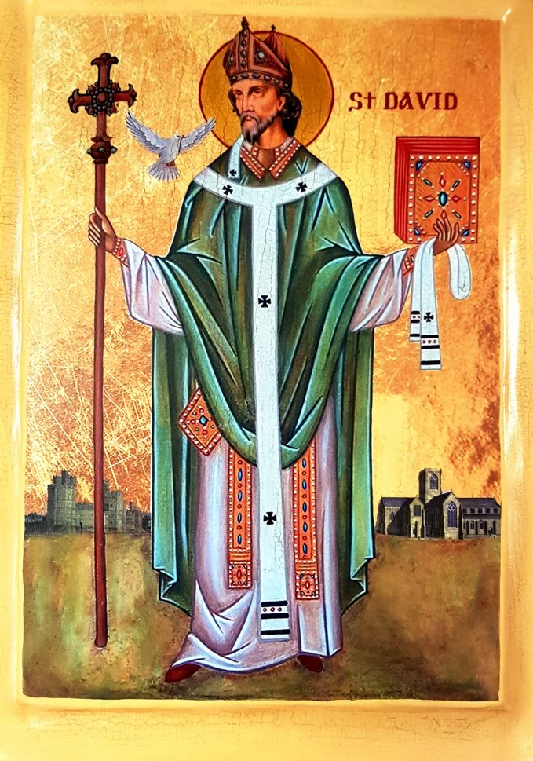
Solemnity of
Saint David
~ 1st March ~
“Gwnewch y pethau bychain” - “Do the little things”.
These are supposed to have been St David’s final words of advice on his deathbed, advice to live your life by small acts of kindness which together would make a large difference.
He is the patron saint of Wales and was a bishop there in the 6th century. He was a teacher, a preacher, a founder of monasteries and churches, an inspirational man who lived a simple life, and a visionary.
BDES

Slide 8
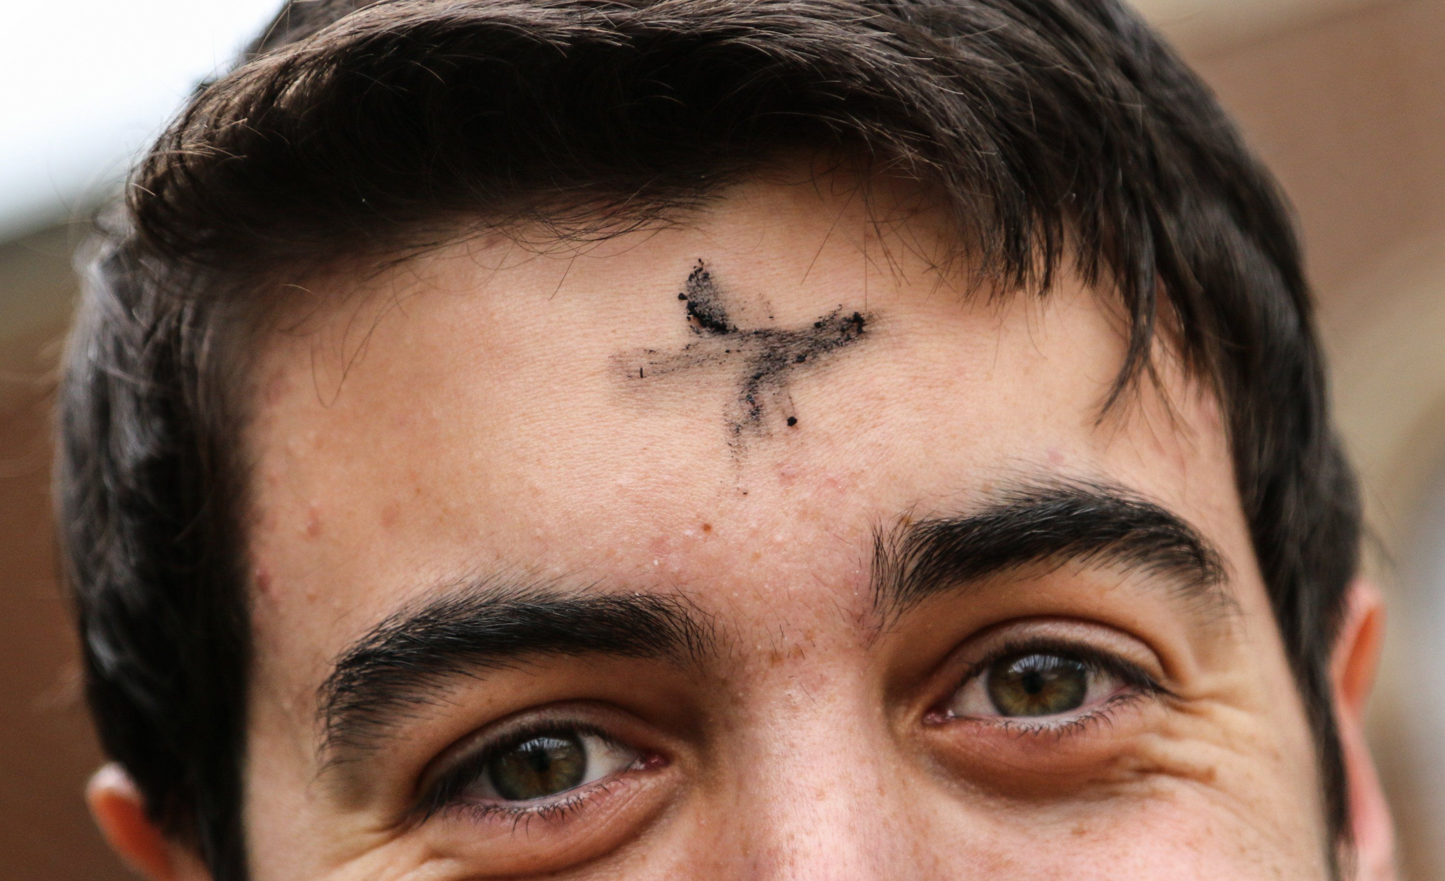
Ash Wednesday, 2nd March 2022
“The ashes mean that I’m a sinner. The shape of the Cross means that I have a Saviour.”
- Father Mike Schmitz, Youth Director, Diocese of Duluth, MN
BDES

Slide 9
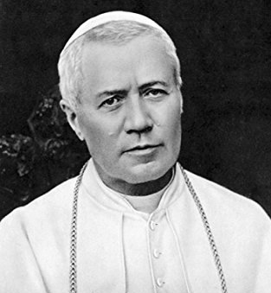
Schools and saints # 15 : St Pius X
Giuseppe Melchiorre Sarto was born in 1835, the son of a postman. He was ordained a priest at the age of 23, became Bishop of Mantua, was made a cardinal and became Pope Pius X in 1903.
Pope Pius was devoted to the Blessed Virgin Mary under the title Our Lady of Confidence. He was known for his personal poverty, and made the Vateran Palace available to refugees from the 1908 Messina earthquake.
He died in 1914 was canonized a saint by Pope Pius XII in 1954.
St Pius X is remembered in the name of one of our diocesan schools in Chelmsford.
BDES

Slide 10
Looking Forward
~ Looking Forward to Easter ~
Monday 28th February 2022
Brentwood Diocese Education Service

