Slide 1
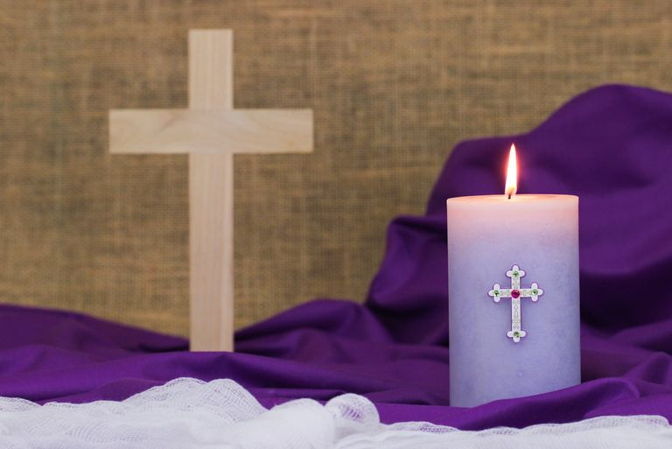
Looking Forward
~ Looking Forward to Easter ~
Monday 7th March 2022
Brentwood Diocese Education Service

Slide 2
We are Looking Forward
~ In the Year of the Family ~
During the season of Lent,
we are looking forward to Easter
and reflecting on the fact that Jesus is our salvation.
What are you doing to make this Lent a positive experience?
How are you contributing to making the world a better place?
BDES

Slide 3
Your Lenten Journey
Look at the CAFOD calendar above.
How is your Lenten journey progressing?
Are you or your school involved in fundraising for CAFOD
in their Walk Against Hunger?
BDES

Slide 4
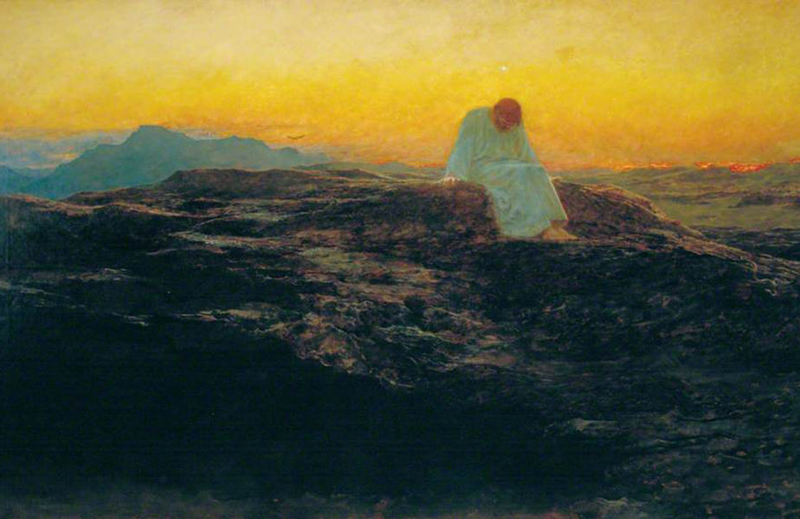
The Synoptic Problem
In Sunday’s Gospel Reading …
Sunday 6th March 2022 :
The Gospel of Luke:
“ You shall worship the Lord, your God, and him alone shall you serve.”
BDES

Slide 5
Reflection
“Brother Wind”
- St Francis of Assisi, Canticle of the Creatures
BDES

Slide 6
Reflection
Praised be You, my Lord, through Brother Wind, and through the air, cloudy and serene, and every kind of weather through which You give sustenance to Your creatures.
BDES

Slide 7
A Prayer for Ukraine
Loving God, We pray for the people of Ukraine, for all those suffering or afraid, that you will be close to them and protect them.
We pray for world leaders, for compassion, strength and wisdom to guide their choices.
We pray for the world that in this moment of crisis, we may reach out in solidarity to our brothers and sisters in need.
May we walk in your ways so that peace and justice become a reality for the people of Ukraine and for all the world.
Amen.
BDES

Slide 8
Preparing as communities for World Youth Day 2023
“You have been entrusted with an exciting but also a challenging task : …
to stand tall while everything around us seems to be collapsing.”
- Pope Francis, Youth Sunday Mass 2021
BDES

Slide 9
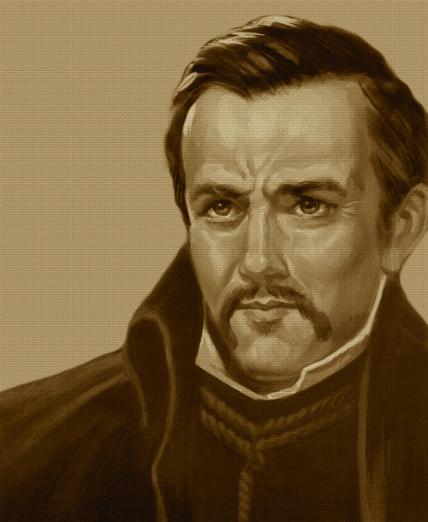
St John Ogilvie: 10th March
St John Ogilvie was a Scottish Jesuit.
He worked as a priest in Scotland and was executed in 1615 and is the only post Reformation Scottish saint.
He was brought up as a Protestant, although some of his family were Catholic and following his travels in Europe he studied with the Benedictines and then joined the Jesuits.
He travelled to Scotland to support the small Catholic community. He was arrested, tried and executed in Glasgow becoming the ‘only Scottish Catholic martyr’.
BDES

Slide 10
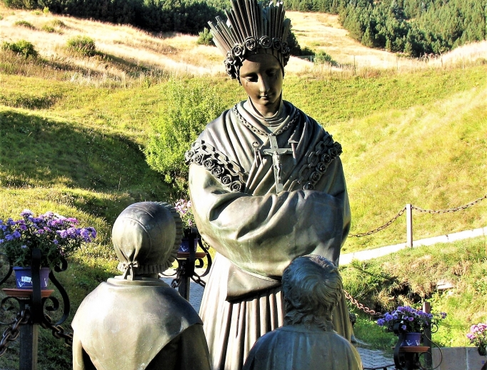
Saints and Schools # 16 : Our Lady of La Salette
Our Lady of La Salette appeared to 2 children in the village of La Salette in France in 1846.
When they saw her she was said to be weeping bitterly. They described her as sitting with her elbows resting on her knees and her face buried in her hands. She was clothed in a white robe studded with pearls; and a gold coloured apron; white shoes and roses about her feet and high headdress. Around her neck she wore a crucifix suspended from a small chain.
She explained that people should return to God and her message was one of reconciliation.
There is one school in the Diocese of Brentwood called La Salette whose mission statement points out that children are loved by Jesus and Our Lady of La Salette : they learn and grow together in joy and friendship.
BDES

Slide 11
Looking Forward
~ Looking Forward to Easter ~
Monday 7th March 2022
Brentwood Diocese Education Service

