Slide 1
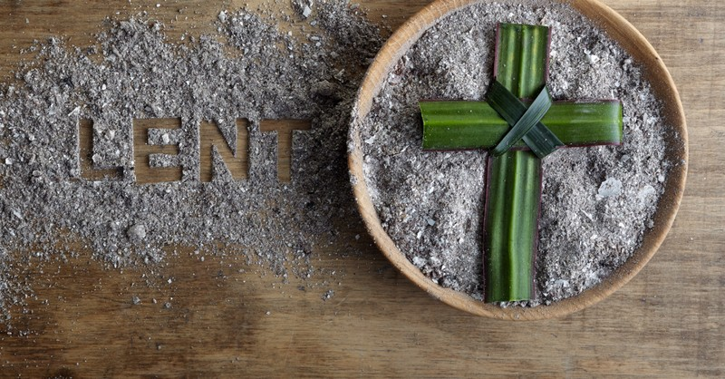
Looking Forward
~ Looking Forward to Easter ~
Monday 14th March 2022
Brentwood Diocese Education Service

Slide 2
We are Looking Forward
~ In the Year of the Family ~
Loving God,
during the sacred season of Lent, bring me closer to You.
Prepare a place in my home and heart for silence and solitude,
so that I may rediscover the gift of a prayer-filled life.
Enlarge my heart so that I may give to those in need,
And rediscover the gifts of gratitude and generosity.
Help me to fast from those things that are unnecessary to the well-being of my body and soul, reminding me of the gift of simplicity.
May this season be a time to rekindle my love for You and my faith in You.
Amen
BDES

Slide 3
Your Lenten Journey
Look at the CAFOD calendar above.
How is your Lenten journey progressing?
Are you or your school involved in fundraising for CAFOD
in their Walk Against Hunger?
BDES

Slide 4
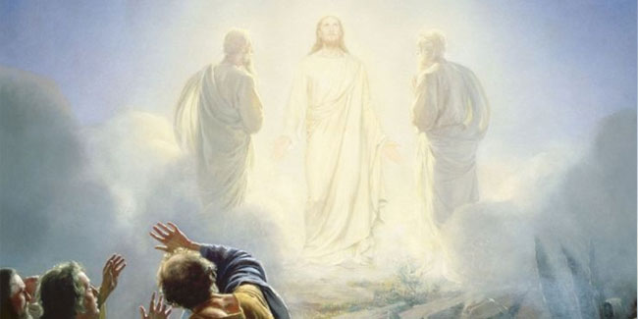
The Synoptic Problem
In Sunday’s Gospel Reading …
13th March 2022 :
In the Gospel of Luke, the Voice of God tells us:
“This is my chosen Son; listen to him.”
BDES

Slide 5
Reflection
“Sister Water”
- St Francis of Assisi, Canticle of the Creatures
BDES

Slide 6
Reflection
Praised be You,
my Lord,
through Sister Water, so useful and humble and precious and pure.
BDES

Slide 7
Preparing for World Youth Day 2023
“You have been entrusted with an exciting but also a challenging task : … to be builders amid the ruins; to be capable of dreaming.”
- Pope Francis, Youth Sunday Mass 2021
BDES

Slide 8
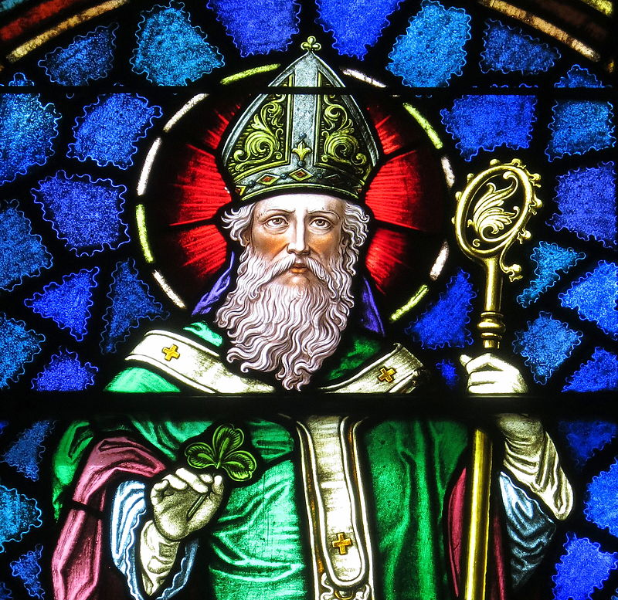
Solemnity of St Patrick
~ 17th March ~
Christ beside me, Christ before me, Christ behind me, King of my heart; Christ within me, Christ below me, Christ above me, never to part.
Christ on my right hand, Christ on my left hand, Christ all around me, shield in the strife; Christ in my sleeping, Christ in my sitting, Christ in my rising, light of my life.
- from St Patrick’s Breastplate
BDES

Slide 9
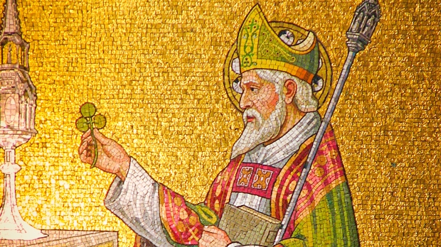
Schools and saints # 17 : St Patrick
When Patrick was about 16, he was captured by pirates and taken from his home in Britain to be sold in Ireland. He escaped and returned to his family, but after being ordained a priest he went back to Ireland as a missionary to convert the land to Christianity. He is regarded as the first bishop of Armagh and the first Primate of Ireland.
His feast day is 17th March, the day on which he is thought to have died.
He is the patron saint of Ireland, Nigeria and Montserrat.
St Patrick is honoured by two schools named after him in our diocese, in Collier Row and in xxxxxxxxxx Walthamstow.
BDES

Slide 10
Looking Forward
~ Looking Forward to Easter ~
Monday 14th March 2022
Brentwood Diocese Education Service

