Slide 1
Looking Forward
~ Looking Forward to Easter ~
Monday 21st March 2022
Brentwood Diocese Education Service

Slide 2
We are Looking Forward
~ In the Year of the Family ~
This week includes the Solemnity of the Annunciation
when the Angel Gabriel announced that Mary was to bear a son.
She was to name him Jesus, which means “God is salvation”.
Mary accepted God in her life.
How are you reflecting this?
What are you doing to show that you accept God’s salvation?
BDES

Slide 3
Your Lenten Journey
Use the CAFOD calendar above to reflect.
How are you progressing on your Lenten journey?
BDES

Slide 4
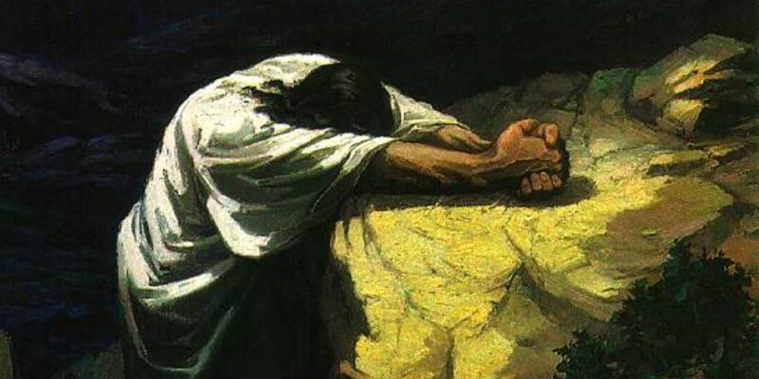
The Synoptic Problem
In Sunday’s Gospel Reading …
Sunday 20th March 2022 :
The Gospel of Luke:
“ If you do not repent...”
BDES

Slide 5
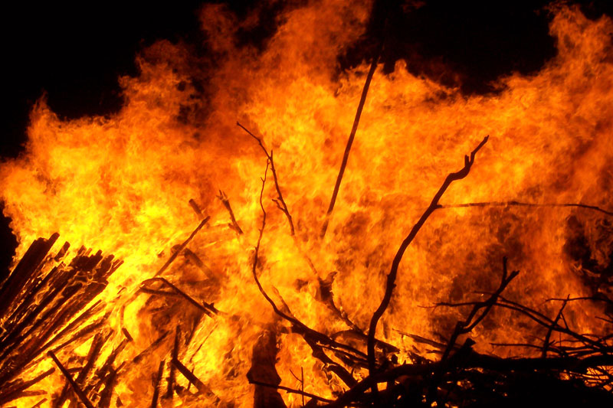
Reflection
“Brother Fire”
- St Francis of Assisi, Canticle of the Creatures
BDES

Slide 6
Reflection
Praised be You,
my Lord,
through Brother Fire, through whom you light the night :
he is beautiful and playful and robust
and strong.
BDES

Slide 7
Preparing as communities for World Youth Day 2023
“Watch in the night visions … let your eyes remain bright even amid the darkness.”
- Pope Francis, Youth Sunday Mass 2021
BDES

Slide 8
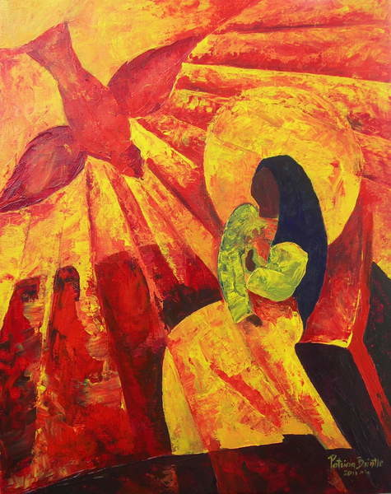
The Annunciation: 25th March
The Annunciation is the beginning of Jesus in His human nature. It was with the consent of Mary, which was foreseen through eternity that the will of God was done. It is through Mary that Jesus is a member of the human race.
We ask Mary to intercede for us and for the world.
Holy Mary, mother fair, Filled with love for God, Pray for us in all our needs. Pray for us today.
Amen
BDES

Slide 9
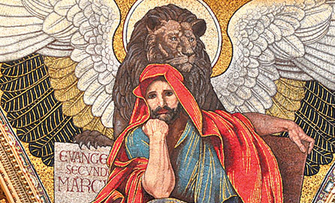
Saints and Schools # 18 : St Mark
St Mark is credited by modern scholars with writing what may be the first surviving written Gospel.
According to tradition, he may have been a companion of Jesus on the night of his arrest. He accompanied Peter and Paul and Barnabas on missionary journeys of the early Church.
The Coptic Orthodox Church, the Greek Orthodox Church of Alexandria and the Coptic Catholic Church trace their origins to the Christian community in Alexandria which Mark is said to have founded.
He died either in Rome or Alexandria during the persecution of Christians. His relics were taken to Venice, where the famous St Mark’s Square is xxxxxx named after him.
St Mark’s West Essex Catholic School in Harlow is a diocesan secondary school established in 1965 and named after the evangelist. Gospel values inform all aspects of its community life.
BDES

Slide 10
Looking Forward
~ Looking Forward to Easter ~
Monday 21st March 2022
Brentwood Diocese Education Service

