Slide 1
Looking Forward
~ Looking Forward to Easter ~
Monday 28th March 2022
Brentwood Diocese Education Service

Slide 2
We are Looking Forward
~ In the Year of the Family ~
Yesterday, Laetare Sunday marked the midpoint of Lent
and the rose-colored vestments used at Mass
gave us a glimpse at the light of the end of the 40-day tunnel of penance.
Lent is a journey that is marked with the struggle of penance and self-knowledge,
but it should not be simply a gloomy trudge.
Even as we journey, we are reminded to rejoice in the coming promise of Easter.
Our journey is half complete.
Rejoice: new life is coming!
BDES

Slide 3
Your Lenten Journey
Look at the CAFOD calendar above.
How is your Lenten journey progressing?
Are you or your school involved in fundraising for CAFOD
in their Walk Against Hunger?
BDES

Slide 4
The Synoptic Problem
In Sunday’s Gospel Reading …
27th March 2022 :
In the Gospel of Luke, the father in the parable tells his child :
“Everything I have is yours.”
BDES

Slide 5
Reflection
“Sister Mother Earth ”
- St Francis of Assisi, Canticle of the Creatures
BDES

Slide 6
Reflection
Praised be You,
my Lord,
through Sister Mother Earth, who sustains us and governs us.
BDES

Slide 7
Preparing for World Youth Day 2023
“Never stop seeking the light amid whatever darkness we may bear in our hearts or see all around us.”
- Pope Francis, Youth Sunday Mass 2021
BDES

Slide 8
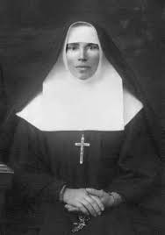
Feast Day of Blessed Olha Bida
~ 2nd April ~
Sister Olympia (“Olha”) Bida was born in 1903 in the village of Tsebliv, near Lviv in Ukraine. She joined the Sisters of St Joseph and served in various towns and villages as a catechist, director of novices, and a servant to the aged and infirm. She had a special gift for youth work and was responsible for the education of a number of young women. She was appointed superior of the convent in the town of Kheriv, and did her best to see to the spiritual and social needs of the people in spite of the Communist pressure surrounding their work. In 1951, she was arrested with two other sisters, imprisoned for a while, then exiled to the Tomsk region of Siberia.
Under conditions of heavy forced labour, Sister Olympia tried to perform her duties as superior and organized her sisters and other sisters in other camps to come together and to pray and support each other. Succumbing to a xxxxxx serious illness, she died on 28 January 1952. She was beatified by Pope xxx John Paul II in 2001.
BDES

Slide 9
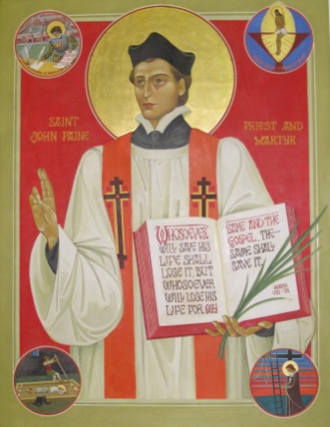
Schools and saints # 19 : St John Payne
John Payne was born in Peterborough in 1532 and was ordained a priest in Douai in 1576; he returned to Elizabethan England as a missionary for the faith, basing himself in Ingatestone.
He was eventually betrayed in 1581 and taken to the Tower of London where he was tortured. Finally, he was taken to Chelmsford jail to be tried at the Assizes there in 1582.
Father Payne was executed at Chelmsford on Monday 2nd April 1582. He prayed on his knees for half an hour and kissed the scaffold.
He was made a saint along with the other Martyrs of England by Pope Paul VI on 25th October 1970.
St John Payne Catholic School in Chelmsford is named after this brave local saint and martyr.
BDES

Slide 10
Looking Forward
~ Looking Forward to Easter ~
Monday 28th March 2022
Brentwood Diocese Education Service

