Slide 1
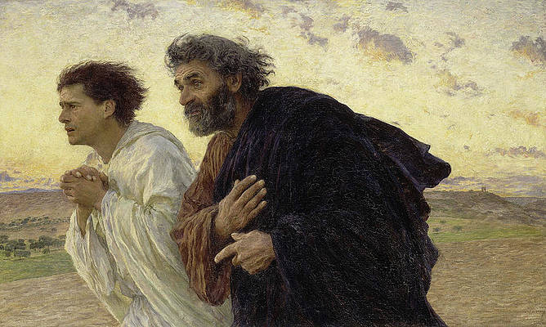
Looking Forward
~ We are an Easter People~
Monday 18th April 2022
Brentwood Diocese Education Service

Slide 2
We are Looking Forward
~ In the Year of the Family ~
On 25th March Pope Francis consecrated Russia and Ukraine to the Immaculate Heart of Mary.
In doing so he prayed that through her intercession the gentle rhythm of peace be returned to the world.
What can you do to reflect this?
How are you following Mary on the path of peace?
BDES

Slide 3
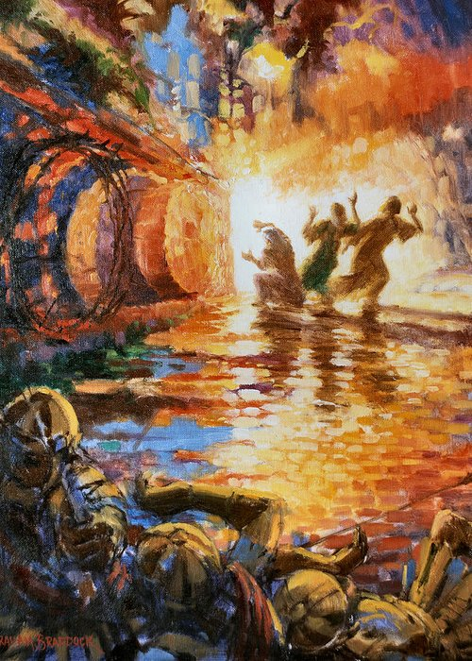
The Synoptic Problem
In Sunday’s Gospel Reading …
Sunday 17th April 2022 :
The Gospel of Matthew:
“Do not be afraid!
I know that you are seeking Jesus.”
BDES

Slide 4
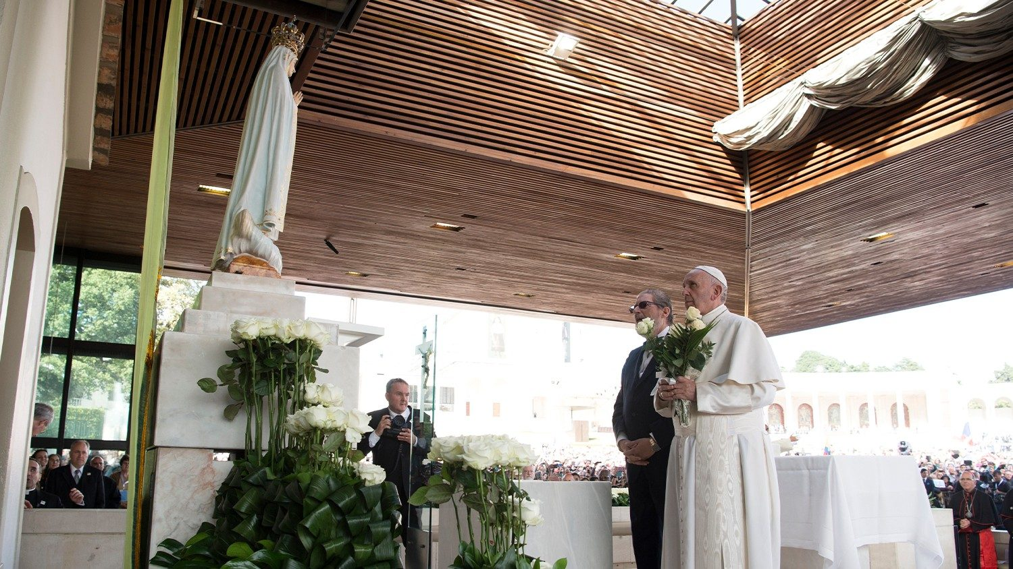
Reflection
March 25th 2022 Consecration of Russia and Ukraine to Our Lady
BDES

Slide 5
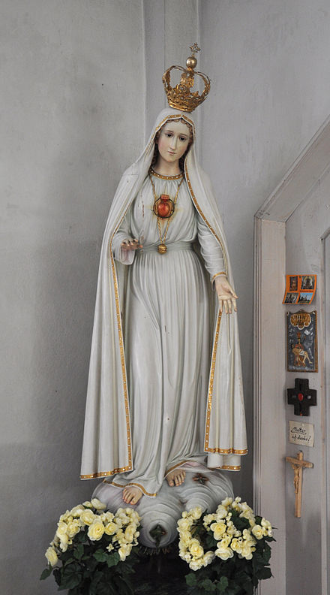
Reflection
Therefore, Mother of God and our Mother, to your Immaculate Heart we solemnly entrust and consecrate ourselves, the Church and all humanity, especially Russia and Ukraine. Accept this act that we carry out with confidence and love.
Grant that war may end and peace spread throughout the world.
Your words, “Let it be done,” arose from your heart opened the doors of history to the Prince of Peace.
We trust that, through your heart, peace will dawn once more.
To you we consecrate the future of the whole human family,
the needs and expectations of every people,
the anxieties and hopes of the world.
BDES

Slide 6
Preparing as communities for World Youth Day 2023
“Everyone is grateful to you when you dream.”
- Pope Francis, Youth Sunday Mass 2021
BDES

Slide 7
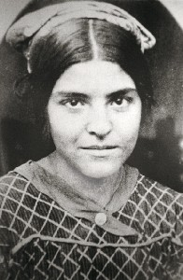
St Maria Gabriella Sagheddu
Feast Day : 22nd April
Maria Sagheddu (17 March 1914 - 23 April 1939) - was an Italian nun, a member of the Trappist order. Her religious name was Maria Gabriella.
She was deeply devoted to ecumenism, the concept that Christians who belong to different Christian denominations should work together to develop closer relationships among their churches and promote Christian unity - something for which she had offered her life. She wanted everyone to become one in Jesus Christ.
She was described as being stubborn and obstinate as a child but through her increasingly active life of faith in teaching catechism and joining Azione Cattolica (the Italian Catholic Action Group) she became gentle and attentive.
She became a cloistered nun whose life was devoted to prayer and died aged 25.
She was beatified in Rome in 1983.
BDES

Slide 8
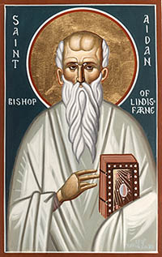
Saints and Schools # 20 : St Aidan
St Aidan was an Irish monk who lived in the 7th Century.
He founded a monastery on the Holy Island of Lindisfarne off the Northumbrian coast. He spent his life converting the Anglo-Saxons to Christianity.
He spread the Good News both to the nobles and those who were seen at the time as unimportant, including children and slaves.
He had been a monk on the island of Iona but because of his work across Northumbria he is known as the Apostle of Northumbria.
He died in 651 and his body was buried in the church he founded.
St Aidan’s Catholic Primary Academy in Ilford is named after the saint.
The children there follow in his tradition of spreading the Good News as the school has the mission statement of
‘Together we enjoy Learning, Achieving, Sharing and Praying.
Let Jesus' love shine through in everything we do.'
BDES

Slide 9
Looking Forward
~ We are an Easter People~
Monday 18th April 2022
Brentwood Diocese Education Service

