Slide 1
Looking Forward
~ We are an Easter People~
Monday 25th April 2022
Brentwood Diocese Education Service

Slide 2
We are an Easter People
~ In the Year of the Family ~
We are all walking wounded in our own way.
We all bear scars, physical and emotional.
We try to hide our scars. We flinch from the scars of others.
In Sunday’s Gospel reading, Jesus bares His scars to His friends.
Christ shows Himself once more as one of us.
And Christ shows us, amidst the scars,
new life and new hope.
BDES

Slide 3
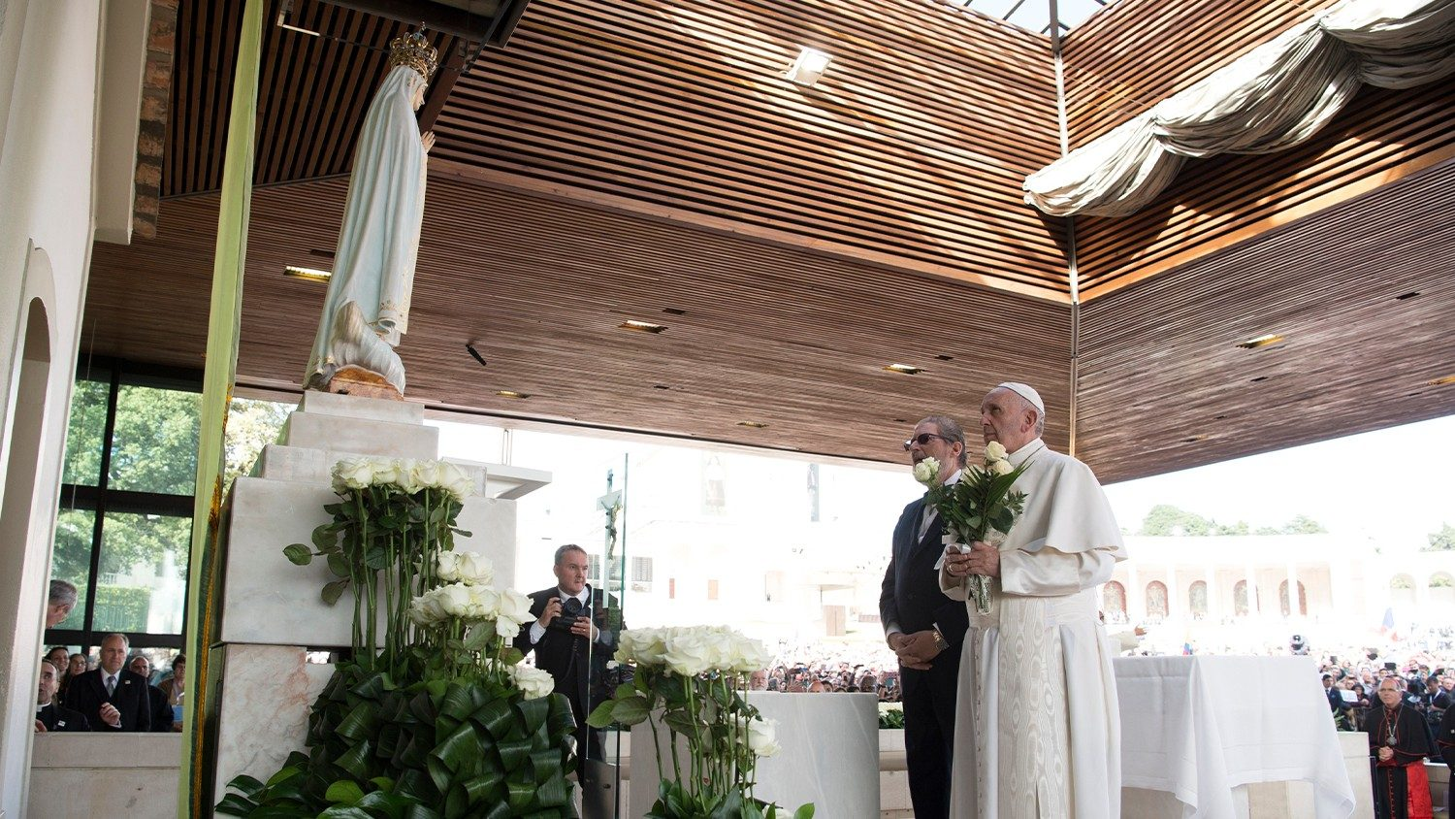
Reflection
Consecration of Russia and Ukraine to Our Lady
BDES

Slide 4
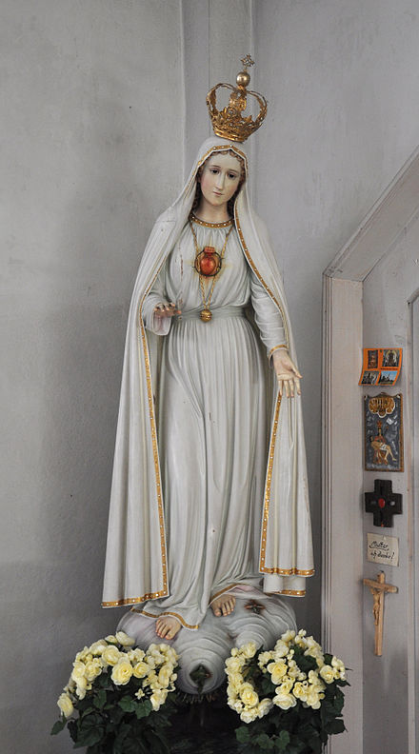
Reflection
Through your intercession, may God’s mercy be poured out on the earth and the gentle rhythm of peace return to mark our days.
Our Lady who spoke the words “Let it be done”,
on whom the Holy Spirit descended,
restore among us the harmony that comes from God.
May you, our “living fountain of hope”,
water the dryness of our hearts.
In your womb Jesus took flesh;
help us to foster the growth of communion.
You once trod the streets of our world;
lead us now on the paths of peace.
Amen.
BDES

Slide 5
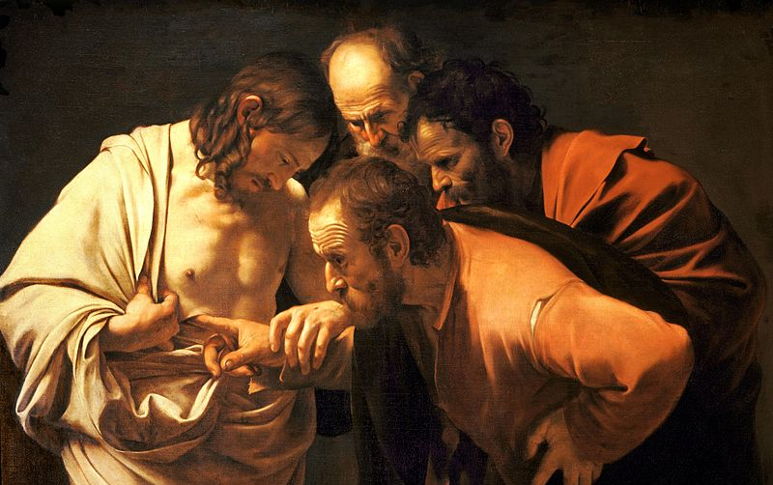
The Synoptic Problem
In Sunday’s Gospel Reading …
24th April 2022 :
In the Gospel of John, Jesus says to his disciples :
“Peace
be with you.”
BDES

Slide 6
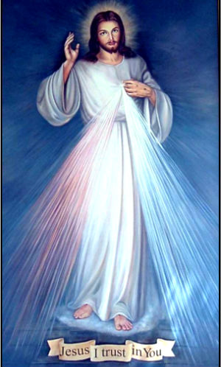
The Synoptic Problem
Divine Mercy Sunday
The Second Sunday of Easter was designated Divine Mercy Sunday by Pope John Paul II in the year 2000, upon the canonisation of Saint Maria Faustina Kowalska of the Blessed Sacrament, who had visions of Jesus and commissioned the first Divine Mercy painting.
“Merciful Jesus, I trust in you.”
BDES

Slide 7
Preparing for World Youth Day 2023
“When you make Jesus your life’s dream, and you embrace him with joy and a contagious enthusiasm, this does us all good.”
- Pope Francis, Youth Sunday Mass 2021
BDES

Slide 8
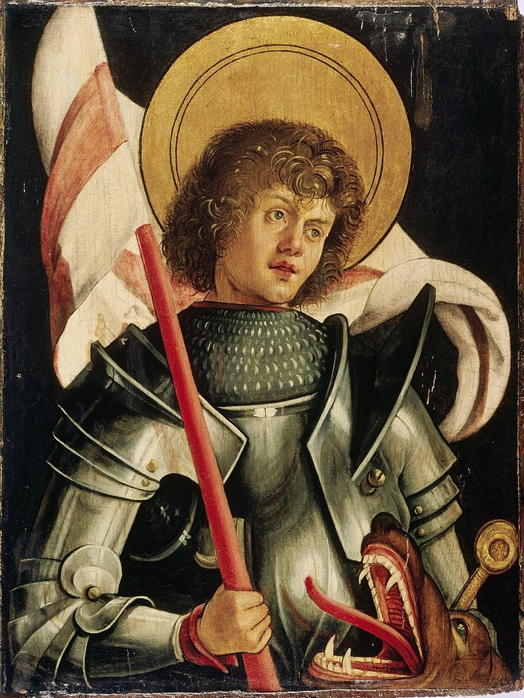
National Solemnity of St George
~ 26th April (transferred from 23rd) ~
According to legend, Saint George of Lydda was a Christian soldier in the Roman army who was martyred by the emperor Diocletian in the 3rd century for refusing to renounce his faith. He is one of the Fourteen Holy Helpers, a group of saints whose intercession is believed to be effective in times of illness, and has been venerated as a military saint since the Crusades. The legend of St George and the Dragon is widely known and very popular in art.
As well as being the patron saint of England, whose flag bears his cross, St George is the patron saint of Ethiopia, Georgia, Moscow, Catalonia and Aragon in Spain, and numerous regions, cities, universities, professions and organisations.
His bones are believed to be buried in the Church of St George xxxxxx in Lod in Israel.
BDES

Slide 9
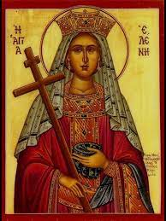
Schools and saints # 21 : St Helen
The medieval historians Geoffrey of Monmouth and Henry of Huntingdon promoted a popular tradition that St Helen was a British princess from near Colchester; this led to 135 churches being dedicated to her in England.
She was the mother of Constantine the Great and was made Augusta Imperatrix upon the accession of her son. She is credited with locating the True Cross while on pilgrimage to Jerusalem and is depicted in Christian art holding the Cross.
She died around 330 A.D. and was buried in the Mausoleum of Helena outside Rome.
Our diocese has schools named in honour of St Helen at Brentwood, Canning Town and Westcliff.
BDES

Slide 10
Looking Forward
~ We are an Easter People~
Monday 25th April 2022
Brentwood Diocese Education Service

