Slide 1
Looking Forward
~ We are an Easter People~
Monday 2nd May 2022
Brentwood Diocese Education Service

Slide 2
We are an Easter People
~ In the Year of the Family ~
In the Magnificat, Mary proclaims the greatness of the Lord.
St Joseph is often asked to guide the steps that fail.
How are you following Mary in rejoicing in God’s saving mercy?
How are you asking for help when you need it?
How are you looking forward in prayer?
BDES

Slide 3
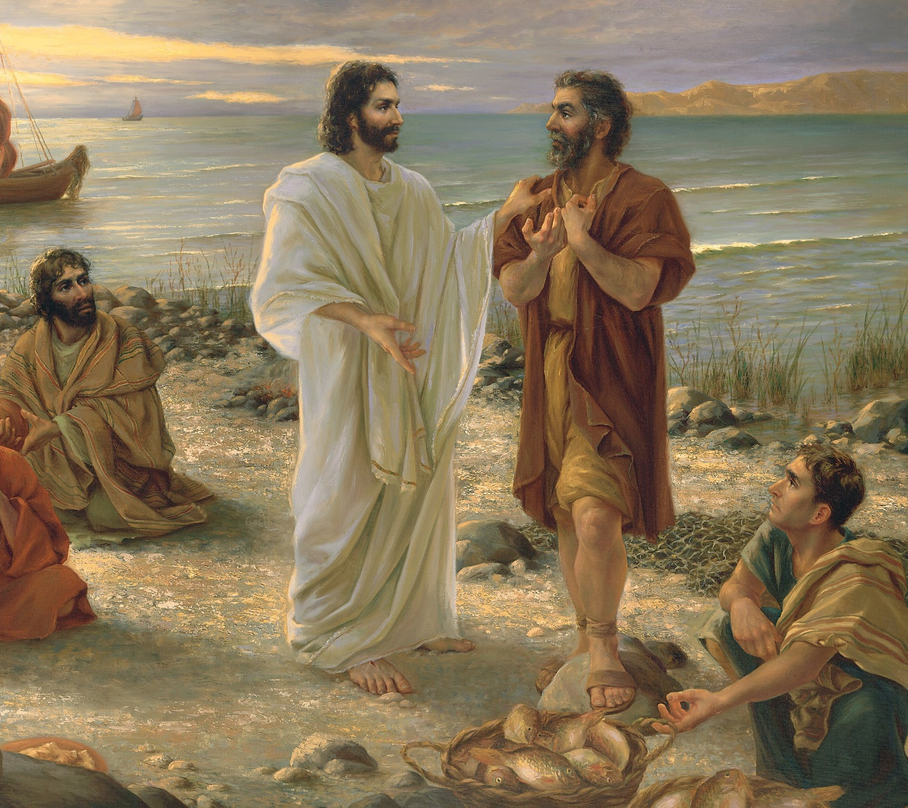
The Synoptic Problem
In Sunday’s Gospel Reading …
Sunday 1st May 2022 :
In the Gospel of John, Peter says :
“Lord, you know
that I love you.”
BDES

Slide 4
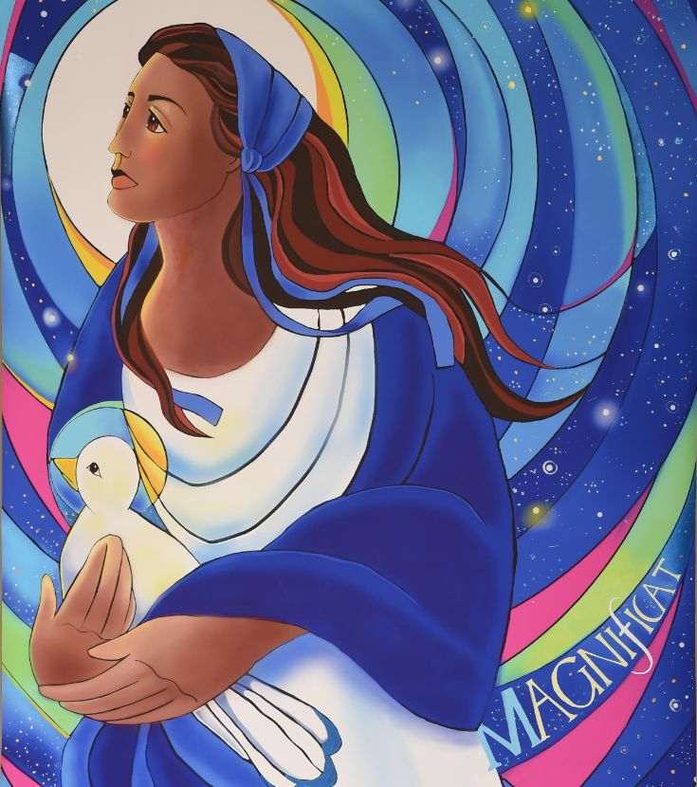
Reflection
My soul proclaims the greatness of the Lord,
my spirit rejoices in God my Saviour,
for He has looked with favour on His humble servant.
From this day all generations will call me blessed.
BDES

Slide 5
Preparing as communities for World Youth Day 2023
“In a world that thinks only of present gain, that tends to stifle grand ideals,
you have not lost the ability to dream.
This helps us adults,
and the Church as well.”
- Pope Francis, Youth Sunday Mass 2021
BDES

Slide 6
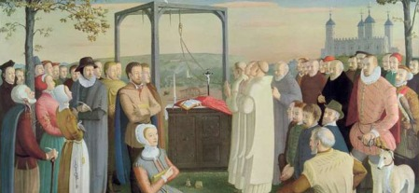
National Feast of English Martyrs:
4th May
The Forty Martyrs of England and Wales are a group of lay people and religious, men and women, executed between 1535 and 1679 for treason and related offences under various laws enacted by Parliament.
The individuals range from Carthusian monks who in 1535 refused to accept Henry VIII as head of the Church, to priests caught up in an alleged plot against King Charles II in 1679. The list includes three women, Margaret Clitherow, Anne Line and Margaret Ward.
Many were sentenced to death without trial.
They were canonised in 1970 by Pope Paul VI and their feast day was 25th October. They are now celebrated with all the 284 canonised or beatified martyrs of the English reformation on 4th May.
BDES

Slide 7
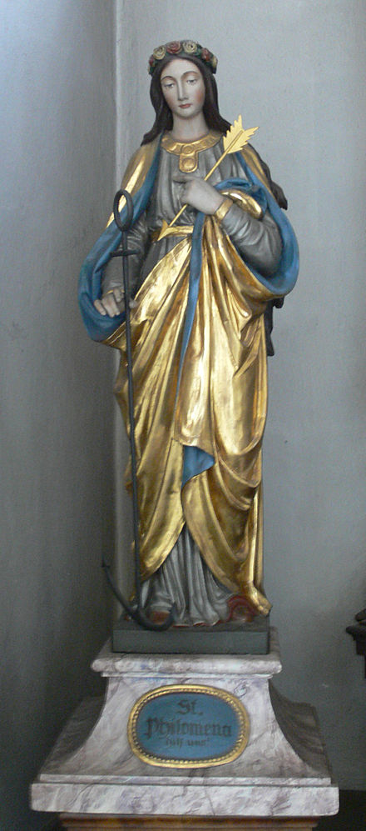
Saints and Schools # 22 : St Philomena
St Philomena was a young woman from Roman times whose remains were found in the catacombs in 1802.
It was suggested that she had been martyred during the reign of Diocletian in the 3rd century AD.
She was the patron saint of babies, infants and youth.
Her name was a very popular one as it is taken to mean ‘beloved’.
St Philomena’s School in Frinton-on-Sea is named after her.
The values that Christ taught underpin everything that they do
and the school’s Mission Statement sums this up
‘Growing Together, Learning Together,
Achieving together in Christ.'
BDES

Slide 8
Looking Forward
~ We are an Easter People~
Monday 2nd May 2022
Brentwood Diocese Education Service

