Slide 1
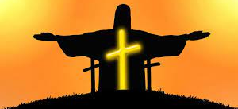
Looking Forward
~ We are an Easter People~
Monday 9th May 2022
Brentwood Diocese Education Service

Slide 2
We are an Easter People
~ In the Year of the Family ~
In the week beginning with Vocations Sunday,
let us think about what God is calling us to do.
St John Henry Newman helpfully wrote :
“God has created me to do Him some definite service.
He has committed some work to me
which He has not committed to another.
I have my mission.”
What do you think God is calling you to do?
What is your personal mission?
BDES

Slide 3
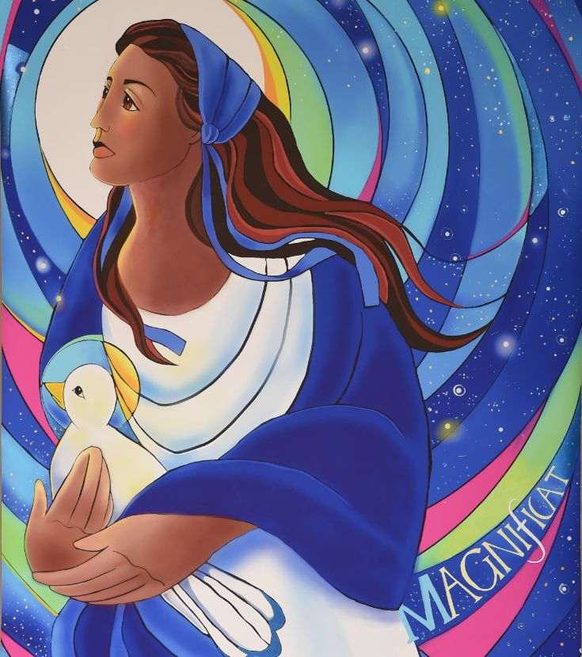
Reflection
For the Almighty has done great things for me — holy is His name. His mercy extends to those who fear him, from generation to generation.
BDES

Slide 4
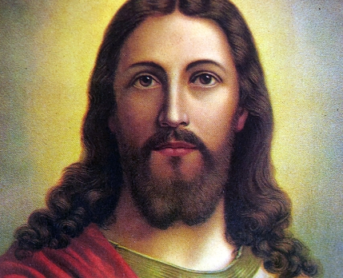
The Synoptic Problem
In Sunday’s Gospel Reading …
8th May 2022 :
In the Gospel of John, Jesus reminds us:
“The Father and I are one.”
BDES

Slide 5
The Synoptic Problem
Vocations Sunday – 8th May 2022
PRAYER FOR VOCATIONS
​
Inspire, in the hearts of your people,
vocations to the priesthood, diaconate
and religious life.
Bless our families with a spirit of generosity,
so that those whom you call
have the courage to give themselves
to your Church in faith.
​
Through Christ our Lord.
​
Amen.
“Heavenly Father,
we ask you
to send
labourers
into your
harvest.”
​
BDES

Slide 6
Preparing for World Youth Day 2023
“By following Jesus,
we see life as it really is.”
- Pope Francis, Youth Sunday Mass 2021
BDES

Slide 7
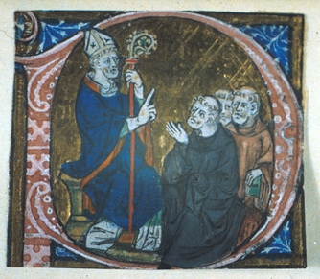
Feast Day of St Erconwald
~ 13th May ~
St Erconwald was born in Lincolnshire and as a member of the royal house established two Benedictine Abbeys, one for men at Chertsey in Surrey, where he became abbot, and one for women at Barking, where his sister Ethelburga was made abbess. In 675 AD he became the Bishop of London.
He is credited with being an influential adviser on law-making and charters, especially for the King of Wessex. He died in 693 and was buried in the churchyard of St Paul’s Cathedral.
St Erconwald is the patron saint of London and the secondary co-patron of our Diocese of Brentwood. He is often depicted in art as a bishop in a small chariot, which he used for travelling around his diocese.
BDES

Slide 8
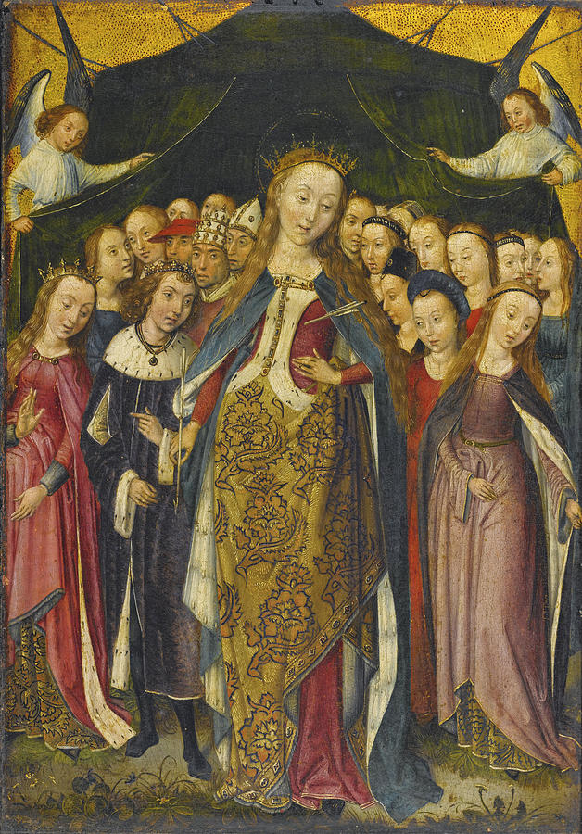
Schools and saints # 23 : St Ursula
According to the legend of St Ursula, she was a Christian princess from the south-west of England who was on pilgrimage to Rome when she and her female attendants were martyred at Cologne.
Her story inspired St Angela Merici to found the Order of Ursulines in 1535, dedicated to the education of young women.
The Virgin Islands are named after her.
In our diocese we have St Ursula’s Primary School in Harold Hill and of course the Ursuline schools which remember and uphold the traditions of the Ursulines.
BDES

Slide 9
Looking Forward
~ We are an Easter People~
Monday 9th May 2022
Brentwood Diocese Education Service

