Slide 1
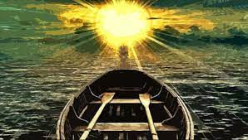
Looking Forward
~ We are an Easter People~
Monday 16th May 2022
Brentwood Diocese Education Service

Slide 2
We are an Easter People
~ In the Year of the Family ~
Pope Francis points out that we should not be dazzled
by all the fashions of the world,
but should follow Jesus.
In this week’s Gospel, Jesus tells us to
“Love one another as I have loved you.”
What does this mean for you?
How are you putting this into practice in your life?
BDES

Slide 3
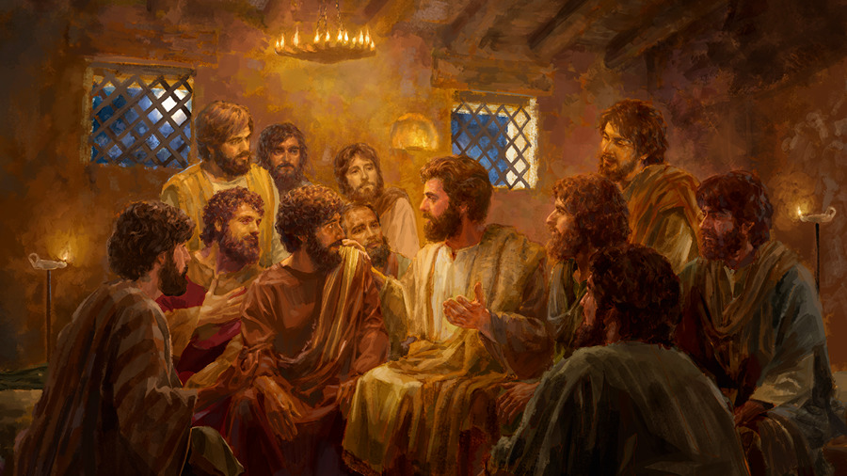
The Synoptic Problem
In Sunday’s Gospel Reading …
Sunday 15th May 2022 :
In the Gospel of John, Jesus says :
“Love one another as I
have loved you.”
BDES

Slide 4
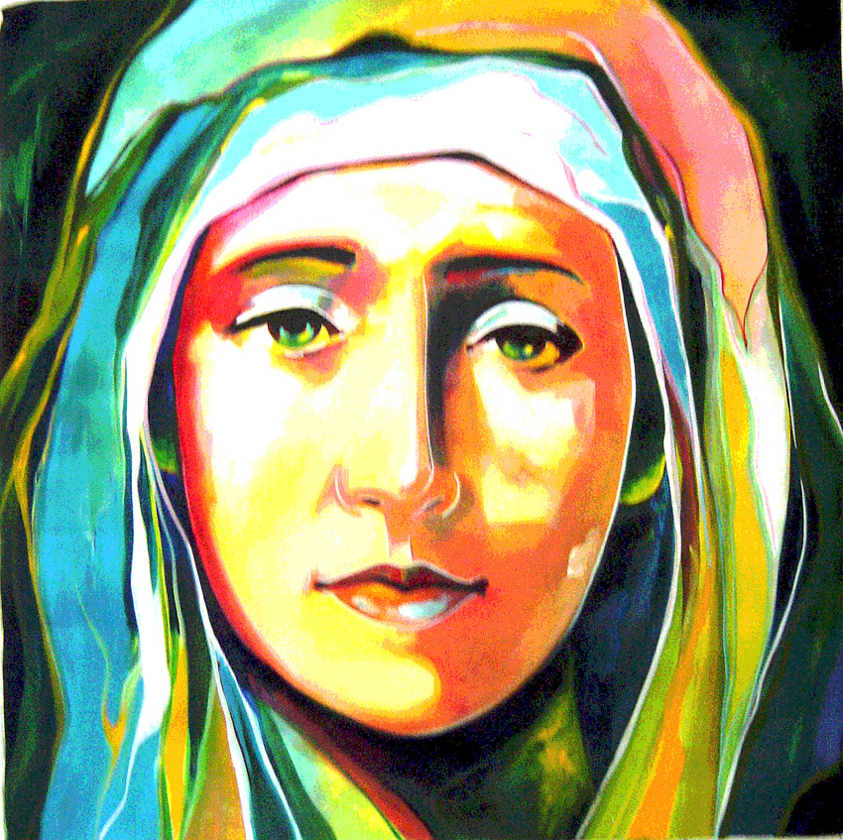
Reflection
He has shown the strength of His arm; he has scattered the proud
in their conceit; He has brought down the mighty from their thrones and lifted up the lowly; He has filled the hungry
with good things, and the rich He has sent away empty.
BDES

Slide 5
Preparing as communities for World Youth Day 2023
“By following Jesus, we are not deceived by the fashions of the moment and the displays of consumerism that dazzle but also deaden.”
- Pope Francis, Youth Sunday Mass 2021
BDES

Slide 6
St Bernadine of Siena
Bernardine came to Siena to study, and through prayer and fasting tried to discover what God wanted him to do. In 1403 he joined the Franciscans and in 1404 he was ordained a priest. The Franciscans were known as missionary preachers, but Bernardine did very little preaching because his voice was weak and hoarse. After twelve years in the background he went to Milan on a mission. Suddenly, when he got up to preach his voice was strong and commanding and his words so convincing that the crowd would not let him leave unless he promised to come back. Bernardine put his whole self into his new career. He crisscrossed Italy on foot, preaching for hours at a time, several times a day. We are told he preached on punishment for sin as well as reward for virtue, but focused in the end on the mercy of Jesus and the love of Mary. His special devotion was to the Holy Name of Jesus. Pope Pius II called him a second Paul.
Saint Bernardine of Siena, words were very important to you.
You spent most of your life speaking the golden words of Jesus' mercy and his Holy Name,
and you abhorred words that were shameful.
Pray for us that we may always choose to speak Jesus' name with reverence
and choose words of love over words of shame.
Amen
BDES

Slide 7
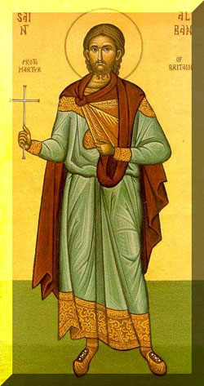
Saints and Schools # 24 : St Alban
St Alban is the first-recorded British Christian martyr, one of three named martyrs recorded at an early date from Roman Britain.
He is traditionally believed to have been beheaded in the Roman city of Verulamium (modern St Albans) sometime during the 3rd or 4th century, and he has been celebrated there since ancient times.
According to his legend, he was executed for sheltering a persecuted Christian priest. For this reason, he is regarded as a patron saint of refugees.
Two primary schools in the Diocese of Brentwood are named after St Alban. Their Mission Statements are inspirational.
Through God’s love we learn together, grow together and achieve together.
(St Alban’s, Harlow)
Inspired by God’s love, we celebrate our gifts as we learn and grow together.
(St Alban’s, Hornchurch)
St Alban, protector and friend, pray for us.
BDES

Slide 8
Looking Forward
~ We are an Easter People~
Monday 16th May 2022
Brentwood Diocese Education Service

