Slide 1
Looking Forward
~ We are an Easter People~
Monday 23rd May 2022
Brentwood Diocese Education Service

Slide 2
We are an Easter People
~ In the Year of the Family ~
Hope is so much a part of the mystery of the Ascension of Jesus.
We celebrate Christ’s victory and triumph over sin and death.
We know that Christ’s strength is greater than our weakness,
greater than the weakness of the whole world.
We imagine the joy of Mary that her Son
had taken His place with His Father,
whom He loved infinitely.
We believe in Jesus’ promise that He has gone to prepare a place for us,
so that He can come back again and take us to Himself.
BDES

Slide 3
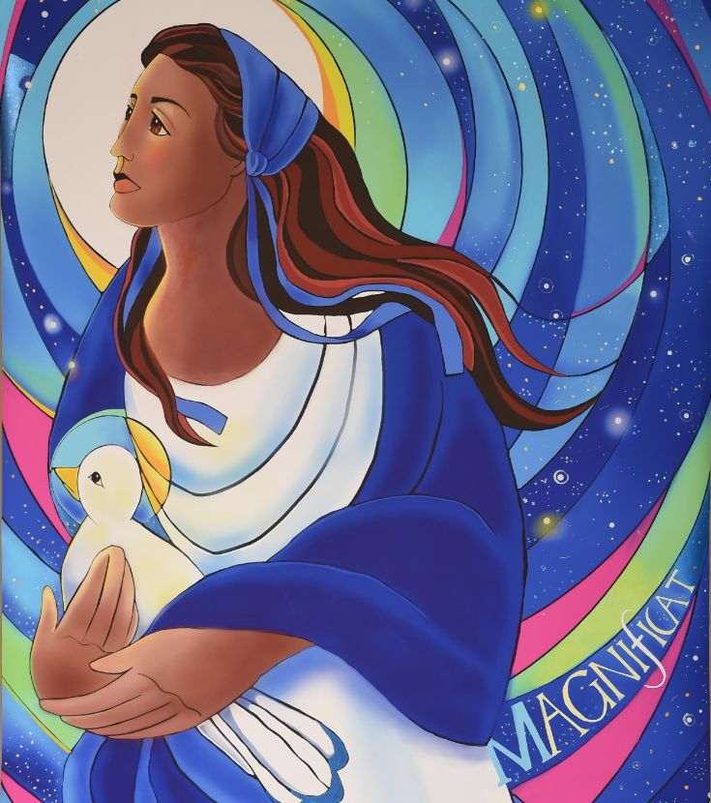
Reflection
He has helped his servant Israel, remembering to be merciful to Abraham and his descendants forever, just as he promised our ancestors.
BDES

Slide 4
The Synoptic Problem
In Sunday’s Gospel Reading …
22nd May 2022 :
In the Gospel of John, Jesus tells us:
“Peace I leave with you;
my peace
I give to you.”
BDES

Slide 5
Preparing for World Youth Day 2023
“Friends, we are not here to be enchanted by the lures of the world, but to take our lives in hand.”
- Pope Francis, Youth Sunday Mass 2021
BDES

Slide 6
Solemnity of The Ascension
~ 26th May ~
“He was taken up into a cloud while they were watching, and they could no longer see him.”
Acts of the Apostles, 1 : 9
BDES

Slide 7
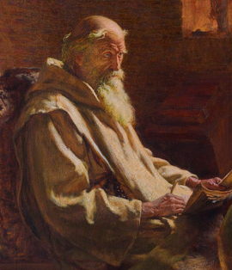
Schools and saints # 25 : St Bede
St Bede (672-735 AD) was a monk in the monasteries of St Peter and St Paul in Monkwearmouth and Jarrow in the north of England.
He was an author, a teacher and a scholar, and is known as the “Father of English History” because of his Ecclesiastical History of the English People. He also wrote commentaries on the Bible, was an expert on computing the calendar, and popularised the system of dating events from the birth of Christ which we use today, in 2022 A.D.
St Bede’s Catholic Primary School and Nursery in Romford is named after the saint. Their motto is : “Shine like a lantern, in the presence of the Lord.”
BDES

Slide 8
Looking Forward
~ We are an Easter People~
Monday 23rd May 2022
Brentwood Diocese Education Service

