Slide 1
Looking Forward
~ Looking Forward in Prayer~
Monday 6th June 2022
Brentwood Diocese Education Service

Slide 2
Looking forward in Prayer
~ In the Year of the Family ~
On 9th June we celebrate the feast of Jesus Christ the Eternal High Priest.
There is a church in Gidea Park with this unique dedication.
Jesus is full of compassion for our weakness, for he died for us.
He offered himself once and for all on the cross for our salvation.
Let us trust in Him.
BDES

Slide 3
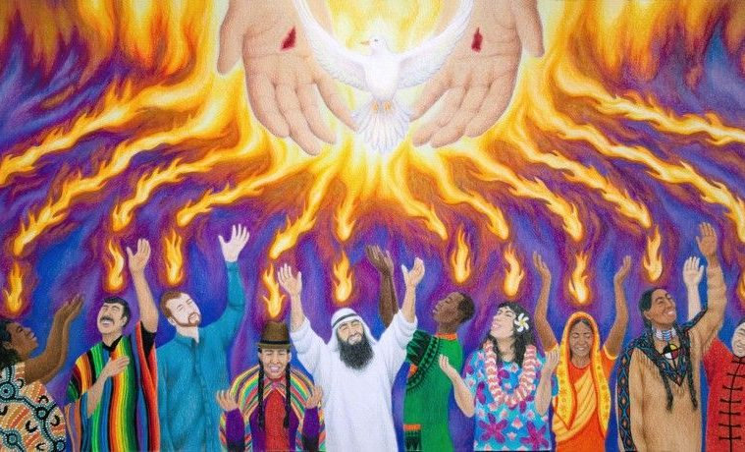
The Synoptic Problem
In Sunday’s Gospel Reading …
Sunday 5th June 2022 :
The Gospel of John, Jesus says :
“Receive the Holy Spirit.”
BDES

Slide 4
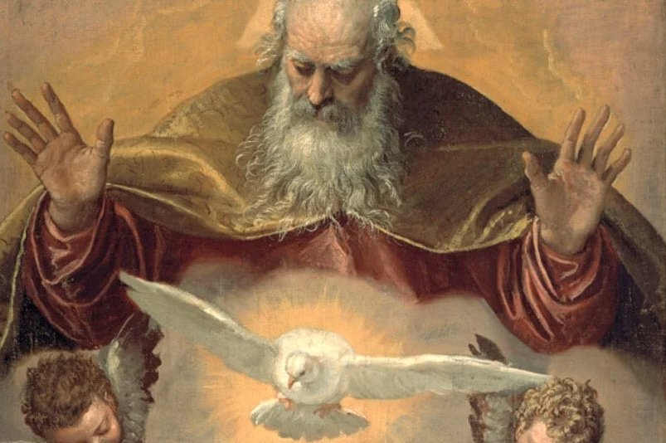
Reflection
Our Father who art in Heaven,
hallowed be thy name.
BDES

Slide 5
Preparing as communities for World Youth Day 2023
“Friends, we are here … to take a bite out of life, in order to live it to the full.”
- Pope Francis, Youth Sunday Mass 2021
BDES

Slide 6
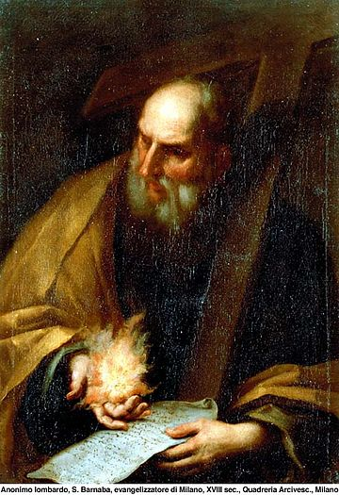
St Barnabas
St Barnabas was one of the disciples in Jerusalem. It is thought he came from Cyprus and travelled for some time with St Paul preaching and converting people. It is also thought that he created a number of writings used by the early Church.
He then returned to Cyprus with another disciple, John Mark.
Tradition suggests he was martyred in Cyprus and his body was buried there. This led to him being made the patron saint of the island as well as many other places.
BDES

Slide 7
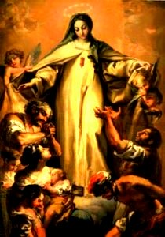
Saints and Schools # 26 : Our Lady of Ransom
There is a tradition that in August 1218, Peter Nolasco - a French saint - experienced a vision of the Virgin Mary, who asked him to found a religious order dedicated to rescuing captives.
In more recent times the devotion to Our Lady of Ransom was revived in England in recognition of its historic title as ‘Our Lady's Dowry’.
Our Lady of Ransom was also know as Our Lady of Mercy and pictures often show people sheltering under her outspread cloak.
In the diocese of Brentwood,
Our Lady of Ransom Catholic Primary School bears it name proudly. It describes itself as :
A place of mercy, where everyone is
welcomed, loved, forgiven
and encouraged to learn,
as we follow in the footsteps of Jesus.
BDES

Slide 8
Looking Forward
~ Looking Forward in Prayer~
Monday 6th June 2022
Brentwood Diocese Education Service

