Slide 1
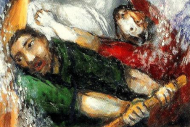
LECTIO DIVINA
Monday 14th June 2021
Brentwood Diocese Education Service

Slide 2
The Sign of the Cross
BDES

Slide 3
Opening Prayer
Lord,
in your presence, let us prepare our hearts for this moment of prayer. Send your Holy Spirit to enlighten us and open our minds and hearts to everything You want to tell us today.
Thank you Lord, for nourishing us with your Word.”
BDES

Slide 4
Silent Reflection
BDES

Slide 5
• LECTIO •
On that day, as evening drew on, Jesus said to his disciples: “Let us cross to the other side.”
Leaving the crowd, they took Jesus with them in the boat just as he was. And other boats were with him.
A violent squall came up and waves were breaking over the boat, so that it was already filling up.
Jesus was in the stern, asleep on a cushion. They woke him and said to him, “Teacher, do you not care that we are perishing?”
BDES

Slide 6
• LECTIO •
He woke up, rebuked the wind, and said to the sea, “Quiet! Be still!” The wind ceased and there was great calm.
Then he asked them, “Why are you terrified? Do you not yet have faith?”
They were filled with great awe and said to one another, “Who then is this whom even wind and sea obey?”
BDES

Slide 7
• MEDITATIO •
REFLECTION
What God is saying to you?
Feel free to share ‘echoes’ of the text,
a phrase that strikes you.
If you wish, please say why.
BDES

Slide 8
• MEDITATIO •
BDES

Slide 9
• ORATIO •
PRAYER
What would you like to say to God?
……..
Lord in your mercy …
R / Hear our prayer
BDES

Slide 10
• ORATIO •
BDES

Slide 11
• CONTEMPLATIO •
LET US
REST IN GOD
IN SILENCE
May the Holy Spirit deepen our awareness of the Word
BDES

Slide 12
• CONTEMPLATIO •
BDES

Slide 13
The Lord’s Prayer
BDES

Slide 14
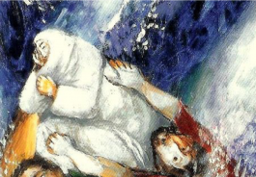
• ACTIO •
BDES

