Slide 1
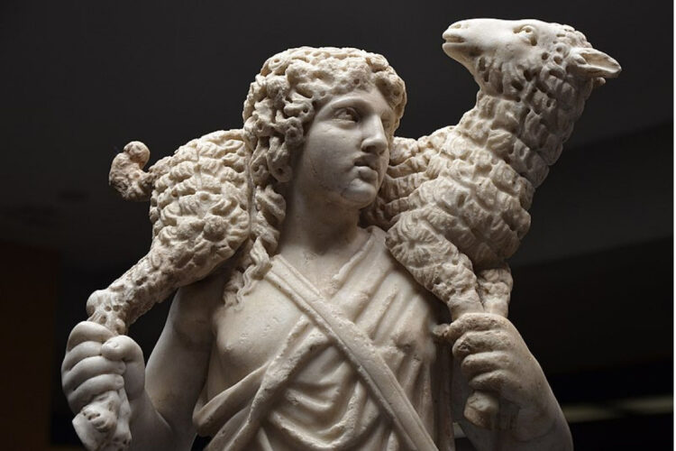
LECTIO DIVINA
Brentwood Diocese Education Service

Slide 2
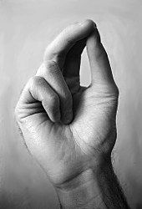
The Sign of the Cross
BDES

Slide 3
Opening Prayer
Saint Augustine’s Prayer to the Holy Spirit
Breathe in me, O Holy Spirit, that my thoughts may all be holy.
Act in me, O Holy Spirit, that my work, too, may be holy.
Draw my heart, O Holy Spirit, that I love but what is holy. Strengthen me, O Holy Spirit, to defend all that is holy.
Guard me, then, O Holy Spirit, that I always may be holy.
Amen
BDES

Slide 4
Silent Reflection
BDES

Slide 5
• LECTIO •
The apostles gathered together with Jesus and reported all they had done and taught.
He said to them, “Come away by yourselves to a deserted place and rest a while.” People were coming and going in great numbers, and they had no opportunity even to eat.
So they went off in the boat by themselves to a deserted place.
BDES

Slide 6
• LECTIO •
People saw them leaving and many came to know about it. They hastened there on foot from all the towns and arrived at the place before them.
When he disembarked and saw the vast crowd, his heart was moved with pity for them, for they were like sheep without a shepherd; and he began to teach them many things.
BDES

Slide 7
• MEDITATIO •
REFLECTION
What God is saying to you?
Feel free to share ‘echoes’ of the text,
a phrase that strikes you.
If you wish, please say why.
BDES

Slide 8
• MEDITATIO •
BDES

Slide 9
• ORATIO •
PRAYER
What would you like to say to God?
……..
Lord in your mercy …
R / Hear our prayer
BDES

Slide 10
• ORATIO •
BDES

Slide 11
• CONTEMPLATIO •
LET US
REST IN GOD
IN SILENCE
May the Holy Spirit deepen our awareness of the Word
BDES

Slide 12
• CONTEMPLATIO •
BDES

Slide 13
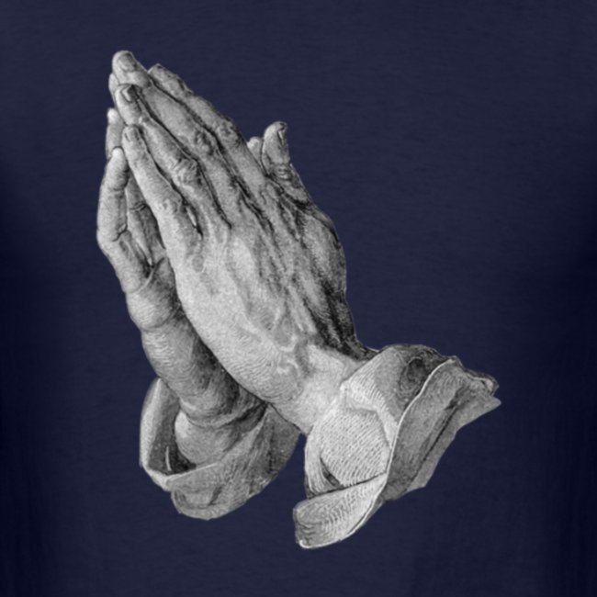
The Lord’s Prayer
BDES

Slide 14
• ACTIO •
BDES

Slide 15
• ACTIO •
Christ has no body now but yours.
Yours are the eyes with which He looks with compassion on the world.
Yours are the feet with which He walks to do good.
Yours are the hands with which He blesses His people.
BDES

Slide 16
• ACTIO •
Christ has no body now but yours.
Yours are the eyes with which He looks with compassion on the world.
Will you
help shepherd my people
?
Yours are the feet with which He walks to do good.
Yours are the hands with which He blesses His people.
BDES

