Slide 1
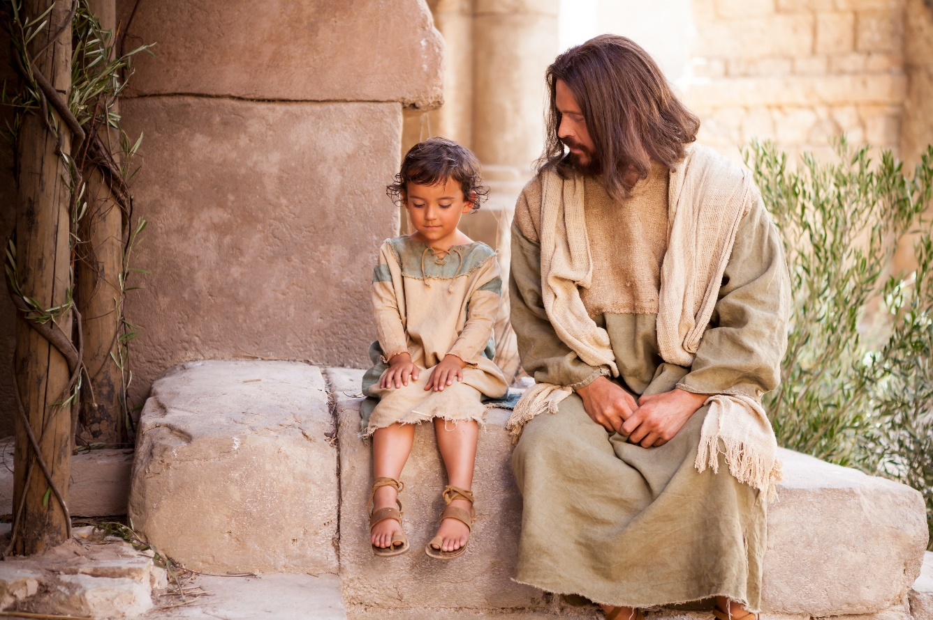
LECTIO DIVINA
Brentwood Diocese Education Service

Slide 2
The Sign of the Cross
BDES

Slide 3
Opening Prayer
Spirit of wisdom and understanding, enlighten our minds to perceive the mysteries of the universe in relation to eternity.
Spirit of right judgment and courage, guide us and make us firm in our baptismal decision to follow Jesus' way of love.
Spirit of knowledge and reverence, help us to see the lasting value of justice and mercy in our everyday dealings with one another. May we respect life as we work to solve problems of family and nation, economy and ecology.
Spirit of God, spark our faith, hope and love into new action each day. Fill our lives with wonder and awe in your presence which penetrates all creation. Amen.
BDES

Slide 4
Silent Reflection
BDES

Slide 5
• LECTIO •
Jesus and his disciples left from there and began a journey through Galilee, but he did not wish anyone to know about it.
He was teaching his disciples and telling them, “The Son of Man is to be handed over to men and they will kill him, and three days after his death the Son of Man will rise.”
But they did not understand the saying, and they were afraid to question him.
They came to Capernaum and, once inside the house, he began to ask them, “What were you arguing about on the way?”
BDES

Slide 6
• LECTIO •
But they remained silent. They had been discussing among themselves on the way who was the greatest.
Then he sat down, called the Twelve, and said to them,
“If anyone wishes to be first, he shall be the last of all and the servant of all.”
Taking a child, he placed it in their midst, and putting his arms around it, he said to them, “Whoever receives one child such as this in my name, receives me; and whoever receives me, receives not me but the One who sent me.”
BDES

Slide 7
• MEDITATIO •
REFLECTION
What God is saying to you?
Feel free to share ‘echoes’ of the text,
a phrase that strikes you.
If you wish, please say why.
BDES

Slide 8
• MEDITATIO •
Jesus and his disciples left from there and began a journey through Galilee, but he did not wish anyone to know about it.
He was teaching his disciples and telling them, “The Son of Man is to be handed over to men and they will kill him, and three days after his death the Son of Man will rise.”
But they did not understand the saying, and they were afraid to question him.
They came to Capernaum and, once inside the house, he began to ask them, “What were you arguing about on the way?”
But they remained silent. They had been discussing among themselves on the way who was the greatest.
Then he sat down, called the Twelve, and said to them, “If anyone wishes to be first, he shall be the last of all and the servant of all.”
Taking a child, he placed it in their midst, and putting his arms around it, he said to them, “Whoever receives one child such as this in my name, receives me; and whoever receives me, receives not me but the One who sent me.”
BDES

Slide 9
• MEDITATIO •
BDES

Slide 10
• ORATIO •
PRAYER
What would you like to say to God?
……..
Lord in your mercy …
R / Hear our prayer
BDES

Slide 11
• ORATIO •
BDES

Slide 12
• CONTEMPLATIO •
LET US
REST IN GOD
IN SILENCE
May the Holy Spirit deepen our awareness of the Word
BDES

Slide 13
• CONTEMPLATIO •
BDES

Slide 14
The Lord’s Prayer
BDES

Slide 15
• ACTIO •
Brentwood Diocese Education Service

