Slide 1
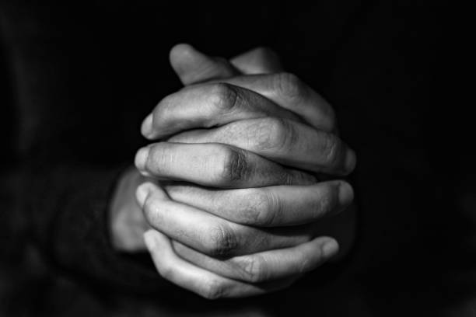
LECTIO DIVINA
Brentwood Diocese Education Service

Slide 2
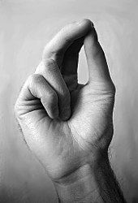
The Sign of the Cross
BDES

Slide 3
Opening Prayer
Holy Spirit,
Open my heart and my mind To Your inspired word,
That it might shape and direct my life
According to the Gospel of Jesus, the Lord.
I make this prayer to You In His name.
Amen.
BDES

Slide 4
Silent Reflection
BDES

Slide 5
• LECTIO •
Jesus said to his disciples : “In those days after that tribulation the sun will be darkened, and the moon will not give its light, and the stars will be falling from the sky, and the powers in the heavens will be shaken.
“And then they will see ‘the Son of Man coming in the clouds’ with great power and glory,
and then he will send out the angels and gather his elect from the four winds, from the end of the earth to the end of the sky.
BDES

Slide 6
• LECTIO •
“Learn a lesson from the fig tree. When its branch becomes tender and sprouts leaves, you know that summer is near.
“In the same way, when you see these things happening, know that he is near, at the gates.
Amen, I say to you, this generation will not pass away until all these things have taken place.
Heaven and earth will pass away, but my words will not pass away.
“But of that day or hour, no one knows, neither the angels in heaven, nor the Son, but only the Father.”
BDES

Slide 7
• LECTIO •
Jesus said to his disciples : “In those days after that tribulation the sun will be darkened, and the moon will not give its light, and the stars will be falling from the sky, and the powers in the heavens will be shaken.
“And then they will see ‘the Son of Man coming in the clouds’ with great power and glory,
and then he will send out the angels and gather his elect from the four winds, from the end of the earth to the end of the sky.
BDES

Slide 8
• LECTIO •
“Learn a lesson from the fig tree. When its branch becomes tender and sprouts leaves, you know that summer is near.
“In the same way, when you see these things happening, know that he is near, at the gates.
Amen, I say to you, this generation will not pass away until all these things have taken place.
Heaven and earth will pass away, but my words will not pass away.
“But of that day or hour, no one knows, neither the angels in heaven, nor the Son, but only the Father.”
BDES

Slide 9
• MEDITATIO •
REFLECTION
What God is saying to you?
Feel free to share ‘echoes’ of the text,
a phrase that strikes you.
If you wish, please say why.
BDES

Slide 10
• MEDITATIO •
BDES

Slide 11
• MEDITATIO •
Jesus said to his disciples : “In those days after that tribulation the sun will be darkened, and the moon will not give its light, and the stars will be falling from the sky, and the powers in the heavens will be shaken.
“And then they will see ‘the Son of Man coming in the clouds’ with great power and glory,
and then he will send out the angels and gather his elect from the four winds, from the end of the earth to the end of the sky.
“Learn a lesson from the fig tree. When its branch becomes tender and sprouts leaves, you know that summer is near.
“In the same way, when you see these things happening, know that he is near, at the gates.
Amen, I say to you, this generation will not pass away until all these things have taken place.
Heaven and earth will pass away, but my words will not pass away.
“But of that day or hour, no one knows, neither the angels in heaven, nor the Son, but only the Father.”
BDES

Slide 12
• ORATIO •
PRAYER
What would you like to say to God?
……..
Lord in your mercy …
R / Hear our prayer
BDES

Slide 13
• ORATIO •
BDES

Slide 14
• CONTEMPLATIO •
LET US
REST IN GOD
IN SILENCE
May the Holy Spirit deepen our awareness of the Word
BDES

Slide 15
• CONTEMPLATIO •
BDES

Slide 16
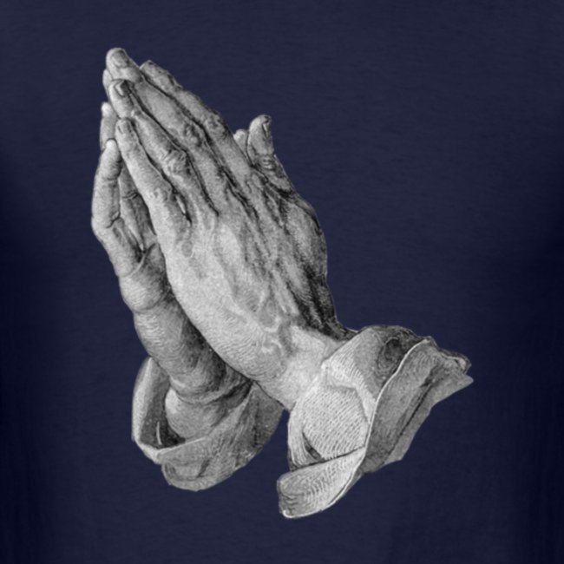
The Lord’s Prayer
BDES

Slide 17
• ACTIO •
BDES

