Slide 1
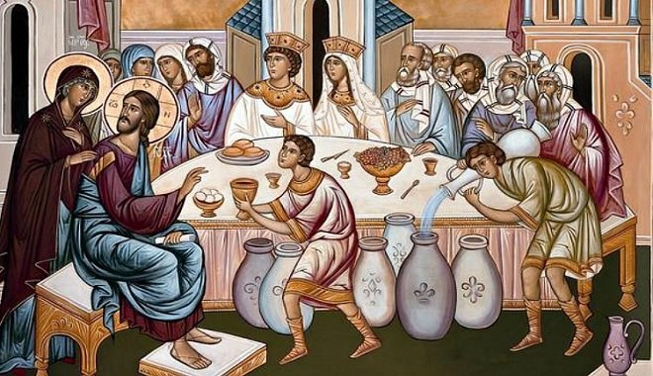
LECTIO DIVINA
Monday 10th January 2022
Brentwood Diocese Education Service

Slide 2
The Sign of the Cross
BDES

Slide 3
Opening Prayer
Father, anoint me with your Holy Spirit, so that as I read your eternal word, your word may penetrate my whole being and transform me. Grant me the blessing to be a faithful disciple in believing the Word of God and that I may be a light shining upon all who are in darkness. Amen.
St. Charles Borromeo
BDES

Slide 4
Silent Reflection
BDES

Slide 5
• LECTIO •
There was a wedding at Cana in Galilee. The mother of Jesus was there, and Jesus and his disciples had also been invited. When they ran out of wine, since the wine provided for the wedding was all finished, the mother of Jesus said to him, “They have no wine.” Jesus said. “Woman, why turn to me? My hour has not come yet”. His mother said to the servants, “Do whatever he tells you.” There were six stone water jugs standing there, meant for the ablutions that are customary among the Jews: each could hold twenty or thirty gallons. Jesus said to the servants, “Fill the jars with water,” and they filled them to the brim.
BDES

Slide 6
• LECTIO •
“Draw some out now” he told them “and take it to the steward.” They did this; the steward tasted the water, and it had turned into wine. Having no idea where it came from - only the servants who had drawn the water knew - the steward called the bridegroom and said, “People generally serve the best wine first, and keep the cheaper sort until the guests have had plenty to drink: but you have kept the best wine until now.”
This was the first of the signs given by Jesus: it was given at Cana in Galilee. He let his glory be seen, and his disciples believed in him.
BDES

Slide 7
• MEDITATIO •
REFLECTION
What God is saying to you?
Feel free to share ‘echoes’ of the text,
a phrase that strikes you.
If you wish, please say why.
BDES

Slide 8
Meditatio
There was a wedding at Cana in Galilee. The mother of Jesus was there, and Jesus and his disciples had also been invited. When they ran out of wine, since the wine provided for the wedding was all finished, the mother of Jesus said to him, “They have no wine.” Jesus said. “Woman, why turn to me? My hour has not come yet”. His mother said to the servants, “Do whatever he tells you.” There were six stone water jugs standing there, meant for the ablutions that are customary among the Jews: each could hold twenty or thirty gallons. Jesus said to the servants, “Fill the jars with water,” and they filled them to the brim.
“Draw some out now” he told them “and take it to the steward.” They did this; the steward tasted the water, and it had turned into wine. Having no idea where it came from - only the servants who had drawn the water knew - the steward called the bridegroom and said, “People generally serve the best wine first, and keep the cheaper sort until the guests have had plenty to drink: but you have kept the best wine until now.”
This was the first of the signs given by Jesus: it was given at Cana in Galilee. He let his glory be seen, and his disciples believed in him.
BDES

Slide 9
• ORATIO •
PRAYER
What would you like to say to God?
……..
Lord in your mercy …
R / Hear our prayer
BDES

Slide 10
• ORATIO •
BDES

Slide 11
• CONTEMPLATIO •
LET US
REST IN GOD
IN SILENCE
May the Holy Spirit deepen our awareness of the Word
BDES

Slide 12
• CONTEMPLATIO •
BDES

Slide 13
The Lord’s Prayer
BDES

Slide 14
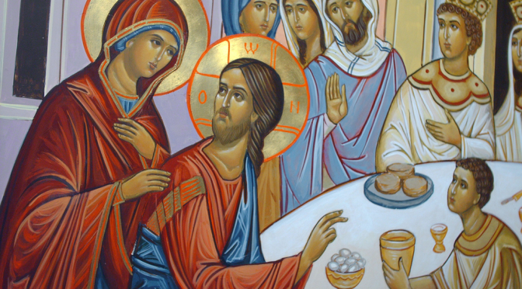
• ACTIO •
BDES

