Slide 1
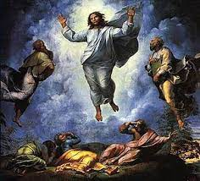
LECTIO DIVINA
Wednesday 23rd February 2022
Brentwood Diocese Education Service

Slide 2
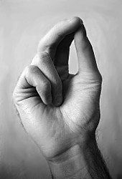
The Sign of the Cross
BDES

Slide 3
Opening Prayer
Father, anoint me with your Holy Spirit, so that as I read your eternal word, your word may penetrate my whole being and transform me. Grant me the blessing to be a faithful disciple in believing the Word of God and that I may be a light shining upon all who are in darkness. Amen.
St. Charles Borromeo
BDES

Slide 4
Silent Reflection
BDES

Slide 5
• LECTIO •
³⁸ John said to Jesus, “Teacher, we saw someone driving out demons in your name, and we tried to prevent him because he does not follow us.”
³⁹ Jesus replied, “Do not prevent him. There is no one who performs a mighty deed in my name who can at the same time speak ill of me.
⁴⁰ For whoever is not against us is for us.”
BDES

Slide 6
• LECTIO •
“³⁸ John said to Jesus, “Teacher, we saw someone driving out demons in your name, and we tried to prevent him because he does not follow us.”
³⁹ Jesus replied, “Do not prevent him. There is no one who performs a mighty deed in my name who can at the same time speak ill of me.
⁴⁰ For whoever is not against us is for us.”
.
BDES

Slide 7
• MEDITATIO •
REFLECTION
What God is saying to you?
Feel free to share ‘echoes’ of the text,
a phrase that strikes you.
If you wish, please say why.
BDES

Slide 8
Meditatio
³⁸ John said to Jesus, “Teacher, we saw someone driving out demons in your name, and we tried to prevent him because he does not follow us.”
³⁹ Jesus replied, “Do not prevent him. There is no one who performs a mighty deed in my name who can at the same time speak ill of me.
⁴⁰ For whoever is not against us is for us.”
BDES

Slide 9
• ORATIO •
PRAYER
What would you like to say to God?
……..
Lord in your mercy …
R / Hear our prayer
BDES

Slide 10
• ORATIO •
BDES

Slide 11
• CONTEMPLATIO •
LET US
REST IN GOD
IN SILENCE
May the Holy Spirit deepen our awareness of the Word
BDES

Slide 12
• CONTEMPLATIO •
BDES

Slide 13
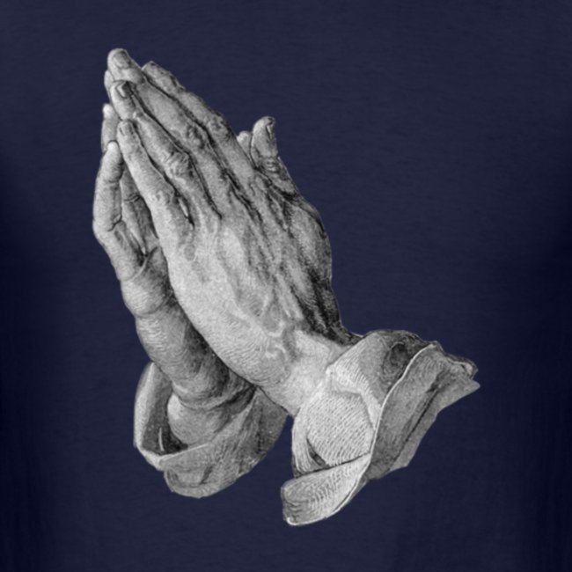
The Lord’s Prayer
BDES

Slide 14
• ACTIO •
BDES

