Slide 1
LECTIO DIVINA
Brentwood Diocese Education Service

Slide 2
LECTIO DIVINA
Brentwood Diocese Education Service

Slide 3
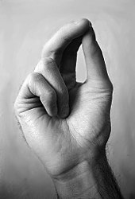
The Sign of the Cross
BDES

Slide 4
Opening Prayer
Breathe into me, Holy Spirit, that my thoughts may all be holy.
Move in me, Holy Spirit, that my work, too, may be holy.
Attract my heart, Holy Spirit, that I may love only what is holy.
Strengthen me, Holy Spirit, that I may defend all that is holy.
Protect me, Holy Spirit, that I may always be holy.
Let me be open and receptive to Your Holy Word.
Amen.
BDES

Slide 5
Silent Reflection
BDES

Slide 6
• LECTIO •
Jesus said to his disciples: “I have much more to tell you, but you cannot bear it now.
But when he comes, the Spirit of truth, he will guide you to all truth. He will not speak on his own, but he will speak what he hears and will declare to you the things that are coming.
BDES

Slide 7
• LECTIO •
He will glorify me because he will take from what is mine and declare it to you.
Everything that the Father has is mine; for this reason, I told you that he will take from what is mine and declare it to you.”
BDES

Slide 8
• LECTIO •
Jesus said to his disciples: “I have much more to tell you, but you cannot bear it now.
But when he comes, the Spirit of truth, he will guide you to all truth. He will not speak on his own, but he will speak what he hears and will declare to you the things that are coming.
BDES

Slide 9
• LECTIO •
He will glorify me because he will take from what is mine and declare it to you.
Everything that the Father has is mine; for this reason, I told you that he will take from what is mine and declare it to you.”
BDES

Slide 10
• LECTIO •
Jesus said to his disciples: “I have much more to tell you, but you cannot bear it now.
But when he comes, the Spirit of truth, he will guide you to all truth. He will not speak on his own, but he will speak what he hears and will declare to you the things that are coming.
He will glorify me because he will take from what is mine and declare it to you.
Everything that the Father has is mine; for this reason, I told you that he will take from what is mine and declare it to you.”
BDES

Slide 11
• MEDITATIO •
REFLECTION
What God is saying to you?
Feel free to share ‘echoes’ of the text,
a phrase that strikes you.
If you wish, please say why.
BDES

Slide 12
• MEDITATIO •
BDES

Slide 13
• MEDITATIO •
Jesus said to his disciples: “I have much more to tell you, but you cannot bear it now.
But when he comes, the Spirit of truth, he will guide you to all truth. He will not speak on his own, but he will speak what he hears and will declare to you the things that are coming.
He will glorify me because he will take from what is mine and declare it to you.
Everything that the Father has is mine; for this reason, I told you that he will take from what is mine and declare it to you.”
BDES

Slide 14
• ORATIO •
PRAYER
What would you like to say to God?
……..
Lord in your mercy …
R / Hear our prayer
BDES

Slide 15
• ORATIO •
BDES

Slide 16
• CONTEMPLATIO •
LET US
REST IN GOD
IN SILENCE
May the Holy Spirit deepen our awareness of the Word
BDES

Slide 17
• CONTEMPLATIO •
BDES

Slide 18
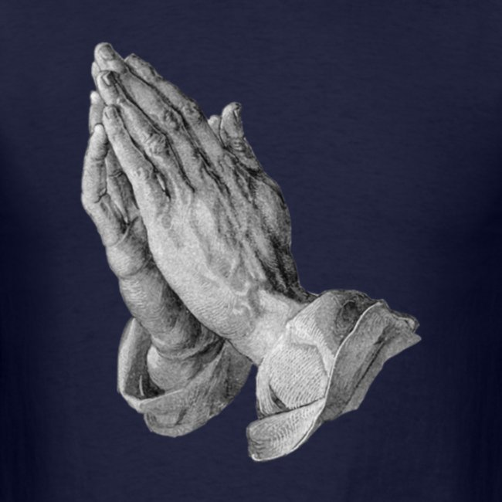
The Lord’s Prayer
BDES

Slide 19
• ACTIO •
Brentwood Diocese Education Service

Slide 20
• ACTIO •
BDES

