Slide 1
Looking Forward
~ Looking Forward in Prayer ~
Monday 13th June 2022
Brentwood Diocese Education Service

Slide 2
Looking Forward in Prayer
~ In the Year of the Family ~
Glory be to the Father, Who by His almighty power and love created me, making me in the image and likeness of God. Glory be to the Son, Who by His Precious Blood delivered me from hell, and opened for me the gates of heaven. Glory be to the Holy Spirit, Who continues to sanctify me by the graces I receive daily from His bounty. Glory be to the Three adorable Persons of the Holy Trinity, now and forever. Amen.
BDES

Slide 3
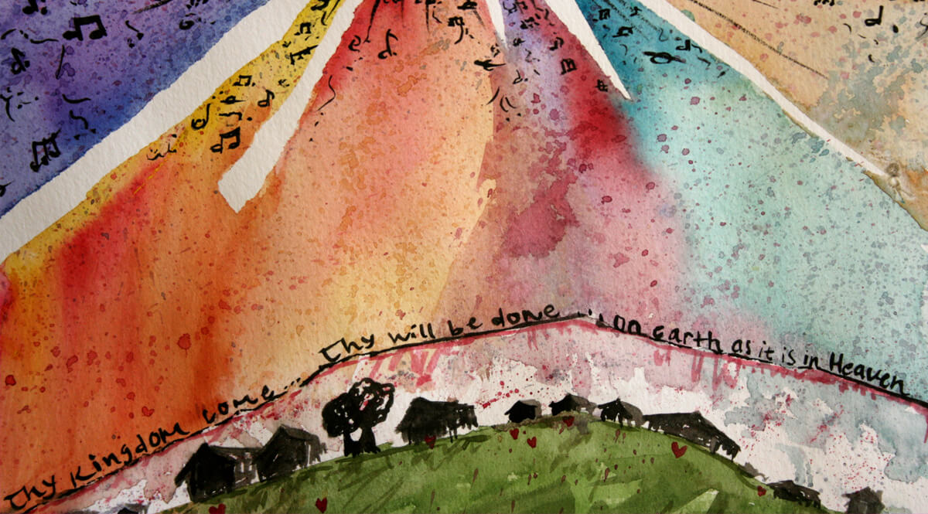
Reflection
Thy Kingdom come
BDES

Slide 4
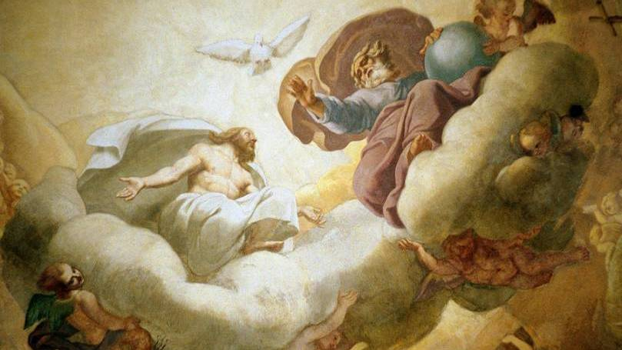
~ Trinity Sunday ~ 12th June ~
BDES

Slide 5
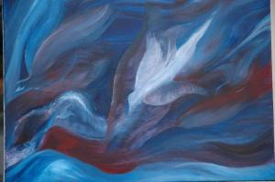
The Synoptic Problem
In Sunday’s Gospel Reading …
12th June 2022
In the Gospel of John, Jesus tells us of the Holy Spirit :
“He will guide you to all truth.”
BDES

Slide 6
Preparing for World Youth Day 2023
“With the freedom of Jesus, we find the courage we need to swim against the current.”
- Pope Francis, Youth Sunday Mass 2021
BDES

Slide 7
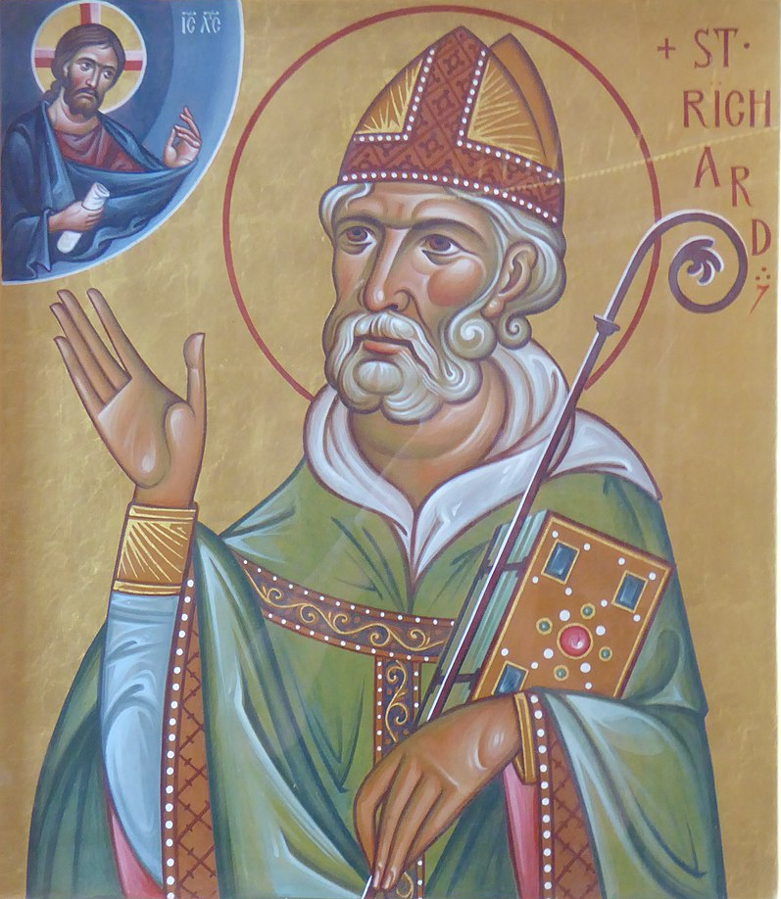
St Richard of Chichester
~ Feast Day 16th June 2022 ~
St Richard was bishop of Chichester in West Sussex from 1244 until his death in 1253. He lived a simple life, refused to eat off silver platters and was a vegetarian since his student days at Oxford. His tomb became a shrine and place of pilgrimage and he was declared a saint only 9 years after he died. Sadly, his shrine was destroyed on the orders of Thomas Cromwell during the Reformation.
St Richard’s feast day is usually on 3rd April but is marked in our diocesan calendar on the alternate date of 16th June this year, 3rd April having fallen on a Sunday. This alternate feast day is also celebrated annually as Sussex Day, as St Richard is the patron saint of the county.
BDES

Slide 8
Names of diocesan schools # 27 : Trinity
Trinity Catholic High School in Woodford was established in 1976 by merging St Mary’s Grammar School and St Paul’s Secondary Modern School.
The school’s motto means :
“In Christ we shall flourish.”
“Here is the Father to whom I pray with the Our Father; there is the Son, who gave me redemption, justification; there is the Holy Spirit who lives in us and inhabits the Church. And this speaks to our heart because we find it encompassed in that expression of Saint John which summarizes all of Revelation: “God is love” (1 Jn 4:8-16). The Father is love; the Son is love; the Holy Spirit is love.”
- Pope Francis, Trinity Sunday 2021
BDES

Slide 9
Looking Forward
~ Looking Forward in Prayer ~
Monday 13th June 2022
Brentwood Diocese Education Service

