Slide 1
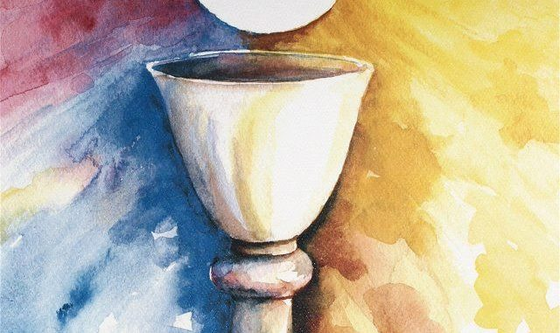
Looking Forward
~ Looking Forward in Prayer~
Monday 20th June 2022
Brentwood Diocese Education Service

Slide 2
Looking forward in Prayer
~ In the Year of the Family ~
We have just celebrated the feast of Corpus Christi.
This feast is concerned with the joy of the Eucharist.
When Jesus instituted the Eucharist on Maundy Thursday he also washed the feet of the disciples as an example of service.
How do you celebrate the joy of the Eucharist and offer service to others?
BDES

Slide 3
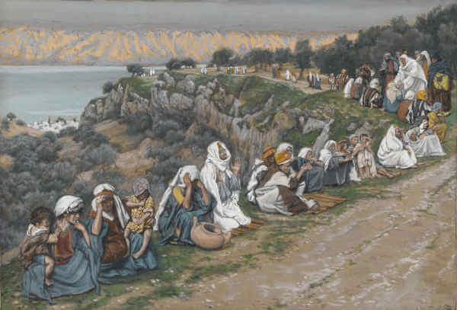
The Synoptic Problem
In Sunday’s Gospel Reading …
Sunday 19th June 2022 :
The Gospel of Luke says :
“He healed those who needed to be cured.”
BDES

Slide 4
Reflection
Thy will be done on earth as it is in Heaven.
BDES

Slide 5
Preparing as communities for World Youth Day 2023
“Continue to dream even when you get older.”
- Pope Francis, Youth Sunday Mass 2021
BDES

Slide 6
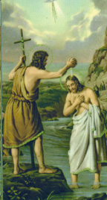
23rd June : Feast of the
Nativity of St John the Baptist
St John the Baptist was a preacher who according to the Gospels fulfilled the prophecy of Isaiah which described a voice crying in the wilderness.
The Gospel of Luke shows Mary visiting Elizabeth and the child in her womb leapt for joy.
John spent his time preaching and baptising.
He is subsequently executed by beheading at the instruction of Herod. His body was reputed to be buried in Palestine but what became of his head is more difficult to establish with several different places claiming to have it.
BDES

Slide 7
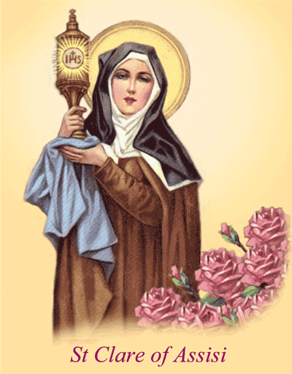
Saints and Schools # 28 : St Clare
Clare of Assisi was born Chiara Offreduccio and her name is sometimes spelled Clara, Clair, Claire, Sinclair. She was born on 16 July 1194 and died on 11 August 1253.
She was one of the first followers of Francis of Assisi who founded the Order of Poor Ladies, a monastic religious order for women. This was following the Franciscan tradition,. St Clare wrote their Rule of Life, the first set of monastic guidelines known to have been written by a woman.
Following her death, the order she founded was renamed in her honour as the Order of Saint Clare, commonly referred to today as the Poor Clares.
In the diocese of Brentwood,
There is a school and nursery named after St Clare.
This is a school where :
With Jesus we learn to love and love to learn.
BDES

Slide 8
Looking Forward
~ Looking Forward in Prayer~
Monday 20th June 2022
Brentwood Diocese Education Service

