Slide 1
Looking Forward
~ Looking Forward in Prayer ~
Monday 27th June 2022
Brentwood Diocese Education Service

Slide 2
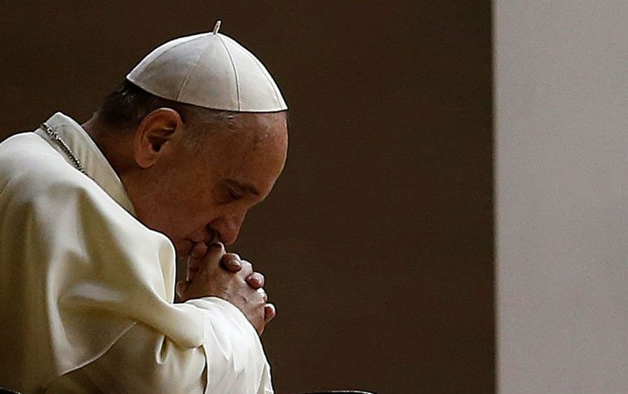
Looking Forward in Prayer
God our Father,
I offer you my day.
I offer You my prayers,
thoughts, words, actions, joys, and sufferings
in union with the Heart of Jesus,
who continues to offer Himself in the Eucharist
for the salvation of the world.
May the Holy Spirit, Who guided Jesus,
be my guide and my strength today
so that I may witness to your love.
Amen.
- Pope Francis, May 2022
BDES

Slide 3
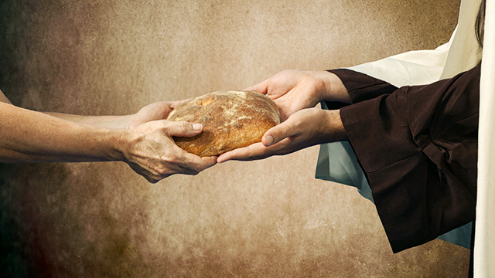
Reflection
Give us this day our daily bread
BDES

Slide 4
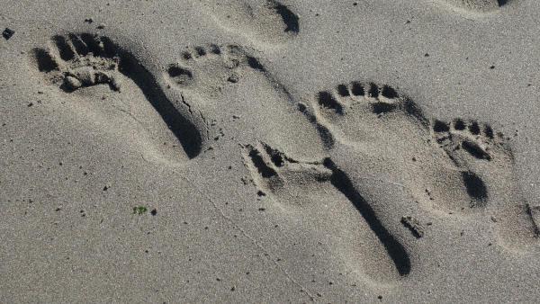
The Synoptic Problem
In Sunday’s Gospel Reading …
26th June 2022
In the Gospel of Luke, a disciple says to Jesus :
“I will follow you wherever you go.”
BDES

Slide 5
Preparing for World Youth Day 2023
“Be free and authentic.”
- Pope Francis, Youth Sunday Mass 2021
BDES

Slide 6
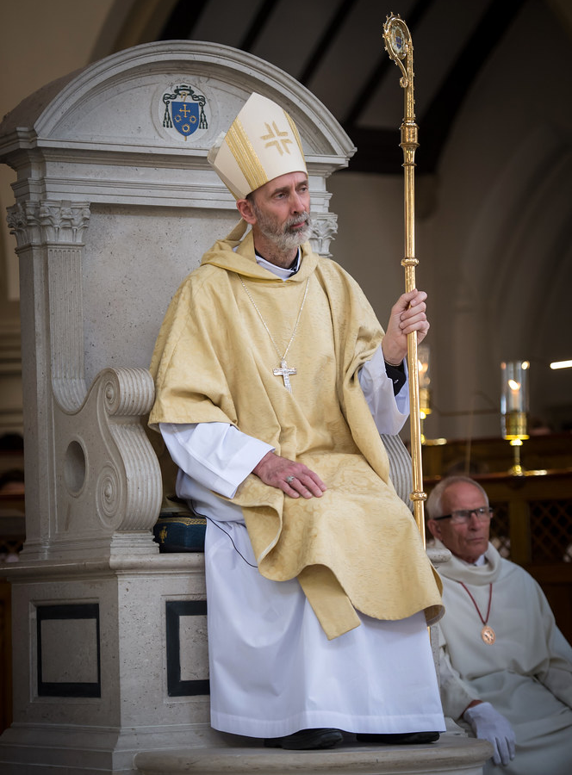
Anniversary of the Episcopal Ordination
of Bishop Alan Williams SM : 1st July
There are 20 Masses “For the Holy Church” in the Roman Missal, among them a Mass for the anniversary of the consecration of a bishop.
Bishop Alan was ordained as Bishop of Brentwood by Cardinal Vincent Nichols, Archbishop of Westminster, on 1st July 2014. The cardinal recalled the words of Pope Francis in his address to the Congregation of Bishops in the same year : “From the lips of the church comes the cry, give us a Bishop, one who can lift us up. Don't send us a manager or a delegate from the agency. We need someone who knows how to reach up to the gaze of God.”
We pray for Bishop Alan on this special day.
BDES

Slide 7
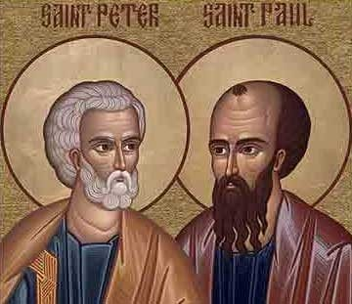
Saints Peter and Paul
Solemnity : 29th June
Wednesday 29th June is a Holy Day of Obligation
St. Peter and Paul’s day is the feast day that honours the martyrdom of the two saints, sometime between AD 64 and 68. While the Church recognizes that they may not have died on the same day, tradition says that this is the day that they were both martyred in Rome by Emperor Nero.
The day is a solemnity or a feast day of the highest rank. This honour is reserved for only the most important events, such as those in the lives of Jesus or Mary. Therefore this xxxx emphasizes just how important the two saints are to the Catholic faith.
BDES

Slide 8
St Oliver Plunket ~ 1st July ~
St Oliver Plunket (1625–1681) was the Catholic Archbishop of Armagh and Primate of All Ireland who fell victim to the anti-Catholic hate campaign of Titus Oates, who invented a fictitious conspiracy, the Popish Plot, in order to incite people against Catholics. 22 people, including Archbishop Plunket, were executed on false charges before Oates was arrested and convicted of perjury.
When anti-Catholic laws were relaxed after the Restoration of Charles II in 1660, the archbishop was able to move to Ireland and establish the first integrated school in the country, where Catholics and Protestants learned side by side. His ministry was an immediate success : in only 4 years he confirmed 48,000 Catholics.
Archbishop Plunket was beatified in 1920 and xxxxxxx canonised in 1975, the first new Irish saint in almost xx 700 years.
BDES

Slide 9
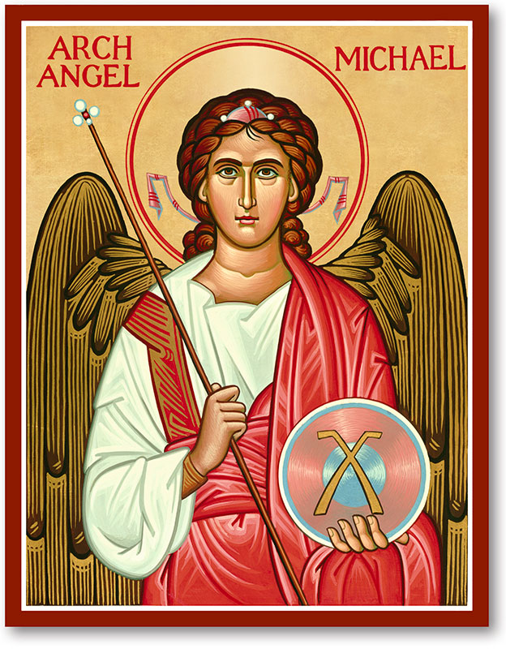
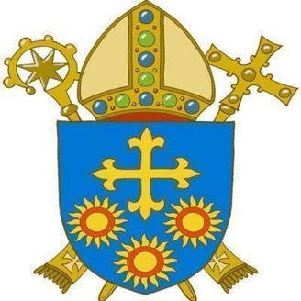
Saints and schools # 29 : St Michael
St Michael’s Catholic School in the diocese of Brentwood has served the people of East Ham since 1926.
Its Mission Statement is :
“In the footsteps of Jesus, we strive to achieve excellence in everything we do.”
The name Michael comes from the Hebrew and can mean “Who is like God?” or “Gift from God”. The archangel Michael is mentioned in the Book of Revelation (12 : 7-12) where he does battle with Satan, and in the Letter of St Jude (1 : 9), where he rebukes the Devil. St Michael is depicted as a warrior angel and people pray to him to stand by them in their own struggles.
BDES

Slide 10
Looking Forward
~ Looking Forward in Prayer ~
Monday 27th June 2022
Brentwood Diocese Education Service

