Slide 1
Looking Forward
~ Looking Forward in Prayer~
Monday 4th July 2022
Brentwood Diocese Education Service

Slide 2
Looking Forward in Prayer
We are looking forward in prayer to the coming of the Kingdom.
We pray in a variety of ways, both silently and out loud,
using our own words or those of traditional prayers.
When we pray we are conversing with God.
Think about how you talk to God,
when you give thanks,
when you ask God for something,
when say you are sorry
or when you praise Him.
BDES

Slide 3
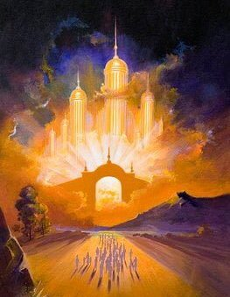
The Synoptic Problem
In Sunday’s Gospel Reading …
Sunday 3rd July 2022 :
In the Gospel of Luke, Jesus tells us :
“The Kingdom of God is close at hand.”
BDES

Slide 4
Reflection
Forgive us our trespasses,
as we forgive
those who trespass against us.
BDES

Slide 5
Preparing as communities for World Youth Day 2023
“Be the critical conscience of society.”
- Pope Francis, Youth Sunday Mass 2021
BDES

Slide 6
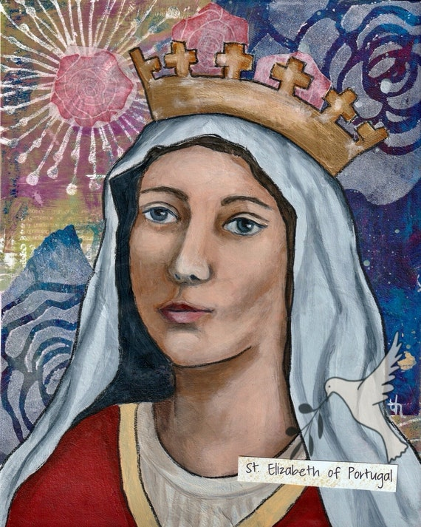
4th July : St Elisabeth of Portugal
St Elisabeth of Portugal was born in 1272 into the royal house of Aragon (now part of Spain).
She was brought up in a very religious way and was devoted to looking after the poor and sick. Her goodness and generosity eventually influenced those around her, including her husband who had previously treated her badly. On his death she joined the community of the Poor Clare nuns in Coimbra.
She intervened a number of times to prevent conflict and was given the title of ‘Peacemaker’. She became a saint in 1625; during her lifetime the miracle of the roses was credited to her when bread she was taking to the poor, against the wishes of her husband, was miraculously turned into roses. This took place xxx in the winter chill of January. Her husband, much xxxxx ashamed, had to allow her to continue.
BDES

Slide 7
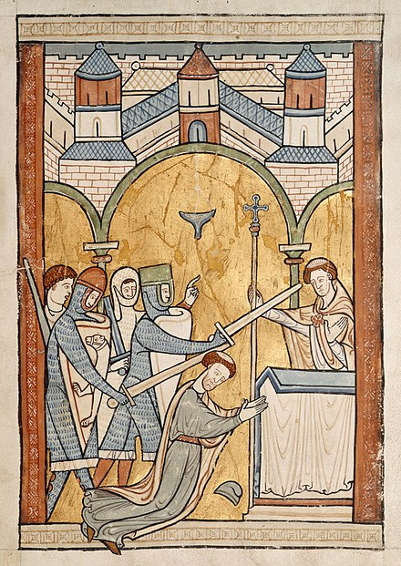
Saints and Schools # 30 : St Thomas of Canterbury
St Thomas of Canterbury. also know as Thomas Becket, was murdered in Canterbury Cathedral on 29th December 1170. He was born in London and became a clerk in Archbishop Theobald's household where he was given important missions abroad, including to Rome. He then became the Chancellor of England which meant that he was responsible for ensuring the money due to the king was collected. He was elected Archbishop of Canterbury, becoming a vigorous supporter of Church rights. This led him into conflict with King Henry II and resulted in Becket leaving England. When he returned from exile Henry said words which suggested he wanted Thomas killed. Four knights murdered Thomas in the cathedral. Following his death, miracles occurred at his shrine and Henry came and did penance the following year.
Our Catholic primary school in Grays is named after the Saint.
There, children learn, achieve and love, following Jesus.
BDES

Slide 8
Looking Forward
~ Looking Forward in Prayer~
Monday 4th July 2022
Brentwood Diocese Education Service

