Slide 1
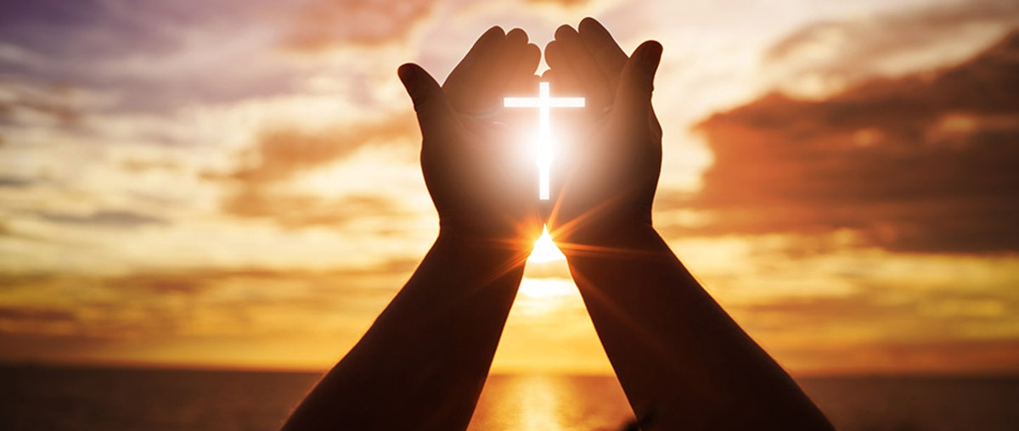
Looking Forward
~ Looking Forward in Prayer ~
Monday 11th July 2022
Brentwood Diocese Education Service

Slide 2
Looking Forward in Prayer
Did you eat a banana with your breakfast this morning?
Have you enjoyed a cup of tea or coffee or juice today?
Did you need petrol to get a bus or a lift by car to school?
Countless other activities that we take for granted would be impossible
without the community of seafarers who deliver these goods and products to our shores. 95 % of the goods and products we consume are brought to Britain by sea.
On Sunday, we celebrated Sea Sunday.
Let us pray for our brothers and sisters who sail the seas to bring us what we need.
Our Lady, Star of the Sea,
pray for us all.
BDES

Slide 3
Reflection
Lead us not into temptation
BDES

Slide 4
The Synoptic Problem
In Sunday’s Gospel Reading …
10th July 2022
In the Gospel of Luke, Jesus teaches us :
“Love your neighbour as yourself.”
BDES

Slide 5
Preparing for World Youth Day 2023
“Be passionate about truth.”
- Pope Francis, Youth Sunday Mass 2021
BDES

Slide 6
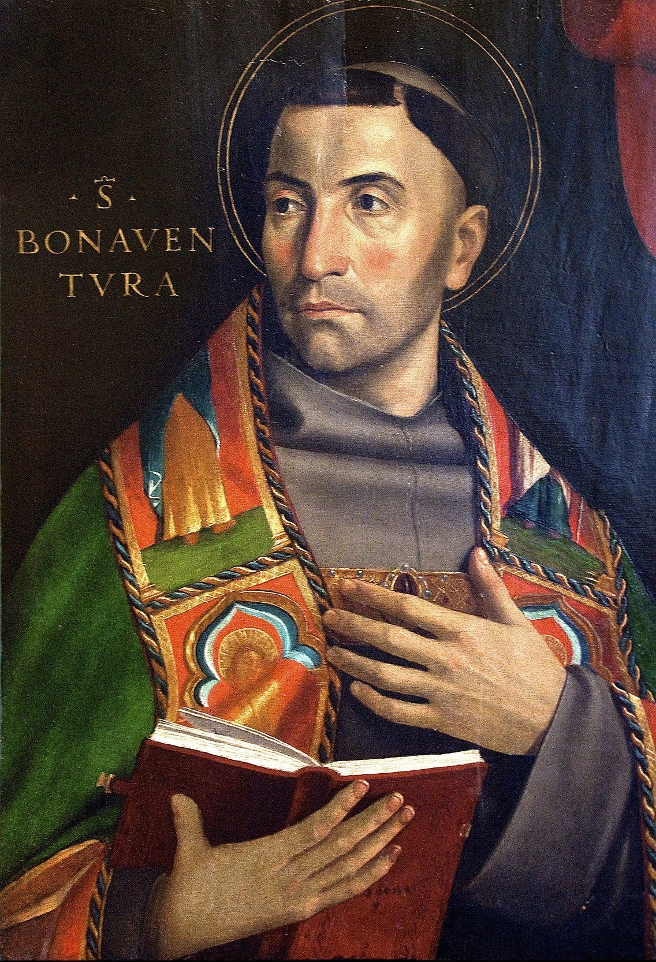
Saint Bonaventure
Feast Day : 15th July
St. Bonaventure (1221-1274) was actually born as Giovanni di Fidanza and became the seventh Minister General of the Franciscans, who gave him the name Bonaventura, meaning “good fortune.” He was a scholar of the University of Paris, and is regarded as one of the greatest philosophers of the Middle Ages. Canonised in 1484, he was declared to be one of the Doctors of the Church in 1587 by the Franciscan pope Sixtus V. St Bonaventure’s School in Forest Gate was founded in 1877 and named in his honour.
BDES

Slide 7
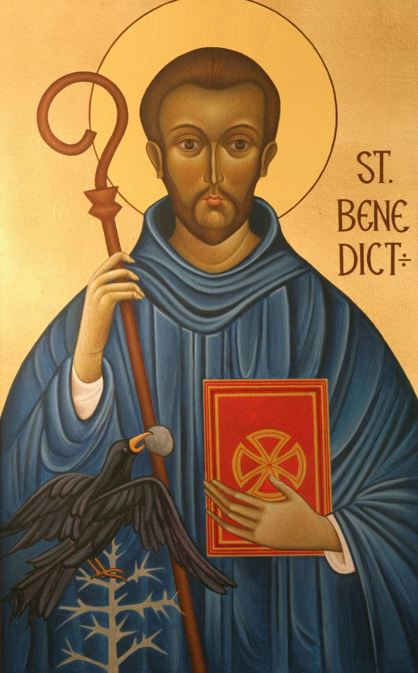
Saints and schools # 31 : St Benedict
St Benedict’s Catholic College was founded in Colchester in 1963 and serves a large area of North Essex. It takes as its motto St Benedict’s Rule to “work and pray” :
ORA ET LABORA
St Benedict (480-548) founded 12 monasteries at Subiaco before moving on to found the great monastery of Monte Cassino. His Rule for his followers and communities is based on a spirit of balance, moderation and common sense. His feast day is this week, on 11th July. In 19080 Pope John Paul II declared St Benedict to be one of the patron saints of Europe.
BDES

Slide 8
Looking Forward
~ Looking Forward in Prayer ~
Monday 11th July 2022
Brentwood Diocese Education Service

