Slide 1
Looking Forward
~ Looking Forward in Prayer~
Monday 18th July 2022
Brentwood Diocese Education Service

Slide 2
Looking Forward in Prayer
The Gospel this week tells the story of sisters Martha and Mary.
Martha appears as someone who is always busy,
Mary as the one who is contemplative.
Martha is a doer, Mary is a thinker.
Ignatius of Loyola,
who founded the Jesuits, came up with the phrase
contemplative in action.
Angela Merici, who established the Ursulines,
also saw the link between prayer and action.
How do you combine the two?
BDES

Slide 3
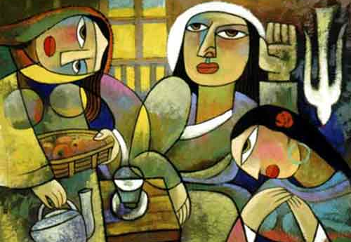
The Synoptic Problem
In Sunday’s Gospel Reading …
Sunday 17th July 2022 :
In the Gospel of Luke, we hear :
“She sat beside the Lord and listened to Him speak.”
BDES

Slide 4
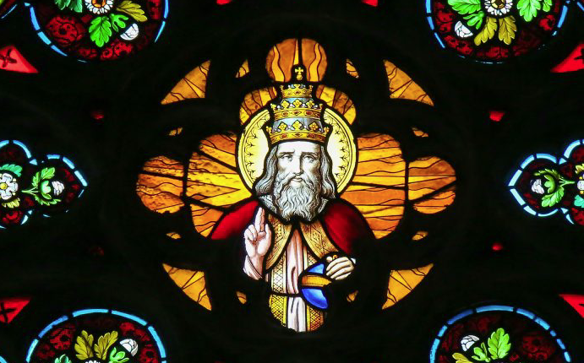
Reflection
Deliver us from evil.
BDES

Slide 5
Preparing as communities for World Youth Day 2023
“In your dreams, you can say : my life is not captive to the mindset of the world.”
- Pope Francis, Youth Sunday Mass 2021
BDES

Slide 6
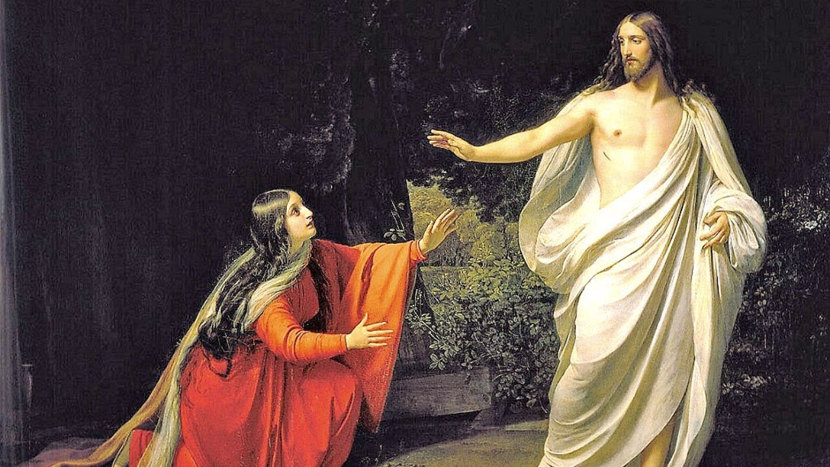
22nd July : St Mary Magdalene
Mary Magdalene appears in the Gospels as one of the women who travel with Jesus. She was present at his crucifixion in all four Gospels and is at his burial according to all except John. She is first to witness the empty tomb and Jesus’ resurrection.
In 2016 Pope Francis raised 22nd July to the status of a feast day and Mary Magdalene to be referred to as ‘The Apostle of the apostles.’
Mary Magdalene was a real figure but we do not hear from her directly as she left no writings. She was healed by Jesus and it may be that she was wealthy. In the Gospel of Matthew an angel tells Mary and the other women that Jesus has risen and then Jesus himself appears to them. In John’s Gospel Mary greets the risen Jesus with the title ‘Rabbouni’ meaning ‘ my teacher’. She is sent to the apostles to tell them the Good News, hence her title as ‘Apostle of the apostles’.
BDES

Slide 7
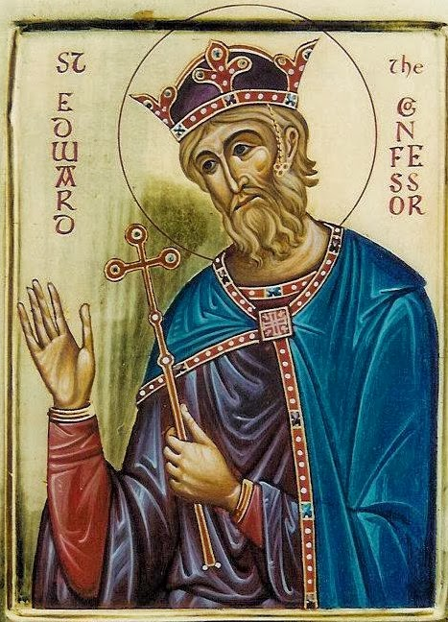
Saints and Schools # 32 : St Edward the Confessor
St Edward the Confessor built the abbey of St Peter, now better known as Westminster Abbey. He became king of England in 1042 and his reign was relatively peaceful.
He was very pious, very saintly and involved in Church affairs. For this he was called Edward ‘the Confessor’, to differentiate him from his uncle King Edward the Martyr.
He died at the start of 1066 and his death set in chain one of the significant events of English history resulting in the Battle of Hastings.
He was made a saint in 1161 by Pope Alexander III.
St Edward’s Catholic Primary School at Upton Park is named after the Saint.
The school is situated in a diverse community in East London.
The children there follow Christ to reach their goals.
BDES

Slide 8
Looking Forward
~ Looking Forward in Prayer~
Monday 18th July 2022
Brentwood Diocese Education Service

