Slide 1
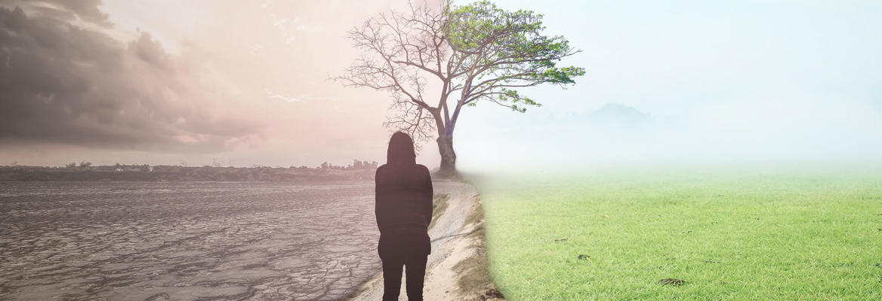
Looking Forward
~ Looking Forward in Hope ~
Monday 29th August 2022
Brentwood Diocese Education Service

Slide 2
Looking Forward in Hope
Lord Jesus,
I ask for Your help as I begin this new school year.
Allow me to experience Your presence in the many blessings You put before me.
Open my eyes to the new challenges and exciting opportunities
that this new school year brings.
Open my heart and mind to new friends and new teachers.
Give me a generous spirit to be enthusiastic with my studies
and courage to embrace what is new with a happy heart.
Help me to be attentive to my lessons
and let me experience Your presence in the people I meet.
Inspire me to do my best this year!
Amen
BDES

Slide 3
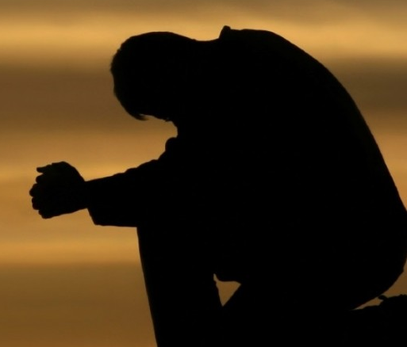
Reflection on the Creed
I
believe
in
One
God
BDES

Slide 4
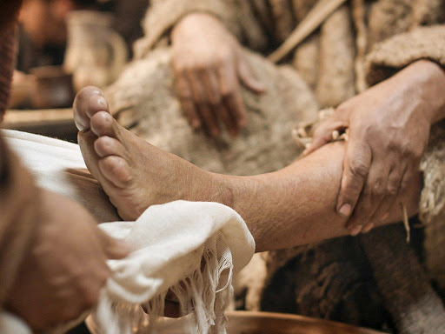
The Synoptic Problem
In Sunday’s Gospel Reading …
28th July 2022
In the Gospel of Luke, Jesus teaches us :
“The one who humbles himself will be exalted.”
BDES

Slide 5
World Day of Prayer for the Care of Creation : 1st September
Father of all, Creator and ruler of the universe, You entrusted your world to us as a gift. Help us to care for it and all people, that we may live in right relationship – with You, with ourselves, with one another, and with creation.
BDES

Slide 6
Preparing for World Youth Day 2023
“Always know in your heart
that God is
by your side.”
- Pope Francis, World Youth Day 2021
BDES

Slide 7
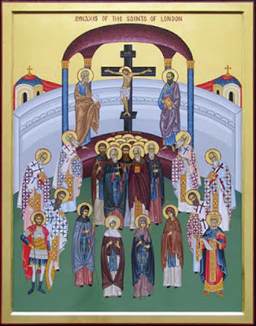
Saint Sebbi of Essex
29th August
Sebbi was King of Essex from 664 until 694 AD. According to St Bede, he was given to “religious action, almsgiving, and frequent prayer, preferring a private and monastic life to all the wealth and honours of his kingdom.” His brother and joint-king Sighere fell back into pagan worship and took many people with him but Sebbi remained a loyal Christian and re-established the faith. He was buried in St Paul’s but his tomb was lost in the Great Fire of London. He is now commemorated in a plaque in Sir xxx Christopher Wren’s magnificent cathedral.
St Sebbi is amongst the saints of London.
He was buried in Old St Paul’s Cathedral.
BDES

Slide 8
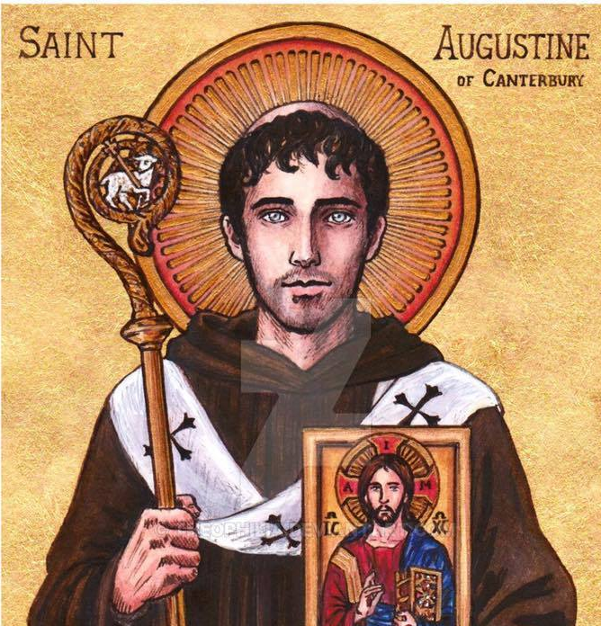
Saints and schools # 33 : St Augustine
St Augustine (d. 604 AD) was originally a monk who became the first Archbishop of Canterbury after being sent by Pope Gregory the Great to England to convert the Angles, Jutes and Saxons. He is known as the “Apostle to the English” and is considered to be the founder of the English Church.
St Augustine’s Catholic Primary School opened in 1938. Its early years were disturbed by war, bombing and evacuation. After World War II it grew and grew until it became the school it is today. Their mission : Following Jesus, our school family shows love and respect for one another and the world around us.
BDES

Slide 9
Looking Forward
~ Looking Forward in Hope ~
Monday 29th August 2022
Brentwood Diocese Education Service

