Slide 1
Looking Forward
~ Looking Forward in Hope~
Monday 5th September 2022
Brentwood Diocese Education Service

Slide 2
Looking Forward in Hope
As the new school year starts,
we are looking forward in hope
to what the year will bring.
We hope that we will be happy and successful.
Throughout the year,
we need to keep going
and tackle the things we find a challenge.
The Gospel this week describes
how, to be a follower of Jesus,
we need to carry our own cross.
BDES

Slide 3
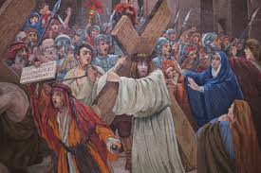
The Synoptic Problem
In Sunday’s Gospel Reading …
Sunday 4th September 2022 :
In the Gospel of Luke, we hear :
“Whoever does not carry his own cross and come after me cannot be my disciple.”
BDES

Slide 4
Reflection on the Creed
I believe in the Father Almighty, the Maker of Heaven and Earth, of all things visible and invisible.
BDES

Slide 5
Preparing as communities for World Youth Day 2023
“God never abandons you.”
- Pope Francis, World Youth Day 2013
BDES

Slide 6
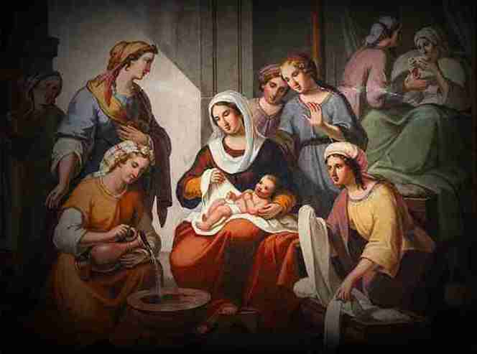
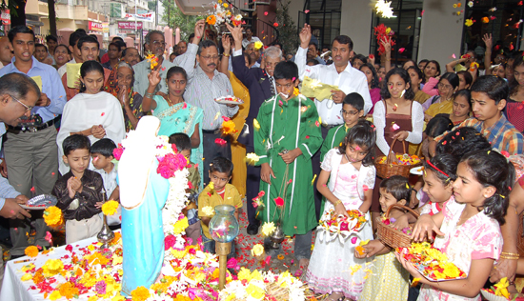
8th September: Nativity of the Virgin Mary
This feast day celebrates the birth of the Virgin Mary the mother of Jesus.
It is celebrated nine months after the feast of the Immaculate Conception, meaning that Mary did not have the stain of original sin on her soul.
There are celebrations in September in different parts of the world.
In France, this time of year is celebrated as ‘Our Lady of the Grape Harvest’ and in different parts of India there are different customs, including holding festive meals and showering flowers on a statue of Mary.
BDES

Slide 7
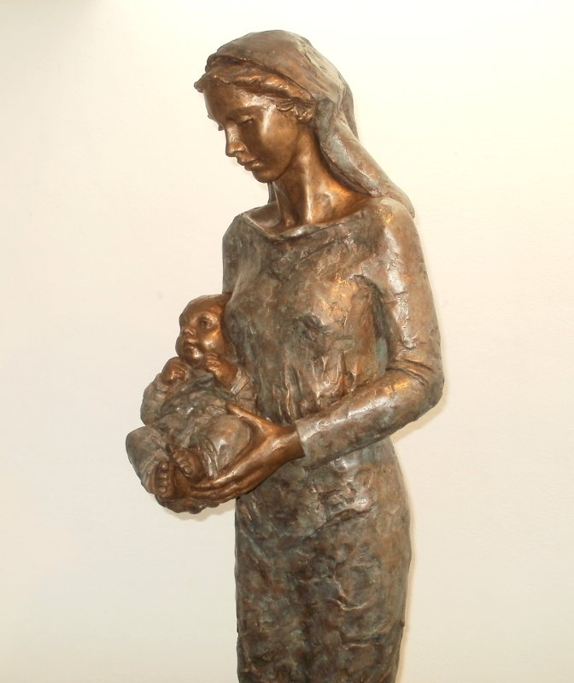
Saints and Schools # 34 : St Mary
There are many schools in the Diocese of Brentwood named after Our Lady.
The schools at Chingford, Tilbury and Hare Park are all called St Mary’s.
BDES

Slide 8
Looking Forward
~ Looking Forward in Hope~
Monday 5th September 2022
Brentwood Diocese Education Service

