Slide 1
Looking Forward
~ Looking Forward in Hope ~
Monday 12th September 2022
Brentwood Diocese Education Service

Slide 2
Looking Forward in Hope
May the Lord show you the greatness of his goodness,
that you overflow with thanks every day.
May the Lord bless you abundantly with rest for the heart,
power for virtue, wisdom for life,
and patience in suffering.
May the Lord bless you with joyful hope,
and one day with the inexpressible joys of eternal life.
BDES

Slide 3
Reflection on the Creed
I believe in one Lord, Jesus Christ,
the Only Begotten Son of God,
born of the Father before all ages.
BDES

Slide 4
The Synoptic Problem
In Sunday’s Gospel Reading …
11th September 2022
In the Gospel of Luke, we hear :
“Everything I have is yours.”
BDES

Slide 5
Education Sunday : 11th September
We pray that all pupils and students know they are beloved children of God. May they journey through school, supporting one another through life’s joys and hardships. At the beginning of this academic year, may they be filled with courage and hope to face the new, exciting and challenging experiences ahead of them.
- Catholic Bishops of England and Wales
BDES

Slide 6
Preparing for World Youth Day 2023
“Let us never lose hope!”
- Pope Francis, World Youth Day 2013
BDES

Slide 7
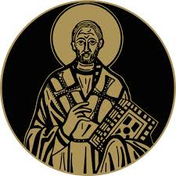
St John Chrysostom
13th September
St John, who lived 347-407 AD in Antioch, was known as Chrysostomos (“Golden Mouth”) on account of his gift of eloquence. He was a gifted public speaker at the Golden Church of Antioch, interpreting Scripture and preaching compassion for the poor. He became Archbishop of Constantinople
in 397, reformed the clergy and founded several hospitals. He lived a simple life but made political enemies on account of his preaching and was banished. One of his celebrated teachings is that “prayer without almsgiving is unfruitful.”
BDES

Slide 8
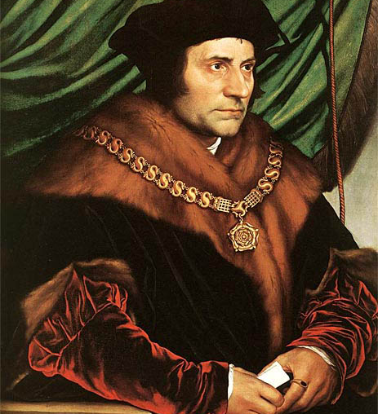
Saints and schools # 35 : St Thomas More
St Thomas More was put to death on the orders of Henry VIII for refusing to accept Henry as Supreme Head of the Church in England.
He was executed in the Tower of London and buried in the church of St Peter ad Vincula inside the walls of the Tower.
St Thomas was made a saint in 1935 and his feast was fixed on 22nd June.
Before he was martyred, More is reported to have said “I die the King’s good servant, but God’s first”.
The Diocese of Brentwood has three schools named after St Thomas More, in Colchester, Saffron Walden and Southend.
BDES

Slide 9
Looking Forward
~ Looking Forward in Hope ~
Monday 12th September 2022
Brentwood Diocese Education Service

