Slide 1
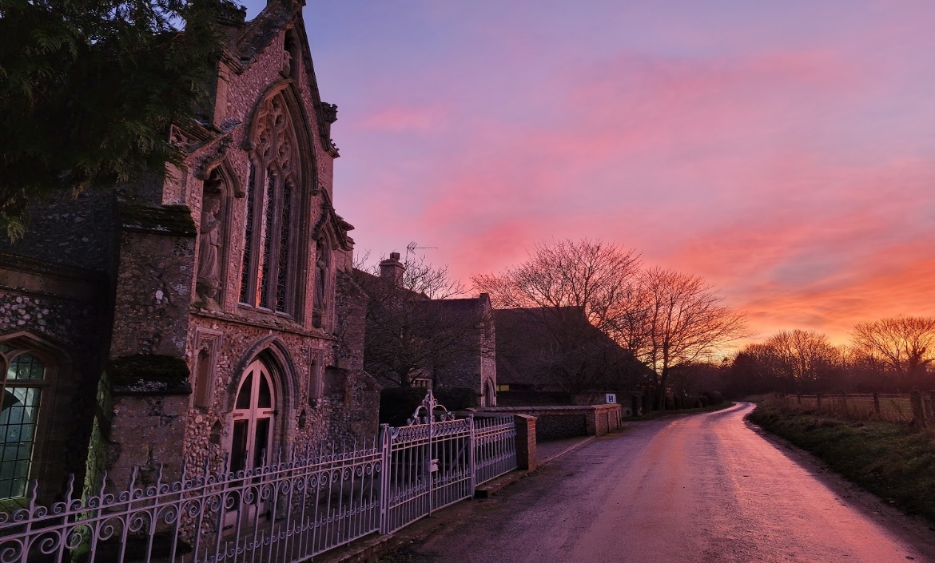
Looking Forward
~ Looking Forward in Hope~
Monday 19th September 2022
Brentwood Diocese Education Service

Slide 2
Looking Forward in Hope
As we move through the year we are looking forward in hope.
We ask Our Lady of Walsingham, whose shrine is in Norfolk to :
Remember we are your children
Called to wholeness
Called to the fullness of joy
Called to realise our heart’s deepest desires,
God’s dream for us.
BDES

Slide 3
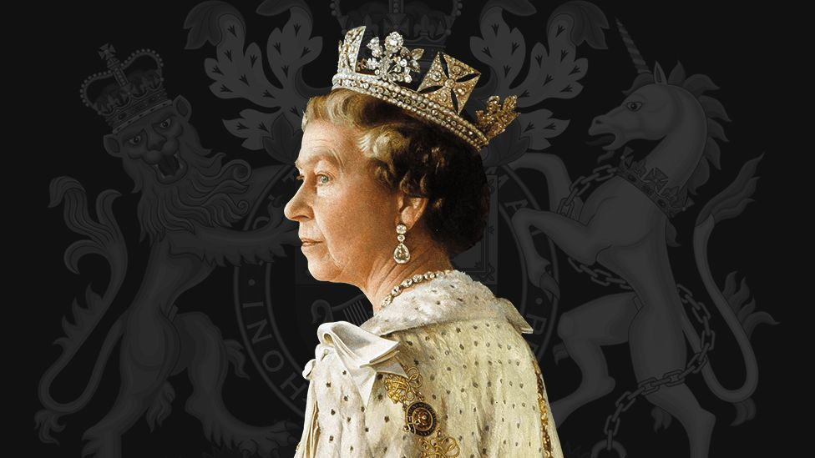
May she rest in peace
and rise in glory
Eternal Rest, grant unto her,
O Lord,
And let perpetual light
shine upon her.
BDES

Slide 4
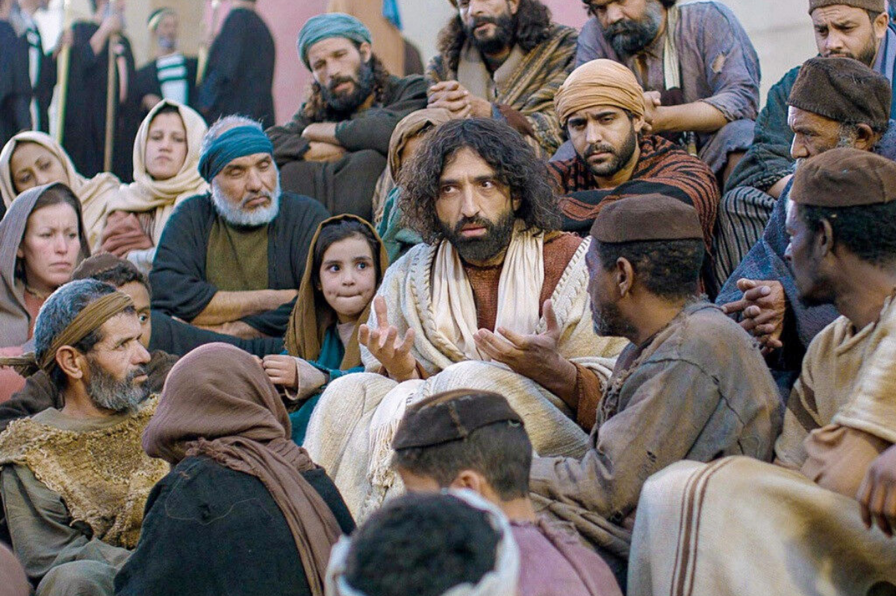
The Synoptic Problem
In Sunday’s Gospel Reading …
Sunday 18th September 2022 :
In the Gospel of Luke, Jesus teaches :
“No one can serve two masters.”
BDES

Slide 5
Reflection on the Creed
I believe in one Lord, Jesus Christ, God from God, Light from Light, true God from true God.
BDES

Slide 6
Preparing as communities for World Youth Day 2023
“Let us never allow hope to die in our hearts!”
- Pope Francis, World Youth Day 2013
BDES

Slide 7
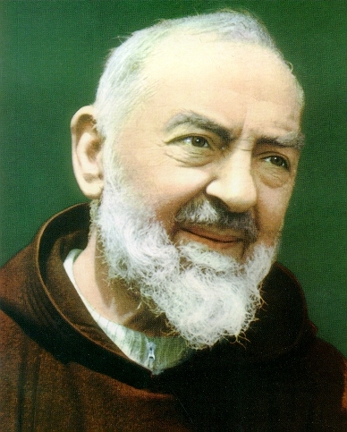
Saint Pius of Pietrelcina (Padre Pio) 23rd September
Francesco Forgione, better known as Padre Pio and also Saint Pius of Pietrelcina was born on 25 May 1887 and died on 23rd September 1968. He was a member of the Italian Franciscan Capuchin order.
Padre Pio became famous for exhibiting stigmata for most of his life, thereby generating much interest and controversy. This means that he experienced bodily marks, pain, and bleeding in locations corresponding to the crucifixion wounds of Jesus.
He was beatified (made Blessed) in 1999. After consideration of Padre Pio's virtues and ability to do good even after his death, including discussion of healings attributed to his intercession, John Paul II declared Padre Pio a saint on 16th June 2002. An estimated 300,000 people attended the canonization ceremony in Rome.
BDES

Slide 8
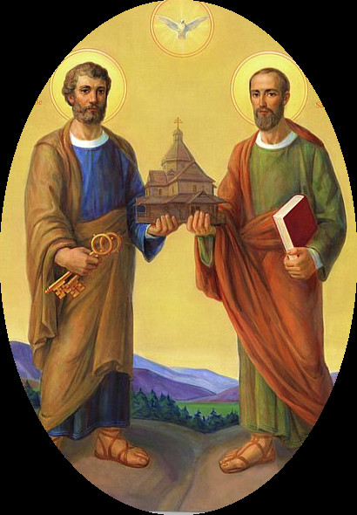
Saints and Schools # 36 : St Peter and SS Peter and Paul
St Peter was the first leader of the church and was frequently mentioned in the Gospels. The Pope is the successor of Peter as the Bishop of Rome and leader of the Roman Catholic Church.
St Paul was the apostle to the Gentiles as he travelled widely throughout the Roman empire. His letters form a large part of the New Testament.
Both Peter and Paul were martyred in Rome.
There are 3 schools in the Diocese of Brentwood named after St Peter (Billericay, Dagenham and Romford) and one after SS Peter and Paul (Ilford).
BDES

Slide 9
Looking Forward
~ Looking Forward in Hope~
Monday 19th September 2022
Brentwood Diocese Education Service

