Slide 1



Looking Forward
~ Looking Forward in Hope ~
Monday 26th September 2022
Brentwood Diocese Education Service

Slide 2
Looking Forward in Hope
May the blessing of light be upon you,
light on the outside and light on the inside.
With God's sunlight shining on you, may your heart glow with warmth.
May the light of the Lord shine from your eyes like a candle in the window.
May the blessing of God's earth be on you and as you walk its paths,
may you always have a kind word for those you meet.
May you understand the strength and power of God in the quiet beauty of creation.
May you come to realize that you are an important part of God's plan.
May He watch over you and keep you safe from harm.
BDES

Slide 3
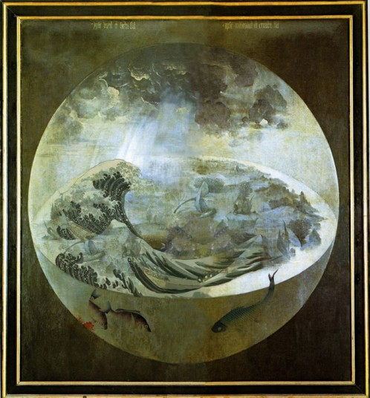
Reflection on the Creed
I believe in one Lord,
Jesus Christ,
begotten, not made, consubstantial with the Father; through Him
all things were made.
BDES

Slide 4

The Synoptic Problem
In Sunday’s Gospel Reading …
25th September 2022
In the Gospel of Luke, we hear :
“Remember that you received what was good.”
BDES

Slide 5


MAY WE REACH OUT IN LOVE
God of abundance,
you entrust to our care
your gift of creation,
our common home.
Open our ears to hear
the cry of the earth
and the cry of the poor.
God of justice,
you show us how to live in
gratitude and solidarity.
Open our mouths to speak out,
challenging greed and inequality,
and standing up for all among us
in desperate need of food.
God of hope,
you share with us your vision
of a world renewed.
Open our hearts to compassion.
As we hold before you
the hungry of the world,
may we reach out in love.
Amen.
Harvest Festivals 25th September
BDES

Slide 6
Preparing for World Youth Day 2023
“Let us be lights of hope!”
- Pope Francis, World Youth Day 2013
BDES

Slide 7
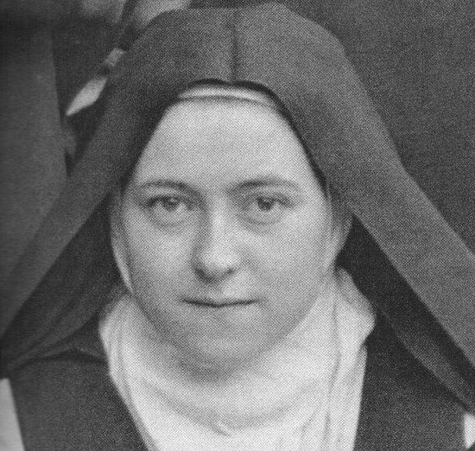
Saint Thérèse of Lisieux
1st October
St Thérèse (1873-1897) is also known as Saint Thérèse of the Child Jesus and the Holy Face, and is one of the most popular Catholic saints in the history of the Church. In the Diocese of Brentwood , we have no fewer than four schools named after her, in Basildon,
Dagenham, Lexden and Rochford. She died when she was only 24 years old, but left a spiritual legacy of simplicity, practicality and common sense expressed in her “Little Way” :
“I will seek a means of getting to Heaven by a little way – a very short and very straight little way that is wholly new. I mean to try and find a lift by which I may be raised to God, for I am too tiny to climb the xxx steep stairway of perfection. Your arms, then, Jesus, are the lift which will raise me up to Heaven.”
BDES

Slide 8
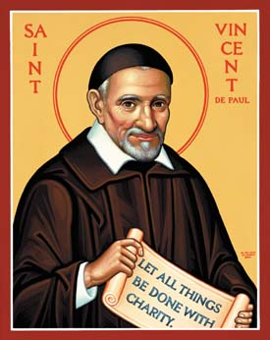
Saints and schools # 37 : St Vincent de Paul
Vincent was born in Gascony, France in 1581 and was ordained a priest in 1600. He dedicated his life to serving the poor and in 1622 was appointed as chaplain to the galley slaves imprisoned in Paris. He became the superior of a new order which we now call the Vincentians. Priests of the order take vows of poverty and devote themselves to care for the poor. Vincent conducted retreats for priests to help them develop spiritually, established seminaries to train them and also founded the Daughters of Charity. He died in 1660 and was canonised in 1737.
In the Diocese of Brentwood we are proud to have St Vincent’s Catholic Primary School xxxxxxx in Dagenham.
BDES

Slide 9
Looking Forward
~ Looking Forward in Hope ~
Monday 26th September 2022
Brentwood Diocese Education Service

