Slide 1
Looking Forward
~ Looking Forward in Hope~
Monday 3rd October 2022
Brentwood Diocese Education Service

Slide 2
Looking Forward in Hope
October is the month of the Rosary.
Pope Benedict XVI said the rosary helps to put Christ at the centre.
To trace the steps of Christ’s incarnation, mission and ministry.
May Mary help us to welcome within ourselves
the grace which comes from these mysteries,
so that through us we can "water" society,
beginning with our daily relationships,
and purifying them from so many negative forces,
thus opening them to the newness of God.
May the Rosary bring us peace and reconciliation.
BDES

Slide 3
The Synoptic Problem
In Sunday’s Gospel Reading …
Sunday 2nd October 2022 :
In the Gospel of Luke,
the disciples ask Jesus :
“Increase our faith.”
BDES

Slide 4
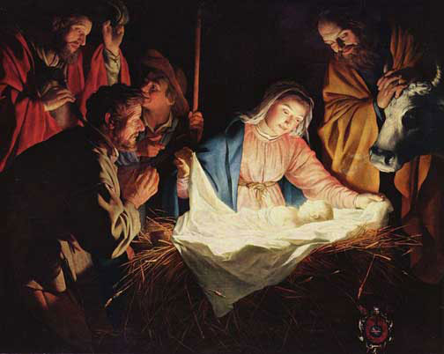
Reflection on the Creed
I believe in one Lord, Jesus Christ :
for us men and
for our salvation
He came down
from heaven.
BDES

Slide 5
Preparing as communities for World Youth Day 2023
“Let us maintain a positive outlook on reality.”
- Pope Francis, World Youth Day 2013
BDES

Slide 6
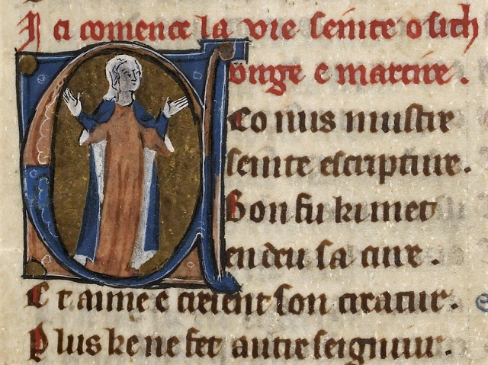
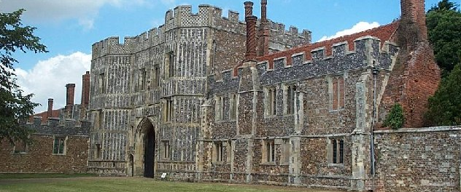
St Osyth : 7th October
St Osyth or Osgyth was an English saint of the 8th century from the Kingdom of Essex. She was from a noble family and became the abbess of a priory near the manor Chich. She probably died about 700 AD, martyred by beheading by some raiding pirates for refusing to renounce her faith.
In the 12th Century a priory of Augustinian Canons was built on the site of Osyth’s monastery and named after her. The village of Chich also took on her name. It was later dissolved during the Dissolution of the Monasteries by Henry VIII. The buildings were sold to the Darcy family in the 16th century and part of the gatehouse remains visible today.
BDES

Slide 7
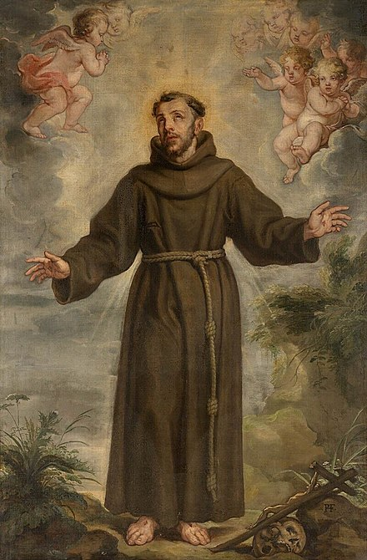
Saints and Schools # 38 : St Francis
The Catholic primary schools at Braintree, Maldon and Stratford are all named after St Francis of Assisi.
St Francis started the order of friars minor (“little brothers”) in 1209 and a female order followed through the foundation of his friend St Clare (known popularly as the “Poor Clares”).
The Franciscan nuns contributed to the foundation of the school in Braintree. In Stratford the school is closely linked to the parish of St Francis of Assisi which has served the area for over 150 years.
St Francis set out to imitate Christ and carry out his work in humility and gentleness. The schools that bear his name continue in this tradition of love and service.
BDES

Slide 8
Looking Forward
~ Looking Forward in Hope~
Monday 3rd October 2022
Brentwood Diocese Education Service

