Slide 1
Looking Forward
~ Looking Forward in Hope ~
Monday 10th October 2022
Brentwood Diocese Education Service

Slide 2
Looking Forward in Hope
May the Lord show you the greatness of his goodness,
that you overflow with thanks every day.
May the Lord bless you abundantly
with peace for the heart,
power for virtue,
wisdom for life,
and patience in suffering.
May the Lord bless you with joyful hope,
and one day with the inexpressible joys of eternal life.
BDES

Slide 3
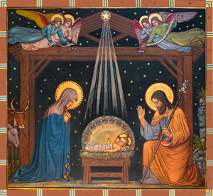
Reflection on the Creed
I believe in one Lord,
Jesus Christ :
by the Holy Spirit
He was incarnate
of the Virgin Mary,
and became man.
BDES

Slide 4
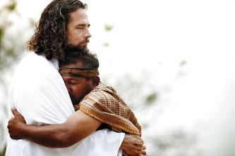
The Synoptic Problem
In Sunday’s Gospel Reading …
9th October 2022
In the Gospel of Luke, Jesus says:
“Your faith has saved you.”
BDES

Slide 5
Prisoners Sunday 9th October 2022
Lord, you offer freedom to all people.
We pray for those in prison.
Break the bonds of fear and isolation that exist.
Support with your love prisoners
and their families and friends,
prison staff and all who care.
Heal those who have been wounded
by the actions of others,
especially the victims of crime.
Help us to forgive one another,
to act justly, love mercy
and walk humbly together with Christ,
in his strength and in his Spirit,
now and every day.
Amen
BDES

Slide 6
Preparing for World Youth Day 2023
“Let us encourage the generosity which is typical of the young and help them to work actively in building a better world!”
- Pope Francis, World Youth Day 2013
BDES

Slide 7
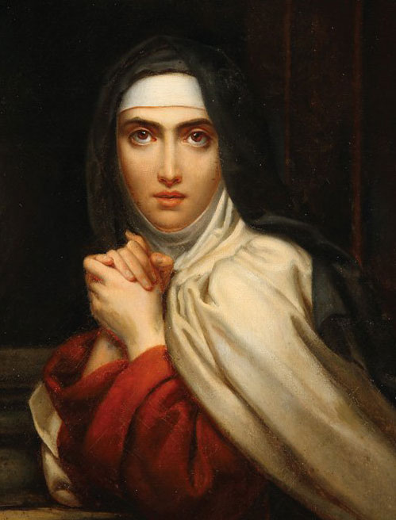
St Teresa of Ávila
15th October
St Teresa founded the order of Discalced Carmelites. She was a mystic, a religious reformer, an author, a theologian of the contemplative life and prayer, and has been such an influential thinker that she has been declared a Doctor of the Church. Her famous prayer is a source of comfort and calm :
Let nothing disturb you. Let nothing frighten you. All things pass away. God never changes. Patience obtains all things.
Whoever has God lacks nothing. God alone suffices.
BDES

Slide 8
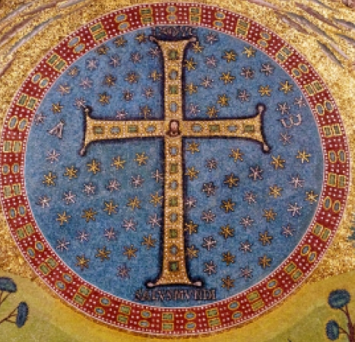
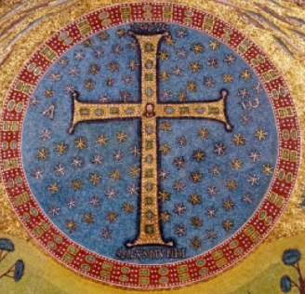
Names of schools # 39 : Holy Cross
In the liturgical calendar,
we have the Feast of the Exaltation of the Cross
on 14th September.
Unlike Good Friday,
where we remember Christ’s passion and the crucifixion,
we celebrate here the cross itself as the sign of salvation.
Two schools in the diocese are named Holy Cross, one in Harlow and one in South Ockendon.
BDES

Slide 9
Looking Forward
~ Looking Forward in Hope ~
Monday 10th October 2022
Brentwood Diocese Education Service

