Slide 1
Looking Forward
~ Looking Forward in Hope~
Monday 17th October 2022
Brentwood Diocese Education Service

Slide 2
Looking Forward in Hope
As we move through the year we are continuing to look forward in hope
to the coming of the Saviour.
Jesus was never paralyzed by fear.
He kept moving forward and He brought the disciples forward with Him.
He had a mission and nothing was going to stop Him.
We have a mission too but sometimes we get stuck.
This can be because we fail to understand the meaning of trusting in Jesus.
It isn’t easy, but can be less overwhelming if, with His grace,
we remind ourselves to keep moving and looking forward in hope.
BDES

Slide 3
The Synoptic Problem
In Sunday’s Gospel Reading …
Sunday 16th October 2022 :
In the Gospel of Luke, Jesus teaches :
“Pray always without
becoming weary .”
BDES

Slide 4
Reflection on the Creed
I believe in one Lord,
Jesus Christ :
for our sake he was crucified under Pontius Pilate, he suffered death and was buried,
and rose again on the third day in accordance with the Scriptures.
BDES

Slide 5
Preparing as communities for World Youth Day 2023
“Young people are
a powerful engine for
the Church and for society. ”
- Pope Francis, World Youth Day 2013
BDES

Slide 6
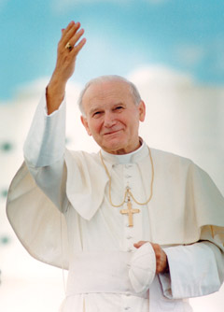
Saint John Paul II: 23rd September
Pope John Paul II was born in Poland as Karol Wojtyla before World War II.
He was a good sportsman, often playing in goal in football and was also involved in the theatre in his younger days.
He was an impressive linguist, using nine of the languages he had learnt when he became Pope.
His decision to become a priest came during the war; he survived having hidden from the German forces who rounded up many of the young men in Krakow.
He was made a Bishop in 1958 and was involved in the Second Vatican Council and in 1964 was made Archbishop of Krakow. In 1978 (the year of the three Popes) he was elected by the College of Cardinals and took the name John Paul II.
He pioneered World Youth Day and was very active in all areas of the Papacy.
He died in 2005 following a period of ill health.
He was beatified by his successor Pope Benedict in 2011 and canonised by
Pope Francis with Emeritus Pope Benedict concelebrating in 2014.
BDES

Slide 7
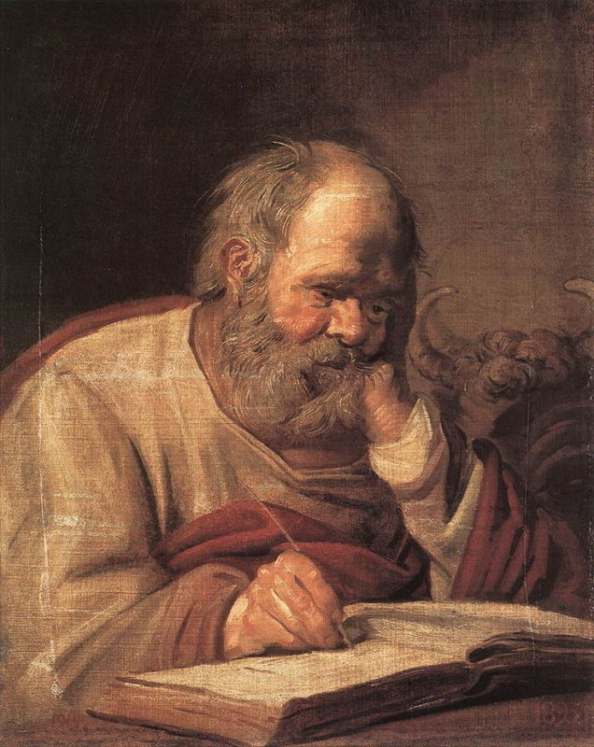
Saints and Schools # 40 : St Luke
St Luke’s in Harlow is named after the saint who was one of the four Evangelists.
The school’s values are embedded in Love through God – Love of self and Love of others.
BDES

Slide 8
Looking Forward
~ Looking Forward in Hope~
Monday 17th October 2022
Brentwood Diocese Education Service

