Slide 1
Looking Forward
~ Looking Forward in Love ~
Monday 31st October 2022
Brentwood Diocese Education Service

Slide 2
Looking Forward in Love
Love is patient, love is kind and is not jealous;
love does not brag and is not arrogant,
does not act unbecomingly;
it does not seek its own, is not provoked,
does not take into account a wrong suffered,
does not rejoice in unrighteousness,
but rejoices with the truth;
bears all things, believes all things,
hopes all things, endures all things.
Love never fails.”
- 1 Corinthians 13 : 1-8, 13
BDES

Slide 3
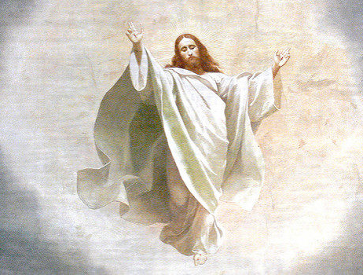
Reflection on the Creed
I believe in one Lord,
Jesus Christ :
He ascended into heaven and is seated
at the right hand
of the Father.
BDES

Slide 4
The Synoptic Problem
In Sunday’s Gospel Reading …
30th October 2022
In the Gospel of Luke, Jesus says:
“The Son of Man has come to seek and to save what was lost.”
BDES

Slide 5
Preparing for World Youth Day 2023
“What is the Lord saying to us? Three simple ideas:
Go, do not be afraid, and serve.”
- Pope Francis, World Youth Day 2013
BDES

Slide 6
1st November
BDES

Slide 7
2nd November
BDES

Slide 8
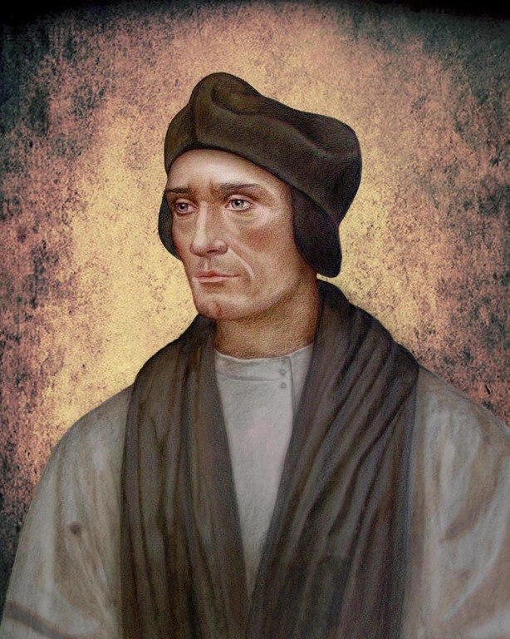
Names of schools # 41 : St John Fisher
St John Fisher (1469 –1535) was an English bishop, cardinal and theologian, an academic and the Chancellor of the University of Cambridge. He was executed by Henry VIII for refusing to recognize him as the supreme head of the Church in England. He is honoured as a martyr and saint by the Catholic Church and his feast day is 22nd June.
St John Fisher Catholic Primary School in Loughton
is named after the martyred saint.
Their Mission Statement tells us :
the love of God helps us all to live, learn and grow
to be a happy, caring and welcoming community.
BDES

Slide 9
Looking Forward
~ Looking Forward in Love ~
Monday 31st October 2022
Brentwood Diocese Education Service

