Slide 1
Looking Forward
~ Looking Forward in Love~
Monday 7th November 2022
Brentwood Diocese Education Service

Slide 2
Looking Forward in Love
In the Gospel of John, Jesus says:
‘This is my commandment, that you love one another, as I have loved you.
Greater love than this has no man, that a man lay down his life for his friends.’
This is the time of year when we remember those who died in war.
These verses from the Gospel of John show that Jesus died to save us and that we should trust in His love and saving mercy.
BDES

Slide 3
The Synoptic Problem
In Sunday’s Gospel Reading …
Sunday 6th November 2022 :
In the Gospel of Luke, Jesus teaches :
“He is the God of the living.”
BDES

Slide 4
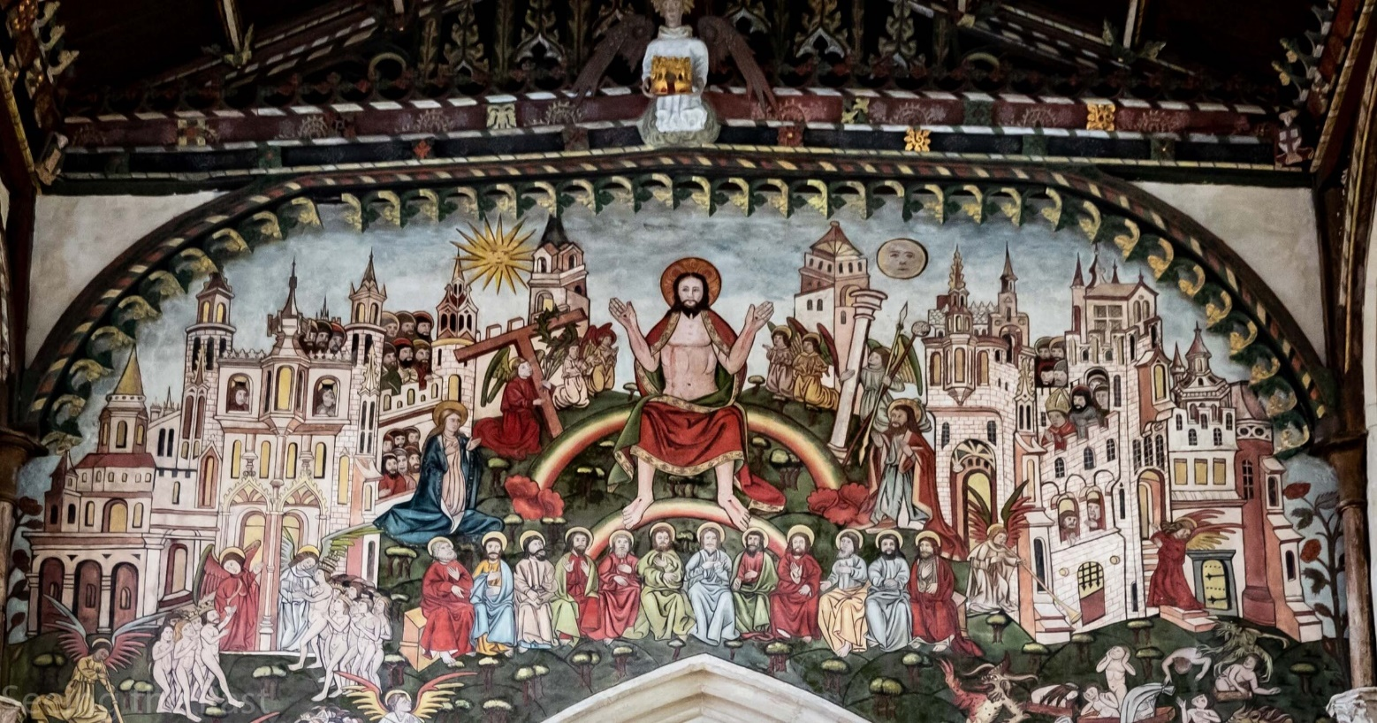
Reflection on the Creed
I believe in one Lord, Jesus Christ : He will come again in glory to judge the living and the dead and his kingdom will have no end.
BDES

Slide 5
Preparing as communities for World Youth Day 2023
“Faith is a flame that grows stronger the more it is shared and passed on.”
- Pope Francis, World Youth Day 2013
BDES

Slide 6
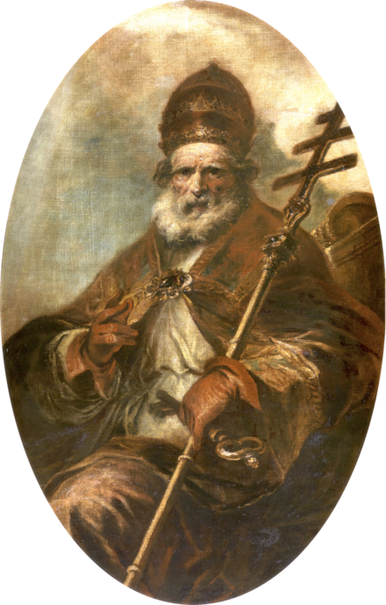
Saint Leo the Great: 10th November
Leo the Great was Pope in the 5th Century.
His papacy has been described by Pope Benedict XVI as "undoubtedly one of the most important in the Church's history.“
Leo persuaded Attila the Hun to turn back from his invasion of Italy, wrote important theological documents as well as developing the idea of Papal authority. It was during his term of office that the word Pope was used to solely mean the Bishop of Rome.
His writings and sermons centred on theological questions around the person of Christ (Christology).
He died on 10th November 461 and was buried in the old Basilica of St Peter in Rome.
He is one of only two Popes to be recognised as a Doctor of the Church.
BDES

Slide 7
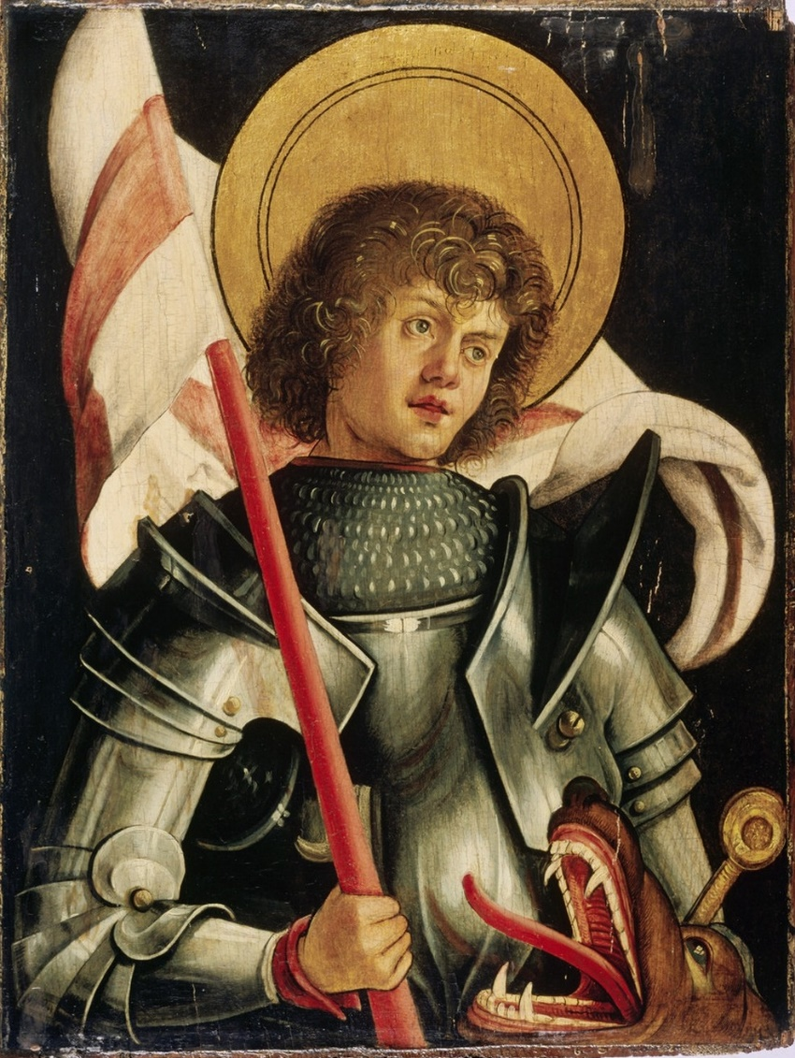
Saints and Schools # 42 : St George
There is very little information about St George’s life. It is thought he was possibly a Roman officer who was martyred for his faith.
St George’s Catholic Primary School in Shoeburyness has four key elements at its heart; Faith, Family, Education and Excellence.
Our Lady and St George’s School in Walthamstow has the mission statement : With Jesus we join together to Love, Listen, Respect, Learn and Enjoy.
BDES

Slide 8
Looking Forward
~ Looking Forward in Love~
Monday 7th November 2022
Brentwood Diocese Education Service

