Slide 1
Looking Forward
~ Looking Forward in Love ~
Monday 14th November 2022
Brentwood Diocese Education Service

Slide 2
Looking Forward in Love
Heavenly Father,
life is complicated and busy.
Sometimes things move so fast
that I find myself falling short of
the love you’ve given me to pass on to others.
Help me not to allow the noise and pace of life
to cause me to forget the most essential thing :
to love you and to love others.
May I always remember the love you’ve shown to me
and to love the people in my life.
BDES

Slide 3
Reflection on the Creed
I believe in the Holy Spirit, the Lord, the Giver of Life, who proceeds from the Father and the Son.
BDES

Slide 4
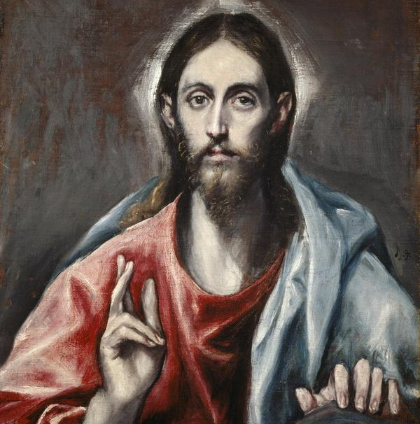
The Synoptic Problem
In Sunday’s Gospel Reading …
13th November 2022
In the Gospel of Luke, Jesus promises :
“ I myself shall give you a wisdom in speaking.”
BDES

Slide 5
Preparing for World Youth Day 2023
“Jesus not only sends us, he accompanies us, he is always beside us in our mission of love.”
- Pope Francis, World Youth Day 2013
BDES

Slide 6
St Hilda of Whitby
17th November
St Hilda (c. 614 – 680 AD) was the founding abbess of the double monastery (i.e. a monastery for men and women) at Whitby in Yorkshire. She was so highly respected that her monastery was chosen as the venue for the important Synod of Whitby in the year 664, where the Christians of Northumbria agreed to accept the dating of Easter according to the Church of Rome. The historian St Bede wrote of her : “All who knew her called her mother because of her xxxxx outstanding devotion and grace.”
BDES

Slide 7
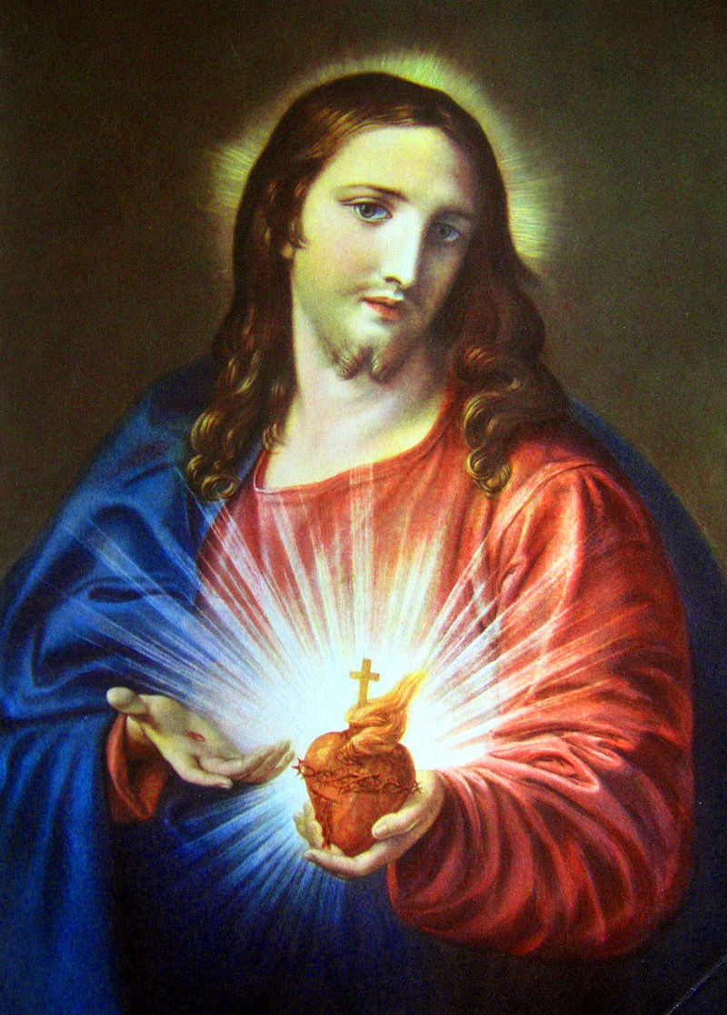
Names of schools # 43 : Sacred Heart
The Most Sacred Heart of Jesus (Cor Jesu Sacratissimum in Latin), is one of the most widely practised and well-known Catholic devotions, where the heart of Jesus is viewed as a symbol of God's boundless love for humankind.
This is the origin of the name of Sacred Heart Roman Catholic Primary School in Southend.
Their focus on God’s love is reflected in their Mission Statement : Love of God, Love of one another, Love of our world, Love of learning
BDES

Slide 8
Looking Forward
~ Looking Forward in Love ~
Monday 14th November 2022
Brentwood Diocese Education Service

