Slide 1
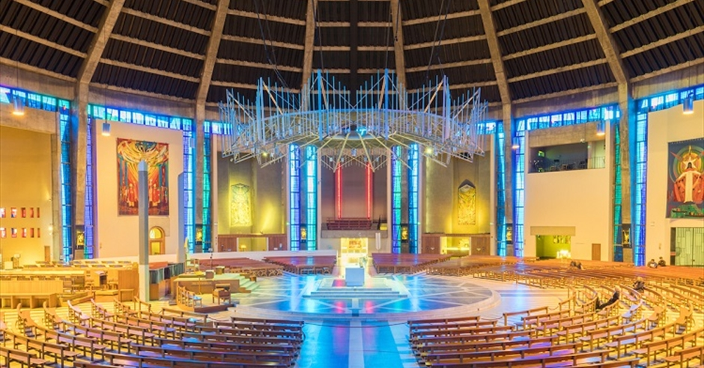
Looking Forward
~ Looking Forward in Love~
Monday 21st November 2022
Brentwood Diocese Education Service

Slide 2
Looking Forward in Love
In the Gospel of Luke the repentant thief says:
‘Jesus, remember me when you come into your kingdom.’
We often ask for things when we pray but we should also think about other types of prayer.
Jesus shows He loves us in many ways
and so we should remember to give thanks
in our prayers for those we love and who love us.
BDES

Slide 3
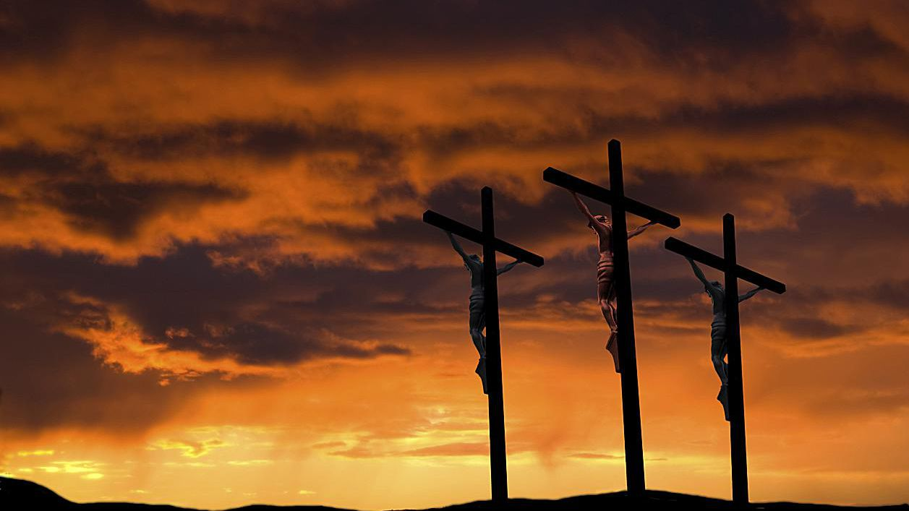
The Synoptic Problem
In Sunday’s Gospel Reading …
Sunday 20th November 2022 :
The Gospel of Luke:
“Jesus, remember me when you come into your kingdom.”
BDES

Slide 4
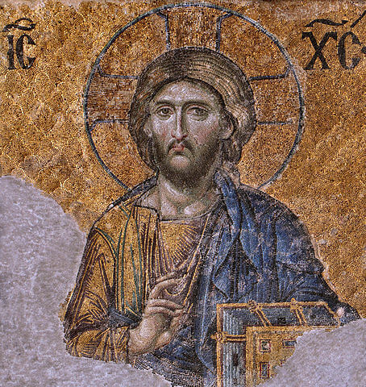
Prayer to Christ the King
O Lord our God, You alone are the Most Holy King and Ruler of all nations.
We pray to You, Lord, in the great expectation of receiving from You, O Divine King, mercy, peace, justice and all good things.
Protect, O Lord our King, our families and the land of our birth.
Guard us, we pray, Most Faithful One.
Protect us from our enemies and from Your Just Judgment.
Forgive us, O Sovereign King, our sins against you.
Jesus, You are a King of Mercy.
We have deserved Your Just Judgment.
Have mercy on us, Lord, and forgive us.
We trust in Your Great Mercy.
O most awe-inspiring King, we bow before You and pray;
May Your Reign, Your Kingdom, be recognized on earth.
Amen.
BDES

Slide 5
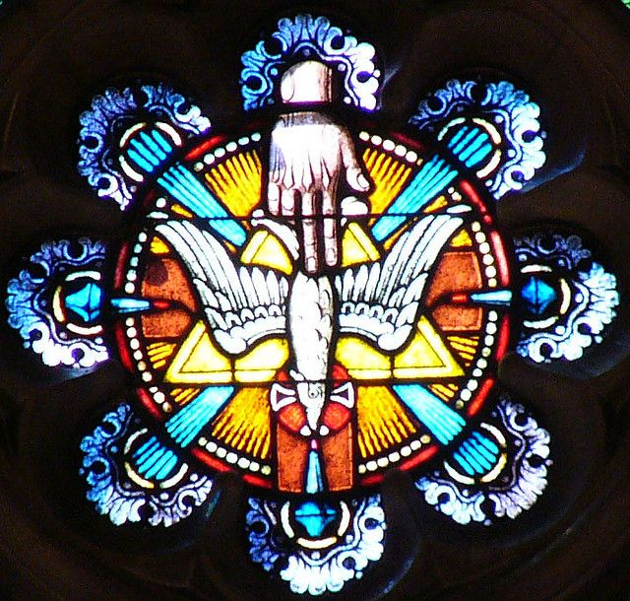
Reflection on the Creed
I believe in
the Holy Spirit,
the Lord, the Giver of Life,
who with the Father and the Son is adored and glorified.
BDES

Slide 6
Preparing as communities for World Youth Day 2023
“The Gospel is for everyone, not just for some.”
- Pope Francis, World Youth Day 2013
BDES

Slide 7
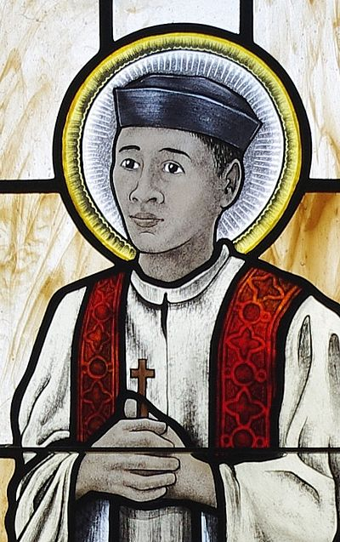
Saint Andrew Dung-Lac:
24th November
His feast day is on 24th November, a day which commemorates all the Vietnamese martyrs of the seventeenth, eighteenth and nineteenth centuries. Andrew was born in Vietnam in 1795 and became a priest in 1823. To avoid persecution he changed his name, but was still captured and executed.
He was canonised in 1988 by Pope John Paul II.
BDES

Slide 8
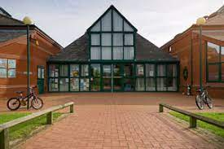
Names of Schools # 44 : The Bishops’ School
The Bishops’ is one of a small and unique number of joint Anglican and Catholic schools in the country, and is the only such primary school in Essex. The school serves all those who wish their children to enjoy an education which puts the whole of their development at its heart – academic, creative, physical, social and spiritual. The heart and foundation of the school is strongly Christian.
BDES

Slide 9
Looking Forward
~ Looking Forward in Love~
Monday 21st November 2022
Brentwood Diocese Education Service

