Slide 1
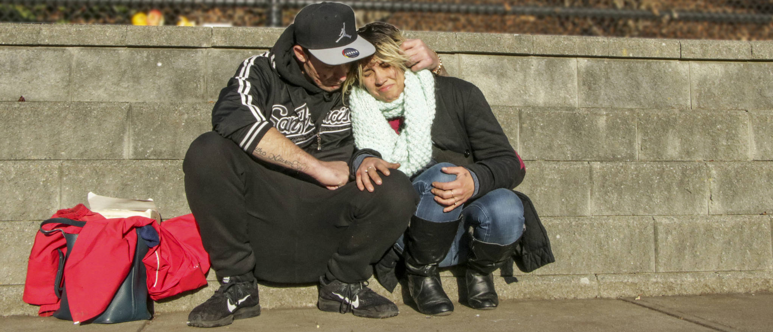
Looking Forward
~ Looking Forward in Love ~
Monday 28th November 2022
Brentwood Diocese Education Service

Slide 2
Looking Forward in Love
Loving God,
thank you for blessing me with your everlasting love,
a love eternally beyond my understanding.
I want to try to imitate your love by loving others as you love me.
Help me to be mindful of all the ways that you love me.
Keep in front of me what Jesus sacrificed to save me.
Teach me how to grow in love by following the example
of your beloved and loving Son.
BDES

Slide 3
We are Looking Forward In Love
We are looking forward –
to seeing a new star appear in the sky, prompting those far off to draw near to you. Lord Jesus, draw us to you.
We are looking forward –
to the familiar stable scenes, their mangers standing empty, waiting to receive you. Lord Jesus, come to us anew.
We are looking forward –
to hearing again the angels singing "Glory to God and Peace to all the earth". Lord Jesus, let us take up their song.
We are Looking Forward
~ In Advent ~
BDES

Slide 4
We are Looking Forward In Love
We are looking forward –
to seeing shepherds and kings, poor and humble, noble and wealthy, all bowing before you. Lord Jesus, unite us in worship.
We are looking forward –
to remembering a girl from an ordinary background, chosen to bring your hope into the world. Lord Jesus, bring new hope through us.
We are looking forward –
to a small child, wrapped in linen, lying in a manger, weak and helpless, small and reliant on others. Lord Jesus, teach us to depend on you.
We are Looking Forward
~ In Advent ~
BDES

Slide 5
We are Looking Forward In Love
We are looking forward –
to seeing, hearing and knowing afresh how you,
the infinite and incomprehensible God,
freely entered Your creation,
becoming humble and tangible
so that we might freely enter your presence. Lord Jesus, we look, we wonder, and we worship. Amen
We are Looking Forward
~ In Advent ~
BDES

Slide 6
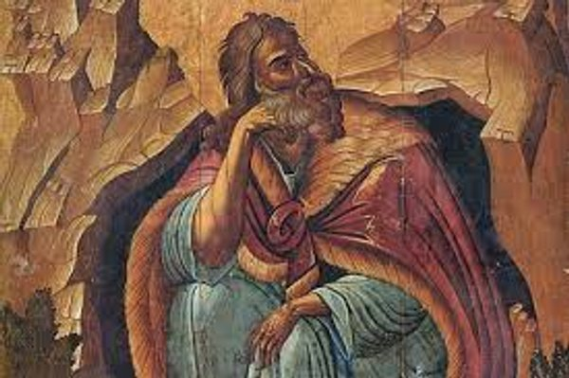
Reflection on the Creed
I believe in the Holy Spirit, the Lord, the Giver of Life, who has spoken through
the prophets
BDES

Slide 7
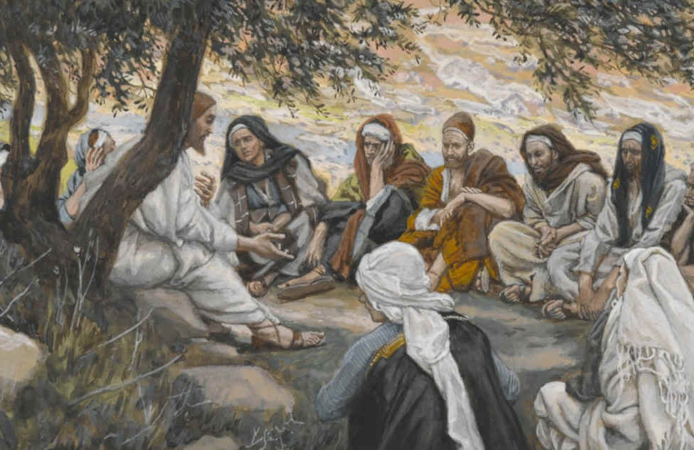
The Synoptic Problem
In Sunday’s Gospel Reading …
27th November 2022
In the Gospel of Matthew, Jesus exhorts us :
“Therefore, stay awake!”
BDES

Slide 8
Preparing for World Youth Day 2023
“Young people must say to the world : to follow Christ is good!”
- Pope Francis, Palm Sunday 2013
BDES

Slide 9
Blessed John Beche
1st December
Blessed John Beche is a saint and martyr of the diocese of Brentwood, the last abbot of Colchester Abbey. He opposed Henry VIII’s Act of Supremacy and claim to be supreme head of the Church in England, and denied the right of the king’s commissioners to confiscate his abbey. He was charged with, and found guilty of treason and was hanged, drawn and quartered at Greenstead on 1st December 1539. His pectoral cross was rescued and is kept at Buckfast Abbey in Devon. He was beatified in 1895.
BDES

Slide 10
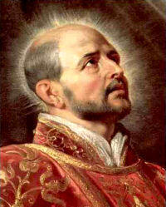
Saints and schools # 45 : St Ignatius of Loyola
Ignatius of Loyola (1491-1556) was a Spanish Catholic priest and theologian who founded the Society of Jesus (the Jesuits) with Peter Faber and Francis Xavier; he was the first Superior General of the order, dedicated to missionary work and teaching. He is famous for his Spiritual Exercises (Ignatian Spirituality).
The Loyola Preparatory School in Buckhurst Hill is named after the saint. Its badge shows the motto Ad Maiorem Dei Gloriam (For the Greater Glory of God)
BDES

Slide 11
Looking Forward
~ Looking Forward in Love ~
Monday 28th November 2022
Brentwood Diocese Education Service

