Slide 1
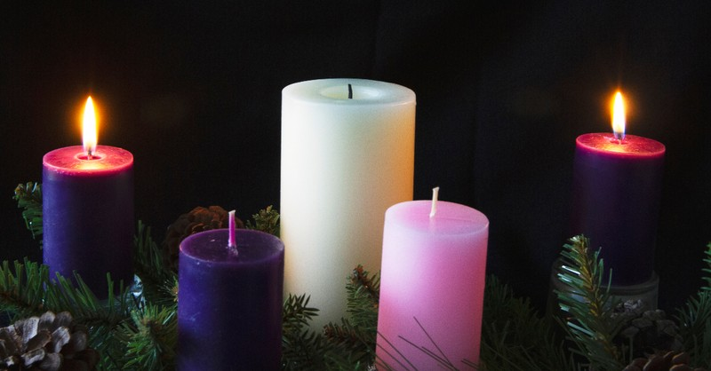
Looking Forward
~ Looking Forward in Love~
Monday 5th December 2022
Brentwood Diocese Education Service

Slide 2
Looking Forward in Love
In the Gospel of Matthew we hear:
‘The kingdom of heaven is at hand!’
What are you doing to build the kingdom?
What are your unique gifts which you can use to transform society?
How can you show leadership that is transformative?
In the lead up to Christmas, what are you doing
to make a difference to yourself and others?
BDES

Slide 3
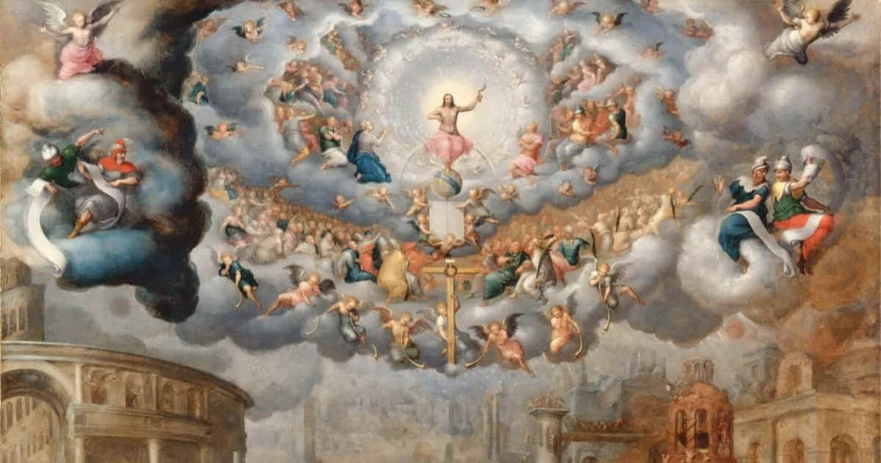
The Synoptic Problem
In Sunday’s Gospel Reading …
Sunday 4th December 2022 :
The Gospel of Matthew :
“The kingdom
of heaven
is at hand!”
BDES

Slide 4
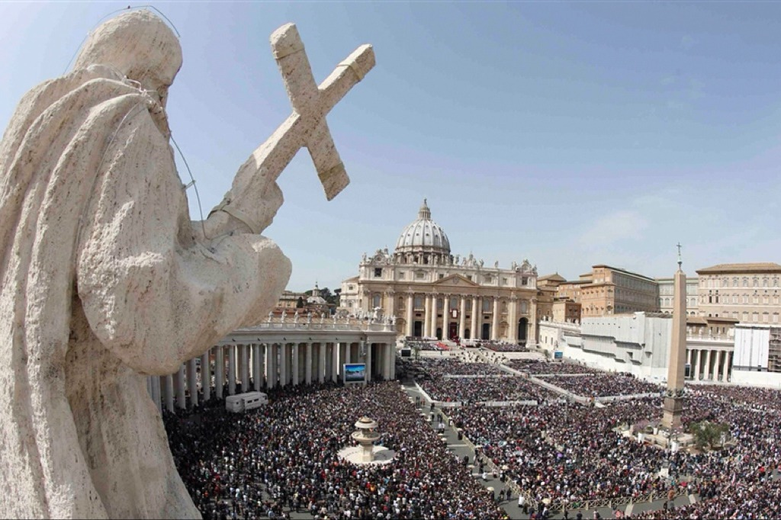
Reflection on the Creed
I believe in
one,
holy,
Catholic
and apostolic
Church.
BDES

Slide 5
Preparing as communities for World Youth Day 2023
“Young people must say
to the world:
to go with Christ
is good.”
- Pope Francis, Palm Sunday 2013
BDES

Slide 6
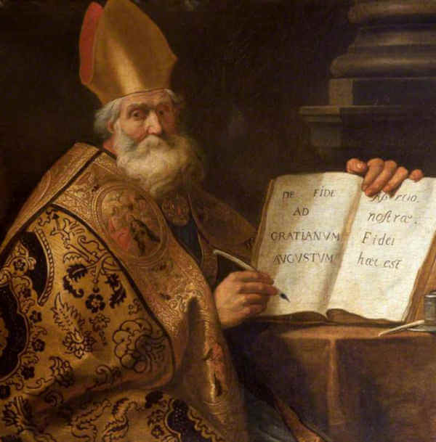
Saint Ambrose:
7th December
St Ambrose was a 4th-century Bishop of Milan.
He was a theologian who also produced hymns and was famous as a preacher.
He is considered to be one of the four doctors of the Church as a result of his works.
He was very concerned about the need of the rich to look after the poor.
Due to an event in his childhood, when a legend has it that a swarm of bees landed on his face whilst he lay in his cradle, he is the patron saint of beekeepers, as well as of the patron of Milan.
His feast day is celebrated on 7th December.
BDES

Slide 7
Saints and Schools # 46 : Our Lady Immaculate
Our Lady Immaculate in Chelmsford is an integral part of the linked Parishes of Our Lady Immaculate and Holy Name. The church of Our Lady Immaculate was opened in 1847 before the Catholic hierarchy was restored. Lord Petre was one of the main benefactors of the church.
In the present day everyone connected to the school strives to enable all members of the school community to grow personally, academically, socially and spiritually, with God at the centre of all that they think, do and say.
BDES

Slide 8
Looking Forward
~ Looking Forward in Love~
Monday 5th December 2022
Brentwood Diocese Education Service

