Slide 1
Looking Forward
~ Looking Forward in Love ~
Monday 12th December 2022
Brentwood Diocese Education Service

Slide 2
Looking Forward in Love
Loving Father,
Your Son told us that the most important thing
we can do with our lives is to love you
with everything we’ve got
and to love others the way we love ourselves.
That often means setting aside our wants and desires
to do what’s best for someone else.
I pray that you will help me to
see the needs of those around me
and lay down my wishes to help someone today.
BDES

Slide 3
We are Looking Forward In Love
Rejoice and be glad!
Last Sunday was Gaudete Sunday.
Gaudete is Latin, and means “Rejoice!”
Why the joy?
Because we are looking forward to Christmas.
We are Looking Forward
~ In Advent ~
BDES

Slide 4
We are Looking Forward In Love
Because Christmas brings wholeness.
Because Christmas brings generosity of spirit and generosity of heart.
Because we think of the poor, the homeless, the needy.
Because we respond to their needs with charity.
We are Looking Forward
~ In Advent ~
BDES

Slide 5
We are Looking Forward In Love
Because we spend time with people important to us.
Because we take time out of the busy, bustling business of life to relax.
Because of the calmness.
Because of the stillness.
We are Looking Forward
~ In Advent ~
BDES

Slide 6
We are Looking Forward In Love
Because of the love we have for each other.
Because of the love God has for us.
Because, in the words of Cardinal Hume :
“The great and awesome God became man for me.”
We are Looking Forward
~ In Advent ~
BDES

Slide 7
Reflection on the Creed
I confess one baptism for the forgiveness of sins.
BDES

Slide 8
The Synoptic Problem
In Sunday’s Gospel Reading …
11th December 2022
In the Gospel of Matthew, Jesus teaches :
“Blessed is the one who takes no offence at me.”
BDES

Slide 9
Preparing for World Youth Day 2023
“Young people must say to the world : the message of Christ is good!”
- Pope Francis, Palm Sunday 2013
BDES

Slide 10
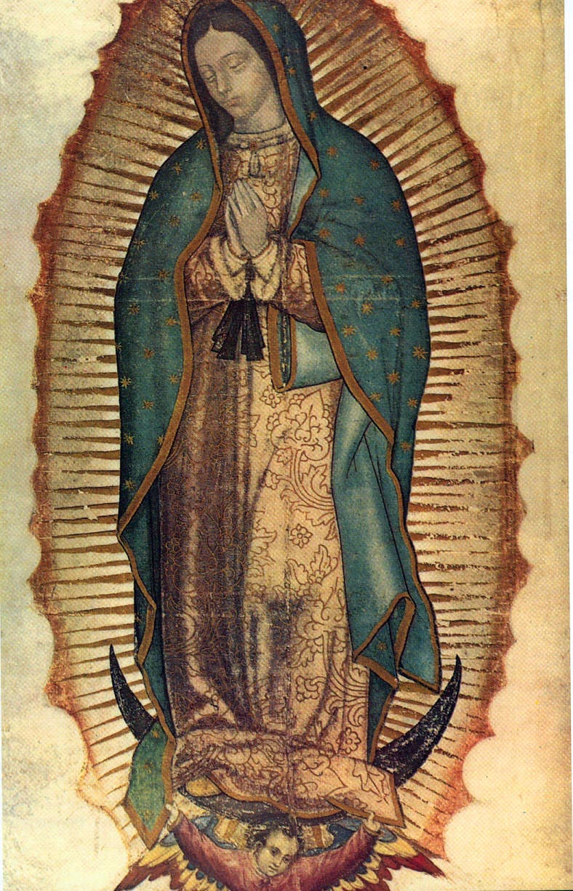
Our Lady of Guadalupe
12th December
12th December is the Feast of Our Lady of Guadalupe. The day commemorates her apparition to Saint Juan Diego in the hills of Tepeyac in 1531. She asked him to go to the bishop and tell him that the Ever Virgin Mary, Mother of God, sent him to ask for a church to be built on top of the Tepayachill. Our Lady of Guadalupe is the patron saint of the Americas. The bishops of the United States affirm that “Mary embraces God’s will and freely chooses to cooperate with God’s grace, thereby fulfilling a crucial role in xxx God’s plan of salvation.”
BDES

Slide 11
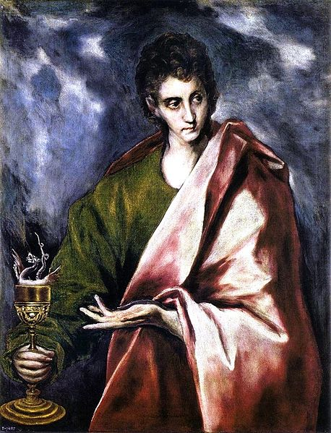
Saints and schools # 47 : St John the Evangelist
St John the Evangelist was one of the sons of Zebedee who became one of the Twelve. He is held to be the beloved disciple of St John’s Gospel, who was entrusted with the care of Christ’s Mother at the Crucifixion.
St John’s RC School in Woodford Green is a Roman Catholic special school named after the saint. Their mission is to create a community of love and learning, based on Christian values, in which each pupil can achieve their fullest educational potential and thus
live life to the full.
BDES

Slide 12
Looking Forward
~ Looking Forward in Love ~
Monday 12th December 2022
Brentwood Diocese Education Service

