Slide 1
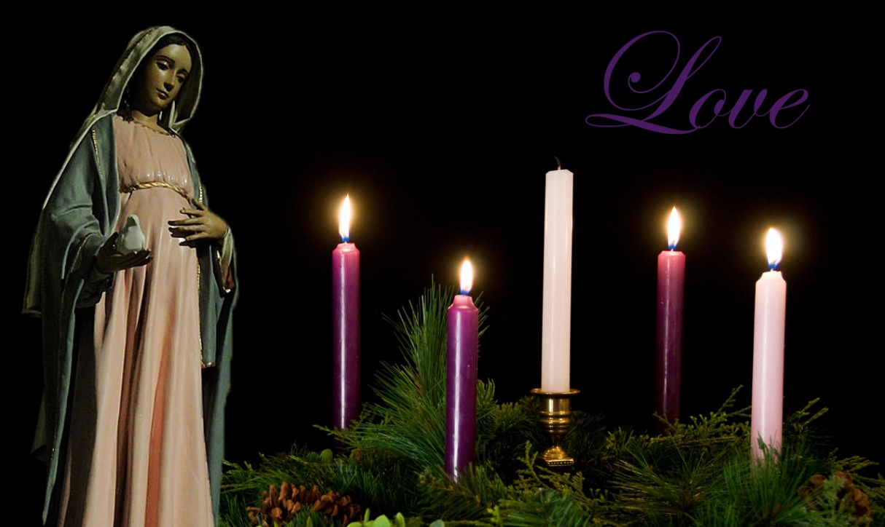
Looking Forward
~ Looking Forward in Love~
Monday 19th December 2022
Brentwood Diocese Education Service

Slide 2
Looking Forward in Love
When we reflect in Advent,
it is often looking at the perspective of Mary, an expectant mother.
She was supported throughout the difficult and at times dangerous journey by Joseph.
At different times both Mary and Joseph heard the words:
Do not be afraid!
We too are called to give birth to Jesus in our lives
through what we do, say and how we treat others.
We should not be afraid because
God is with us through Christ the Lord,
Emmanuel.
BDES

Slide 3
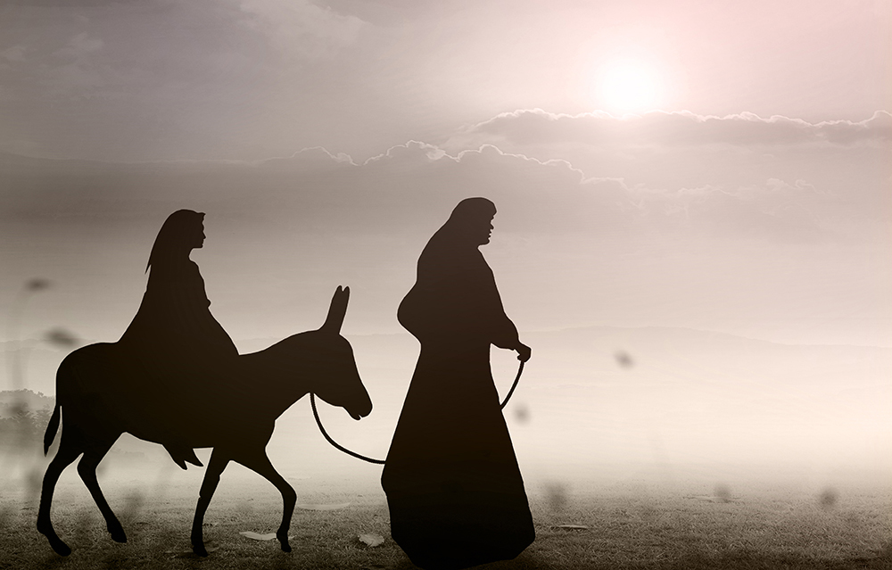
The Synoptic Problem
In Sunday’s Gospel Reading …
Sunday 18th December 2022 :
The Gospel of Matthew:
“God is with us.”
BDES

Slide 4
Reflection on the Creed
I look forward to
the resurrection
of the dead
and
the life
of the world
to come.
BDES

Slide 5
Preparing as communities for World Youth Day 2023
“In your dreams,
you can say :
I am free,
because I reign with Jesus
for justice, love and peace.”
- Pope Francis, Youth Sunday 2021
BDES

Slide 6
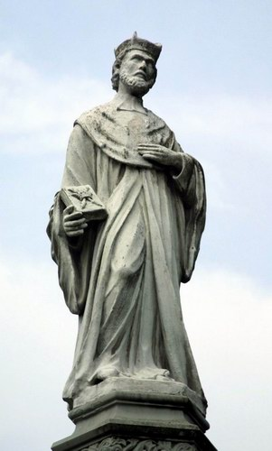
Saint John Kanty: 23rd December
John was from the country. After brilliant studies he became a professor of theology at the university of Kraków, Poland and was ordained a priest. He was then unjustly accused and sent away in disgrace to be a parish priest at Olkusz.
An extremely humble man, he did his best and in the end he won his people’s hearts. After some time he returned to Kraków and taught Scripture for the remainder of his life.
John was a serious man, and humble, but known to all the poor of Kraków for his kindness. His goods and his money were always at their disposal, and time and again they took advantage of him. He kept only the money and clothes absolutely needed to support himself. He slept little, ate sparingly, and took no meat.
His feast day is celebrated on 23rd December.
BDES

Slide 7
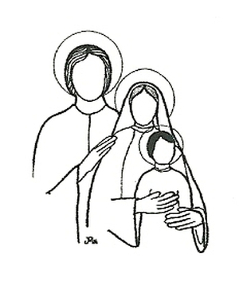
Saints and Schools # 48 : Holy Family
The name of the Holy Family of Jesus, Mary and Joseph
can be seen in a number of schools in the diocese.
These include Holy Family Catholic Primary schools in Benfleet and Witham.
The children in these schools are:
‘United in God's love, through learning and play,
we nurture hearts and minds as we welcome all into our family’
and
‘Living, Loving and Learning Together’.
BDES

Slide 8
Looking Forward
~ Looking Forward in Love~
Monday 19th December 2022
Brentwood Diocese Education Service

