Slide 1
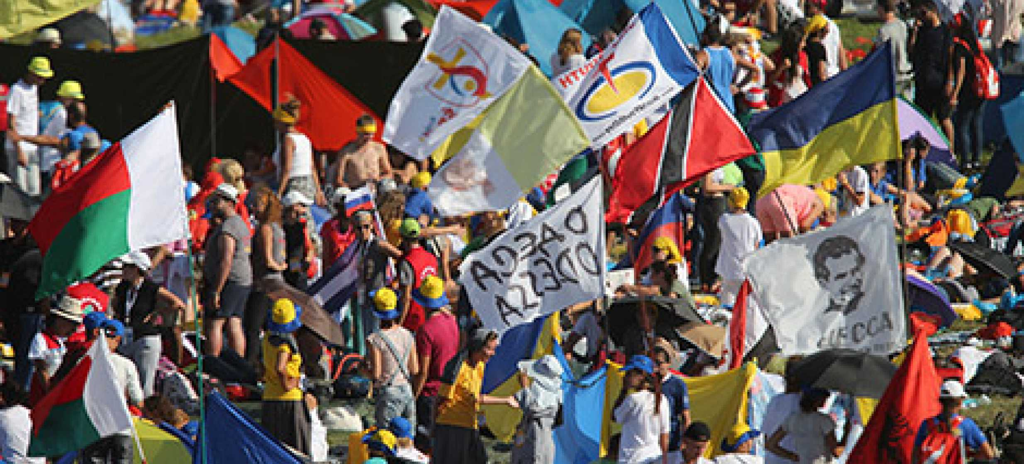
Looking Forward
~ Looking Forward in Faith ~
Monday 2nd January 2023
Brentwood Diocese Education Service

Slide 2
Looking Forward in Faith
Loving God,
give us wise, self-controlled,
patient, understanding,
devout, faithful,
and courageous hearts.
Fill our souls
with devotion to your service,
and strength against all temptations;
through Jesus Christ our Lord.
BDES

Slide 3
BDES

Slide 4
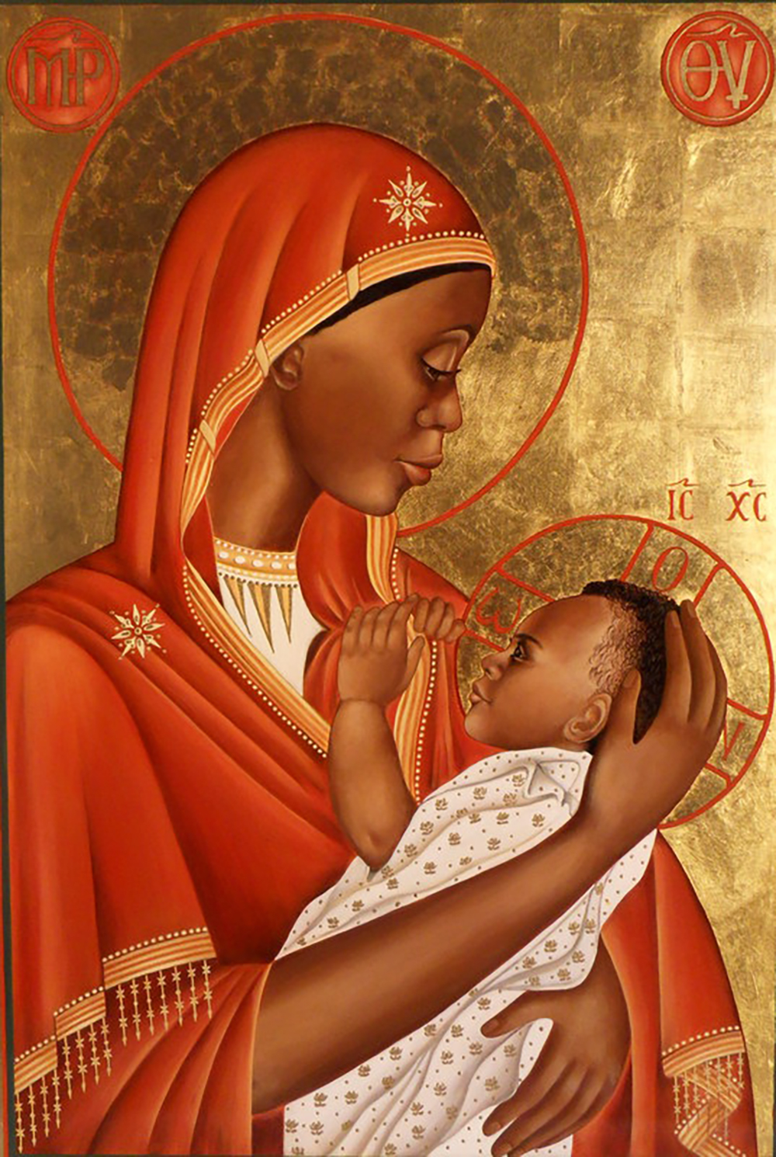
In Sunday’s Gospel Reading
1st January 2023
In the Gospel of Matthew, we hear that
“Mary treasured all these things, reflecting on them in her heart.”
BDES

Slide 5
BDES

Slide 6
Preparing for World Youth Day 2023
“Jesus is in you, He is with you and He never abandons you.”
- Pope Francis, Christus vivit, 2019
BDES

Slide 7
The Lord’s Prayer
As we look forward to World Youth Day in August this year, we remind ourselves of the things we share with our fellow young people from all over the world. At this international event, Catholics will pray the prayer Jesus taught us in a huge number of languages. We will mark this with a weekly inclusion of the Lord’s Prayer in the languages spoken in our schools.
BDES

Slide 8
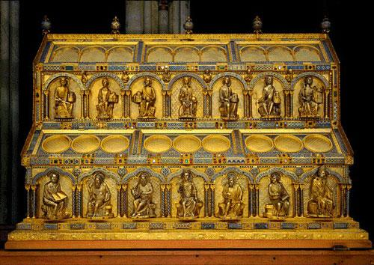
The Three Wise Men
Go to Cologne Cathedral in Germany and you will find the Shrine of the Three Kings. Matthew’s Gospel speaks of wise men rather than kings, and does not specify their number, but they brought the Christ Child three gifts and so people have assumed three visitors. According to tradition they were called Caspar, Melchior and Balthasar, and on the Feast of the Epiphany we remember this as we inscribe xxxxxxxxC + M + Bxxxxxxxx xxxChristus Mansionem Benedicat xx (xx((Christ bless this house)xxx above or on our doors.
BDES

Slide 9
MARTYRS OF ENGLAND AND WALES
Margaret Clitherow (1556 – 25 March 1586) suffered persecution as a Catholic during the reign of Elizabeth I; her third child, William, was born in prison where she was incarcerated for failing to attend Anglican church services. She provided safe accommodation for Catholic priests but when her son Henry went abroad to study for the priesthood, her house was searched and a priest hole was found. She was executed for refusing to plead in court.
St Margaret Clitherow
BDES

Slide 10
Looking Forward
~ Looking Forward in Faith ~
Monday 2nd January 2023
Brentwood Diocese Education Service

