Slide 1
Looking Forward
~ Looking Forward in Faith~
Monday 9th January 2023
Brentwood Diocese Education Service

Slide 2
Looking Forward in Faith
Jesus was baptised by John the Baptist in the River Jordan.
The Catechism of the Catholic Church states that Holy Baptism is the basis of the whole Christian life, the gateway to life in the Spirit, and the door which gives access to the other sacraments – CCC 1213
Baptism transforms us and we become sons and daughters of God.
How have you let God into your life throughout the Christmas Season?
BDES

Slide 3
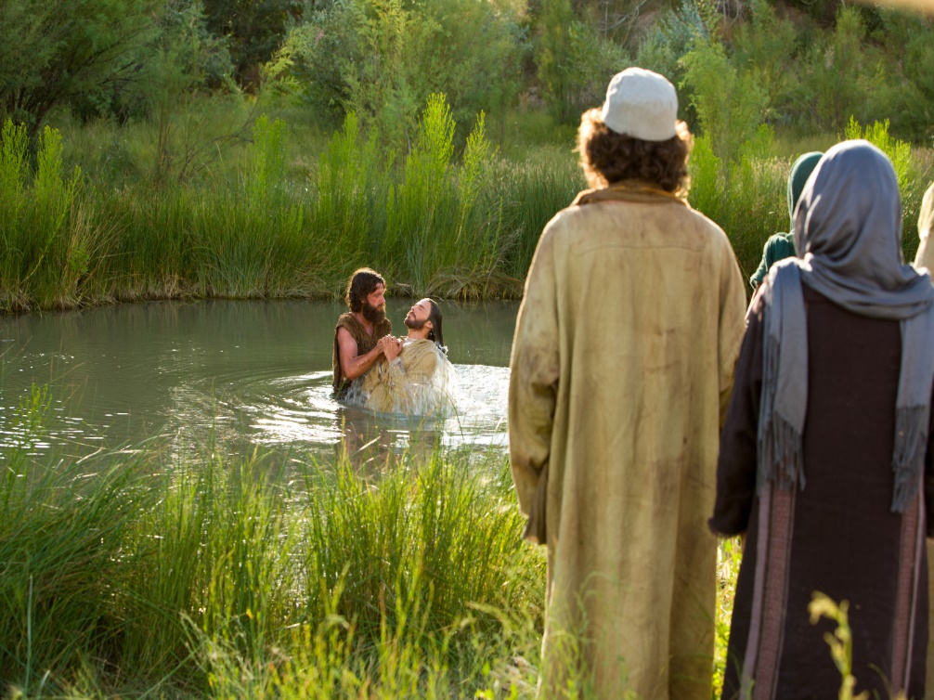
The Synoptic Problem
In Sunday’s Gospel Reading …
Sunday 8th January 2023 :
The Gospel of Matthew:
“This is my beloved Son,
with whom I am well pleased.”
BDES

Slide 4
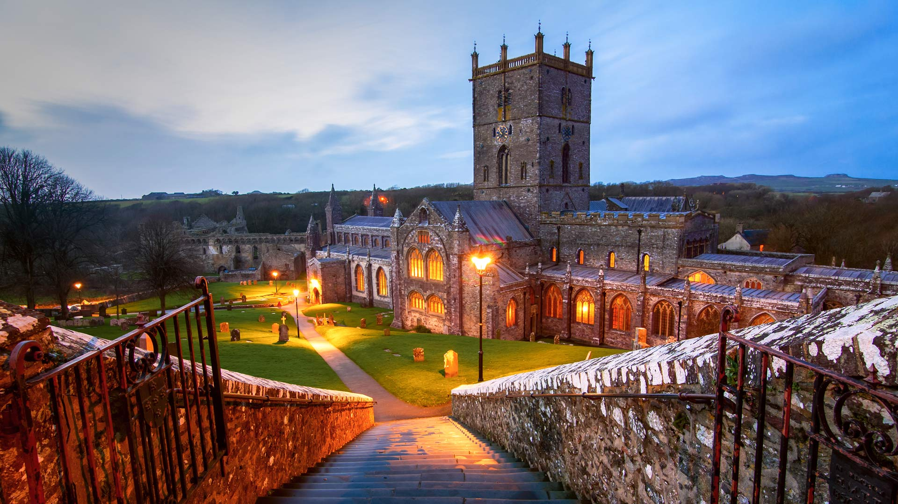
The Lord’s Prayer
Ein Tad yn y nefoedd, sancteiddier dy enw;
deled dy deyrnas;
gwneler dy ewyllys, ar y ddaear fel yn y nef.
Dyro inni heddiw ein bara beunyddiol, a maddau inni ein troseddau, fel yr ym ni wedi maddau i'r rhai a droseddodd yn ein herbyn;
a phaid â'n dwyn i brawf, ond gwared ni rhag yr Un drwg.
Oherwydd eiddot ti yw'r deyrnas a'r gallu a'r gogoniant am byth.
Amen. The 1998 Welsh Bible
As we look forward to World Youth Day in August this year, we remind ourselves of the things we share with our fellow young people from all over the world. At this international event, Catholics will pray the prayer Jesus taught us in a huge number of languages. We will mark this with a weekly inclusion of the Lord’s Prayer in the languages spoken in our schools.
This week the Lord’s Prayer is in Welsh
BDES

Slide 5
Preparing for World Youth Day 2023
“However far you wander, Jesus is always there.”
- Pope Francis, Christus vivit, 2019
BDES

Slide 6
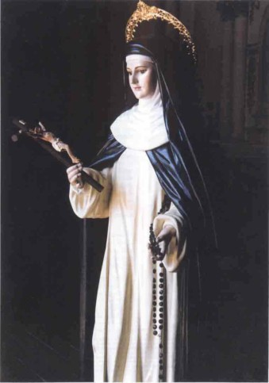
Blessed Ana of the Angels Monteagudo
10th January
Blessed Ana of the Angels Monteagudo was a Peruvian Dominican Nun who was born in 1602 and died in 1686.
In her childhood she was taught by the nuns and decided to become one following a vision she had of Saint Catherine of Siena showing her in the Dominican habit.
Her parents tried to dissuade her from this but she continued to pursue that path until she became a member of the order of Dominican Nuns.
She became noted for her holiness and held leadership positions because of her wisdom and the esteem that others had for her.
When Pope John Paul II made an apostolic trip to Peru in 1985 he beatified Blessed Ana of the Angels Monteagudo.
BDES

Slide 7
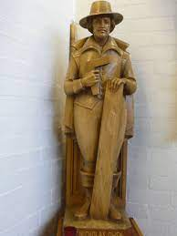
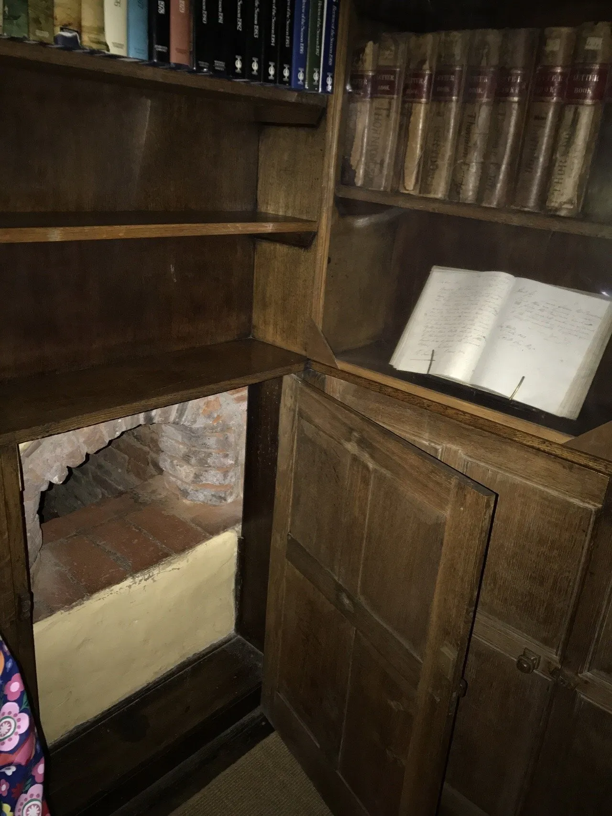
Martyrs of England and Wales : Nicholas Owen
Nicholas Owen was a carpenter by day who built the priests holes or hiding places for priests in English Catholic houses including at Ingatestone Hall in Essex.
Owen had been a servant to St Edmund Campion and then he entered the service of another Jesuit Fr. Henry Garnett. He became member of the Society of Jesus (Jesuits) and was a lay brother.
He was arrested in 1594, tortured and then released because his gaolers did not think he was important. Following this it is likely he masterminded the escape of Fr John Gerard from the Tower of London.
He was finally arrested in 1606 attempting to prevent the capture of Fr. Garnet and died as a result of torture.
BDES

Slide 8
Looking Forward
~ Looking Forward in Faith~
Monday 9th January 2023
Brentwood Diocese Education Service

