Slide 1
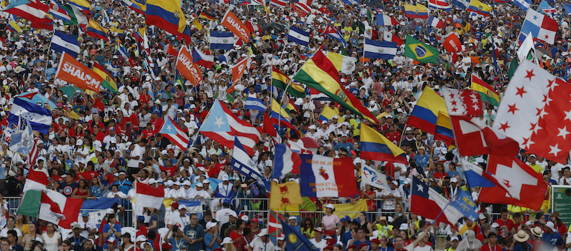
Looking Forward
~ Looking Forward in Faith ~
Monday 16th January 2023
Brentwood Diocese Education Service

Slide 2
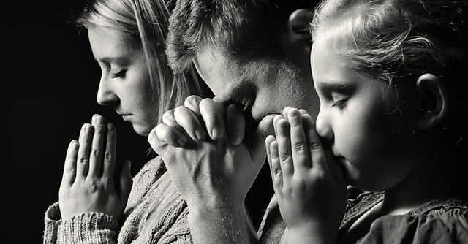
Looking Forward in Faith
Heavenly Father,
please strengthen our hearts,
and remind us to
encourage one another
when the troubles of life
start to overwhelm us.
Please guard our hearts from depression.
Give us the strength up to rise up each day
and fight against the struggles
which may weigh us down.
Amen.
BDES

Slide 3
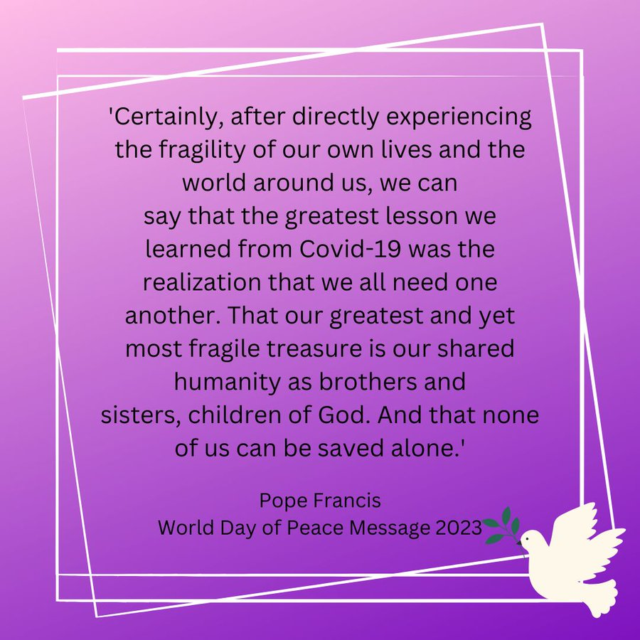
World Day of Peace
BDES

Slide 4
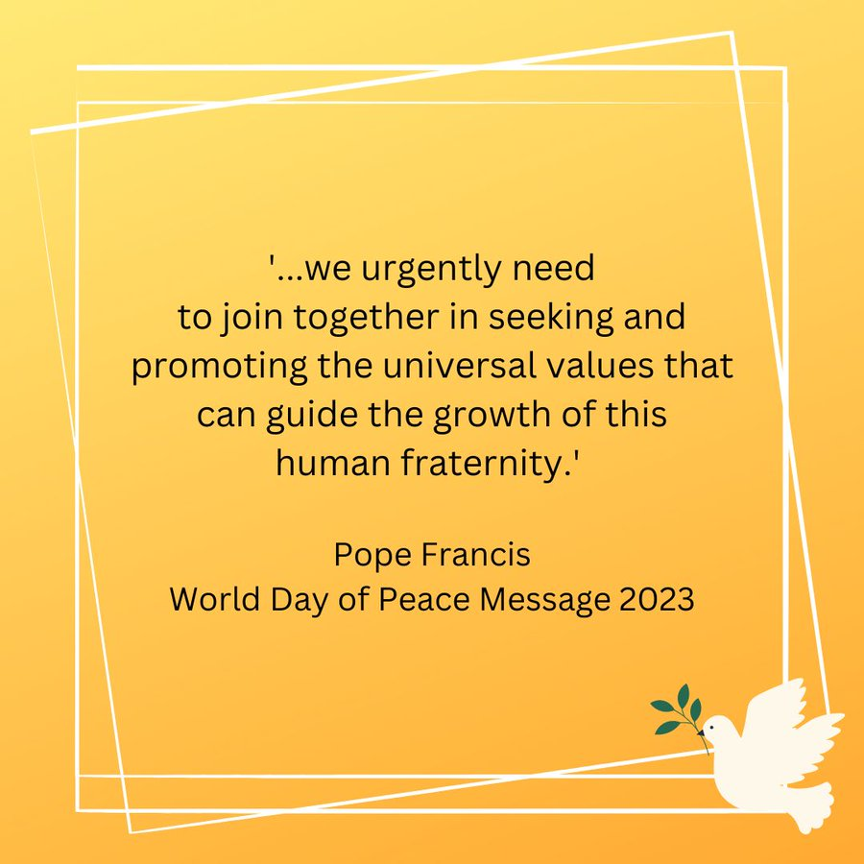
World Day of Peace
BDES

Slide 5
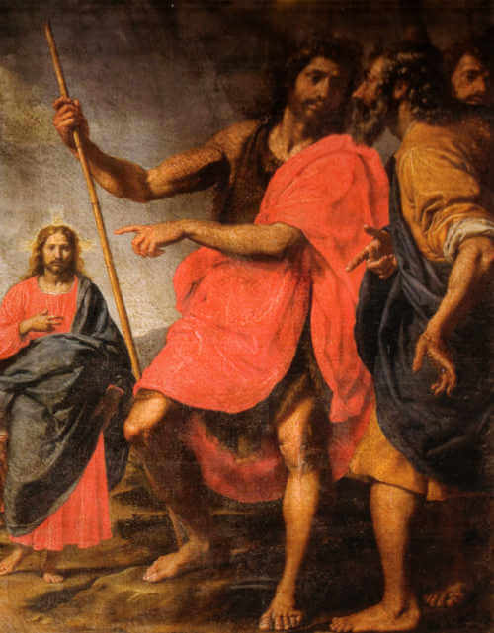
In Sunday’s Gospel Reading
15th January 2023
In the Gospel of John, we are alerted :
“Behold, the Lamb of God, who takes away the sins of the world.”
BDES

Slide 6
Preparing for World Youth Day 2023
“Jesus calls you and He waits for you to return to Him and start over again.”
- Pope Francis, Christus vivit, 2019
BDES

Slide 7
The Lord’s Prayer
As we look forward to World Youth Day in August this year, we remind ourselves of the things we share with our fellow Christians from all over the world. At this international event, Catholics will pray the prayer Jesus taught us in a huge number of languages. This week we mark the passing of His Holiness Pope Benedict XVI with the Lord’s Prayer in German.
Vater unser im Himmel, geheiligt werde dein Name. Dein Reich komme. Dein Wille geschehe, wie im Himmel so auf Erden. Unser tägliches Brot xxxxxxxxxgib uns heute. Und vergib uns unsere Schuld, wie auch wir vergeben unseren Schuldigern. Und führe uns nicht in Versuchung, sondern erlöse uns von dem Bösen.
Amen.
BDES

Slide 8
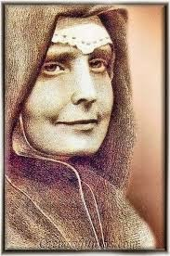
St. Vincenza Mary Lopez y Vicuna
St Vincentia Maria Lopez y Vicuna was the founder of the Daughters of Mary Immaculate, a religious order dedicated to ministering to the needs of young women in domestic employment. She was a social activist on behalf of women workers during the trying times of the Industrial Revolution, founding homes, hostels, technical schools and canteens.
Of her work, she said : “I count myself happier in the service of these my sisters than the great ones of this world in the service of their lords and kings.”
Her work spread throughout Spain, across Europe and in South America.
Never in perfect health, she died at the age of only 43 on 26th December 1896 in Madrid and was canonized by Pope Paul VI in 1975.
18th January
BDES

Slide 9
MARTYRS OF ENGLAND AND WALES
Thomas Garnet (1575 – 1608) was a Jesuit priest martyred during the reign of James I and VI. He left England to study for the priesthood in Valladolid, returned on a mission and was arrested as part of the fallout of the Gunpowder Plot. He was imprisoned, tortured and deported, but returned to continue to serve as a priest. He was captured again and executed at Tyburn, aged 32.
St Thomas Garnet
BDES

Slide 10
Looking Forward
~ Looking Forward in Faith ~
Monday 16th January 2023
Brentwood Diocese Education Service

