Slide 1
Looking Forward
~ Looking Forward in Faith~
Monday 23rd January 2023
Brentwood Diocese Education Service

Slide 2
Looking Forward in Faith
Sunday 22nd January was Word of God Sunday.
Pope Francis said that dedicating a day to the Word of God
“can enable the Church to experience anew how the risen Lord opens up for us the treasury of His Word.”
What is the Word of God saying to you?
How can you proclaim the Word of God by your daily life?
BDES

Slide 3
The Synoptic Problem
In Sunday’s Gospel Reading …
Sunday 22nd January 2023 :
In the Gospel of Matthew, Jesus says:
“Repent, for the kingdom of heaven is close at hand.”
BDES

Slide 4
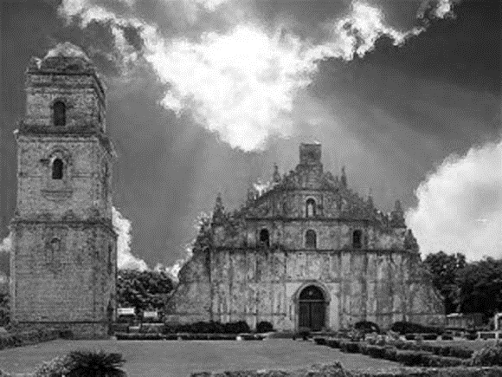
The Lord’s Prayer
Ama namin, sumasalangit Ka. Sambahin ang ngalan Mo. Mapasaamin ang kaharian mo Sundin ang loob Mo dito sa lupa para nang sa langit. Bigyan Mo kami ng aming kakanin sa araw-araw At patawarin Mo kami sa aming mga sala Para nang pagpapatawad namin sa nagkakasala sa amin. At huwag Mo kaming ipahintulot sa tukso At iadya Mo kami sa lahat ng masama Amen
As we look forward to World Youth Day in August this year, we remind ourselves of the things we share with our fellow young people from all over the world. At this international event, Catholics will pray the prayer Jesus taught us in a huge number of languages. We will mark this with a weekly inclusion of the Lord’s Prayer in the languages spoken in our schools.
This week the Lord’s Prayer is in Filipino
BDES

Slide 5
Preparing for World Youth Day 2023
“Jesus will always be there to restore your strength and your hope.”
- Pope Francis, Christus vivit, 2019
BDES

Slide 6
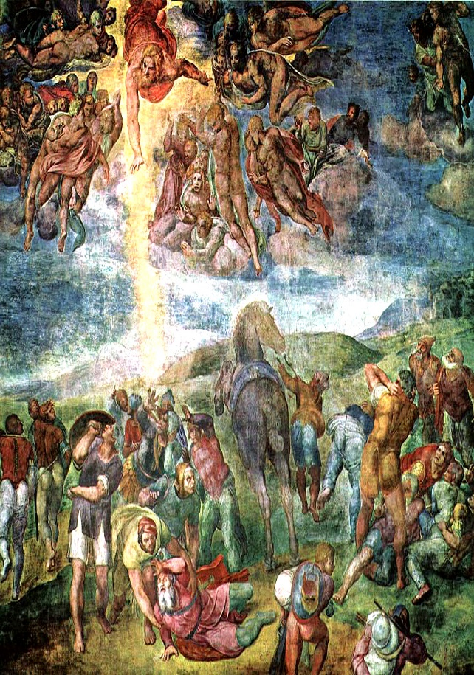
Conversion of St Paul :
25th January
The conversion of Saul on the road to Damascus was, according to the New Testament, an event in the life of Saint Paul the Apostle that led him to cease persecuting early Christians and to become a follower of Jesus.
Saul had persecuted the early church and it was on his way to Damascus he had a divine revelation and became a follower of Jesus. He was given the name Paul meaning ‘humble’.
The feast of his conversion is at the end of a week of prayer for Christian unity.
BDES

Slide 7
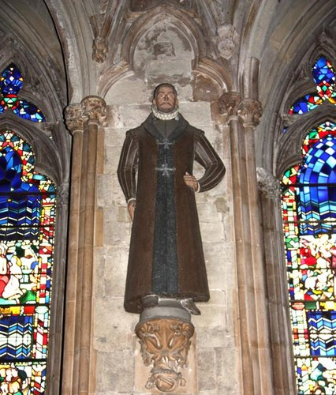
Martyrs of England and Wales : Swithun Wells
Swithun Wells (c. 1536 – 10 December 1591) was executed during the reign of Elizabeth I.
He was born in Hampshire and named after the local saint, Swithun. He was a country gentleman and one time schoolmaster whose family sheltered hunted priests. He was well-educated, a poet, musician, and sportsman. Among his travels, he had been to Rome, and had a working knowledge of Italian. He was a supporter of the Catholic priests and often arranged passage from one safe house to another. He bought his house in Gray's Inn Lane in London in 1585 and was known to welcome recusants.
He was arrested and released a number of times but in 1591 a Mass was being said in his house when the authorities broke in. He was not there but was arrested later. He was executed outside his house in Gray’s Inn Lane. There is a primary school and parish in Hampshire named after him.
BDES

Slide 8
Looking Forward
~ Looking Forward in Faith~
Monday 23rd January 2023
Brentwood Diocese Education Service

